Slide 1
CISO Of 2030
From Gatekeeper to Growth Catalyst:
Translating Risk
Scaling Scope
Leading Change
Dan Holden
CISO, BigCommerce
@desmondholden

Slide 2
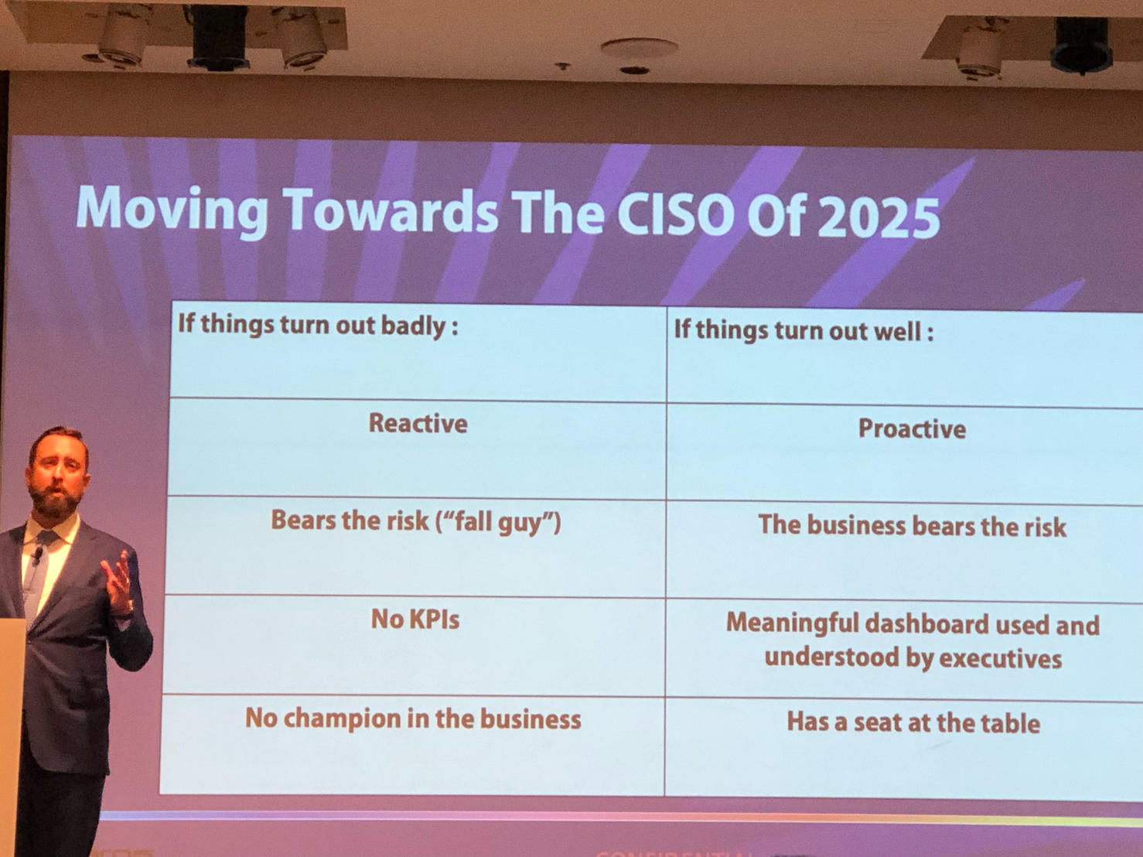
🔒 CISO Evolution
2019 Predictions for 2025
CISO will evolve from tech enforcer to business-aligned risk executive
Role will increasingly require translation of risk into business language
Reporting and communication shifted from functional alignment to strategic influence, with boards, executives, and regulators now primary stakeholders

Slide 3
2019 Forecast: The Road To 2025
What We Expected. What We Became.
📊 Metrics & Measurement
Traditional metrics (e.g. vuln count) will fail at board level
Need for business-impact metrics (e.g., loss exposure, resilience scores)
Emphasis on quantified risk and economic modeling over compliance metrics
🧱 Framework Saturation
Security programs face diminishing returns beyond expected due diligence
After foundational controls, ROI/risk-based investment is the real goal
Urged focus on loss exposure and impact, not just frameworks
🌐 Network Boundary Collapse
Anticipated a dissolving perimeter… Identity and Zero Trust would define the new security model
🔧 Tool Overload & Consolidation
Forecasted platformization (Microsoft, Google, Okta, etc.) to streamline risk & cost
🤝 CISO Isolation
Acknowledged the CISO’s isolated role — but predicted growing peer networks, board access, and strategic visibility
📉 Evidence Over FUD
Advocated for evidence-based programs over fear tactics, with measurable results and business-aligned language

Slide 4

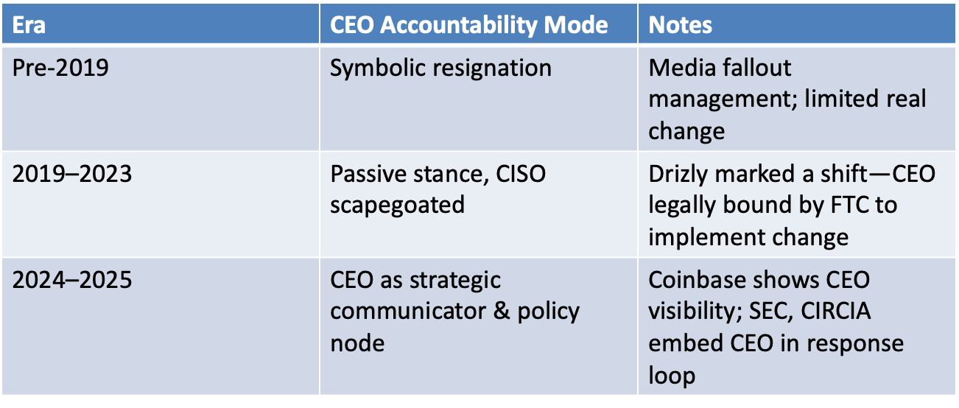

CEO/CISO Dynamic: The CEO is still largely protected from direct legal targeting, while CISOs are now seen as executors of flawed strategy—even when resource-constrained. The buck stops with the CEO, but the blast radius often lands on the CISO.
We’re No Longer Disposable. We’re Accountable.

Slide 5
Reduced CISO turnover, but increased personal consequence
Fewer Firings, Higher Stakes
2019/2020
2020/2021
2022/2023
2024/2025
September 4: Attackers gain initial access to SolarWinds systems, marking the beginning of the SUNBURST supply chain attack.
March 11: The World Health Organization declares COVID-19 a global pandemic, leading to widespread remote work and supply chain issues.
December 8: FireEye discloses a breach, leading to the discovery of the SolarWinds compromise.
Throughout the year: Cyber insurance premiums surge due to a rise in ransomware attacks and high-profile breaches, leading to a hardened insurance market.
October 5: Former Uber CISO is convicted for covering up a 2016 data breach, highlighting personal accountability in cybersecurity roles.
July 26: The SEC adopts new rules requiring public companies to disclose material cybersecurity incidents within four business days via Form 8-K.
September 5: The SEC's cybersecurity disclosure rules become effective, mandating timely and detailed reporting of significant cyber incidents.
Present Day: CISOs are navigating an environment with heightened responsibilities, including regulatory compliance, risk mgmt, and strategic business alignment, amidst evolving cyber threats.

Slide 6
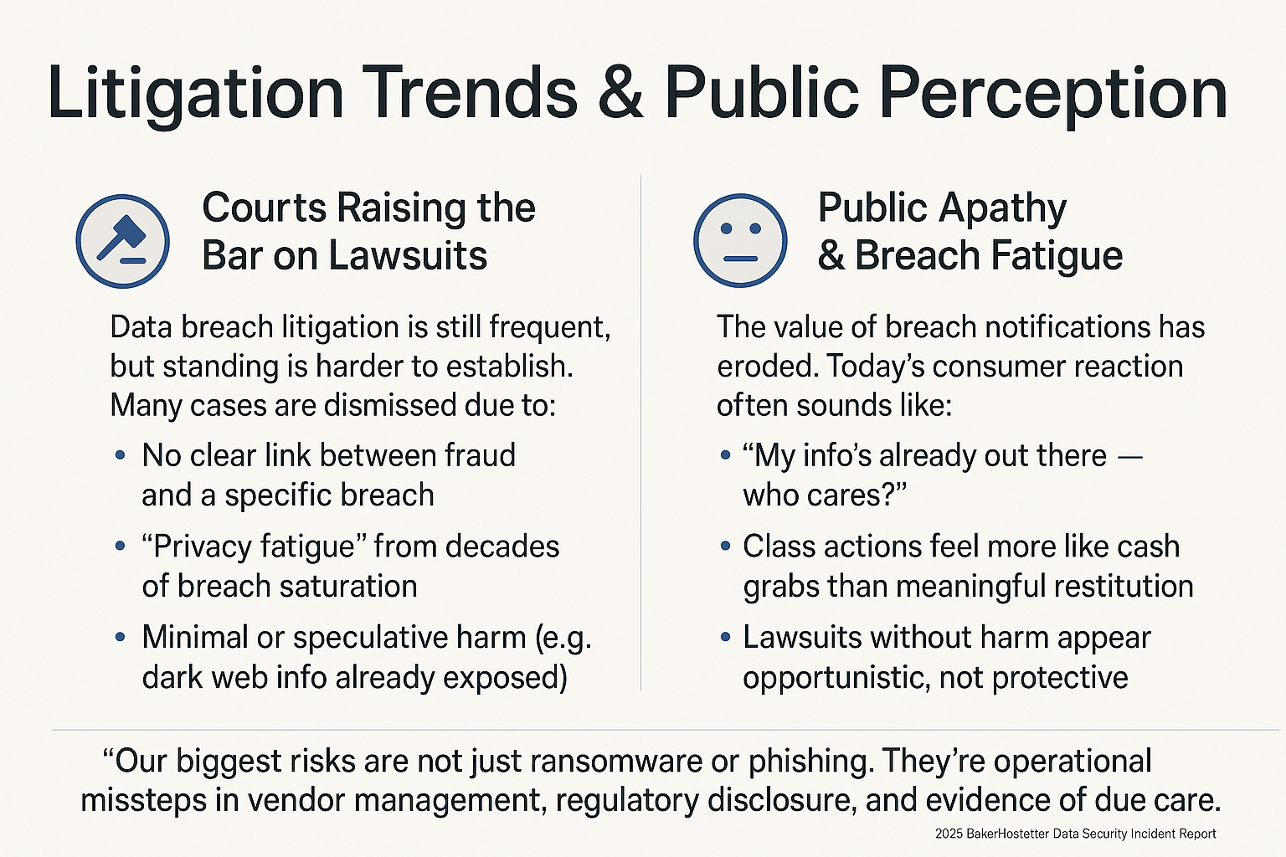

Slide 7

Requirements & Priorities Come From Three Primary Risk Drivers
Opportunity Risk
The competitive and strategic risks related to how the digital business system creates value.
Cybersecurity Risk
The active risks to the digital business system that threaten business value.
Systemic Risk
Inherent risks within the complex digital business system that threatens the purpose of the system.
Compliance/Regulatory
Market Expectations
Risk
SOX
PCI
ISO
SEC
Enterprise Prospects
Customers
Cyber Insurers
Competition
Evidence Based Response
Breach Avoidance

Slide 8
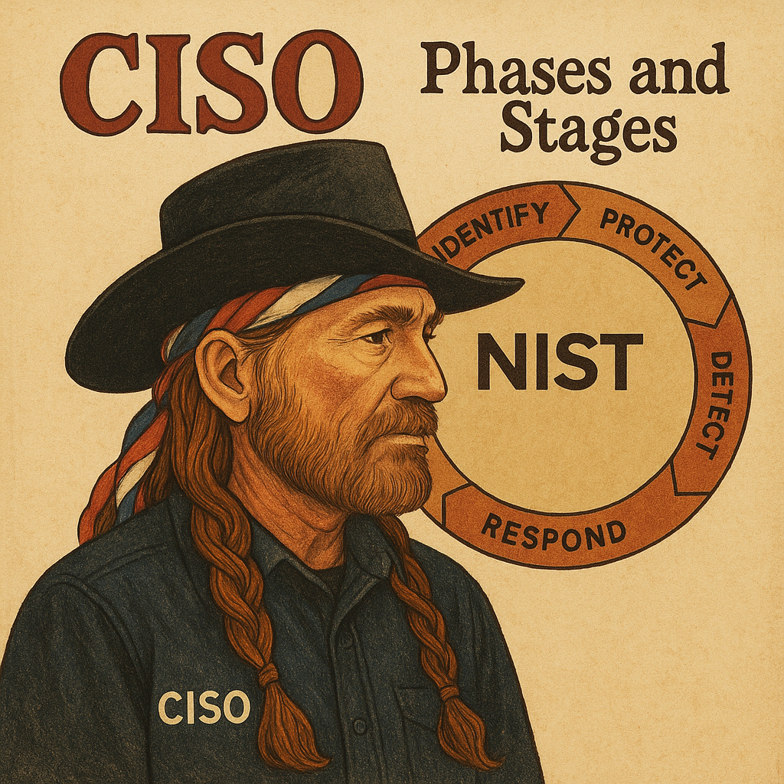
Change agent for controls, policy, process, and culture
Phase 1
Delete me / place square image here
Every CISO starts as a change agent — building a program means rewriting the rules: new controls, new policies, new partners, new culture.
It’s a foundational transformation: from chaos to clarity, from gut feel to governance.
But maturity isn’t the finish line. It’s the turning point.
When the program is finally working, the CISO has to change again — from a builder into a business partner. From an enforcer into a risk executive.

Slide 9

Same Old Slide. The Same Call To Action…

Slide 10
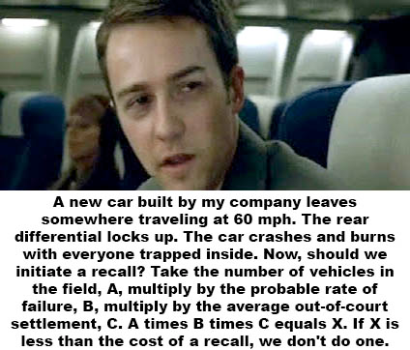
You’re Not just being Audited Anymore
You’re being challenged
Phase 2
NIST/CIS/COBIT are great… until they’re just wallpaper
Maturity 3 = "You’re compliant/mature."
Attacker sophistication vs. control efficacy
After that, it's risk tradeoffs, capital allocation, and defensible ROI
Translating risk into investment decisions
Weighing friction against speed
Leading trade-offs between security, velocity, and customer experience

Slide 11
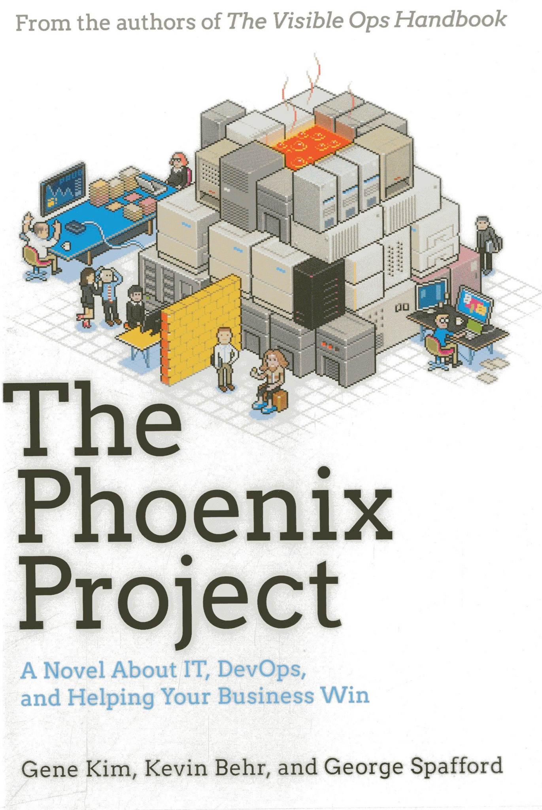

1913 For The Industrial Revolution. 2013 For the Software Revolution.

Slide 12
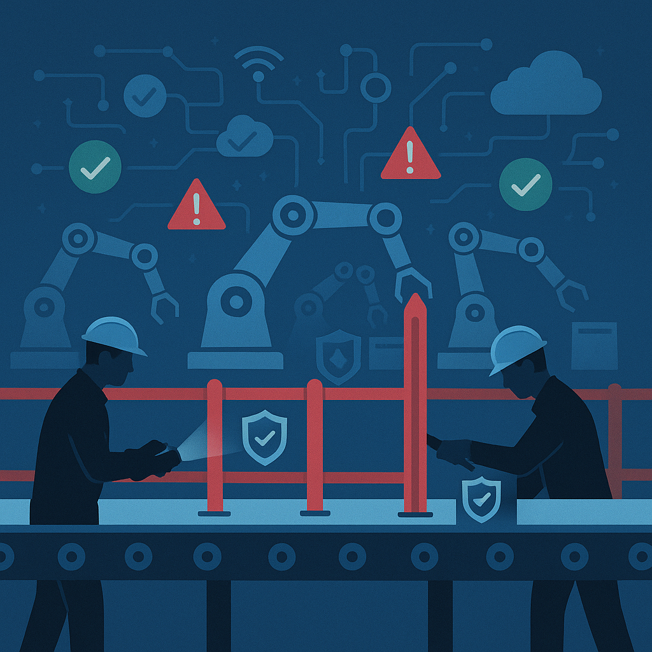
The DevOps Revolution
Infrastructure as Code (IaC): Automating environment creation makes security controls testable and repeatable… like jigs in manufacturing.
Static & Dynamic Application Security Testing (SAST/DAST): Shift-left security scanning in the build process is the equivalent of QA on the factory floor.
Software Composition Analysis (SCA) Treating open-source vulnerabilities like defective parts on an assembly line, identifying before integration.
Pre-merge security gates in CI/CD: Analogous to in-line inspections in lean manufacturing.
Runtime Protections (e.g., Cloud Workload Protection Platforms): Provide monitoring akin to telemetry on assembly robots, triggering alerts when tolerances (or threats) exceed thresholds.

Slide 13

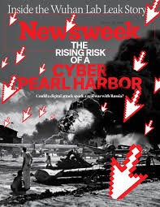
Unsafe At Any Speed Was FUD, But It Worked… Will Ours Be An Event Or Era?

Slide 14

Reporting Lines ≠ Responsibility But They Shape Perception
CISO Reporting Dynamics
Reporting to CIO/CTO:
Embedded in operations — close to architecture but lacking independence. Visibility is high, but objectivity can be constrained.
It can be difficult to audit the builder if you report to the builder.
Reporting to Board/CEO/GC/CFO:
Places security within risk governance, where it provides assurance like Legal or Finance and operates as a strategic function, not just a technical one.
2030 Outlook:
The CISO is a translator of uncertainty into decision-making, similar to CFOs modeling financial risk or GCs analyzing materiality.
We’re not here to stop breaches — we’re here to help the business move fast without derailing.
Notes:
Security Reporting to CIO/CTO:
You're embedded in the assembly line — inside the system you’re meant to assess.
You influence process and architecture, but independence is blurred.
Reporting lines impact communication flow and executive attention, not core duties.
Security Reporting to CEO/GC/CFO:
You're part of risk governance — standing slightly outside the system.
You provide assurance, not just operational input.
You function more like Legal or Finance, not just IT.
"Security is QA for digital business — so CIO/CTOs will/should always care, no matter who the CISO reports to."
The CISO’s value proposition in 2030 is more like a CFO’s risk model or a GC’s materiality analysis —
translating controls and uncertainty into strategic odds (“Vegas-style risk forecasts”)
that help shape business decisions, not just technical ones.
“You can’t audit the builder if you report to the builder.”
“We’re not here to stop breaches. We’re here to help the business go faster… without going off the rails.”

Slide 15

Security Governance 2030: Mirroring the Internal Audit Model
Can We Change How We’re Perceived?
Cyber Security is digital safety
Like internal audit: independent, risk-focused, materially aware
We don’t patch. We assure.
DevOps was the assembly line. Infosec still needs its ‘Unsafe at Any Speed’ moment
We are the safety engineers of digital business. Credibility comes from quantifying risk in business terms.

Slide 16
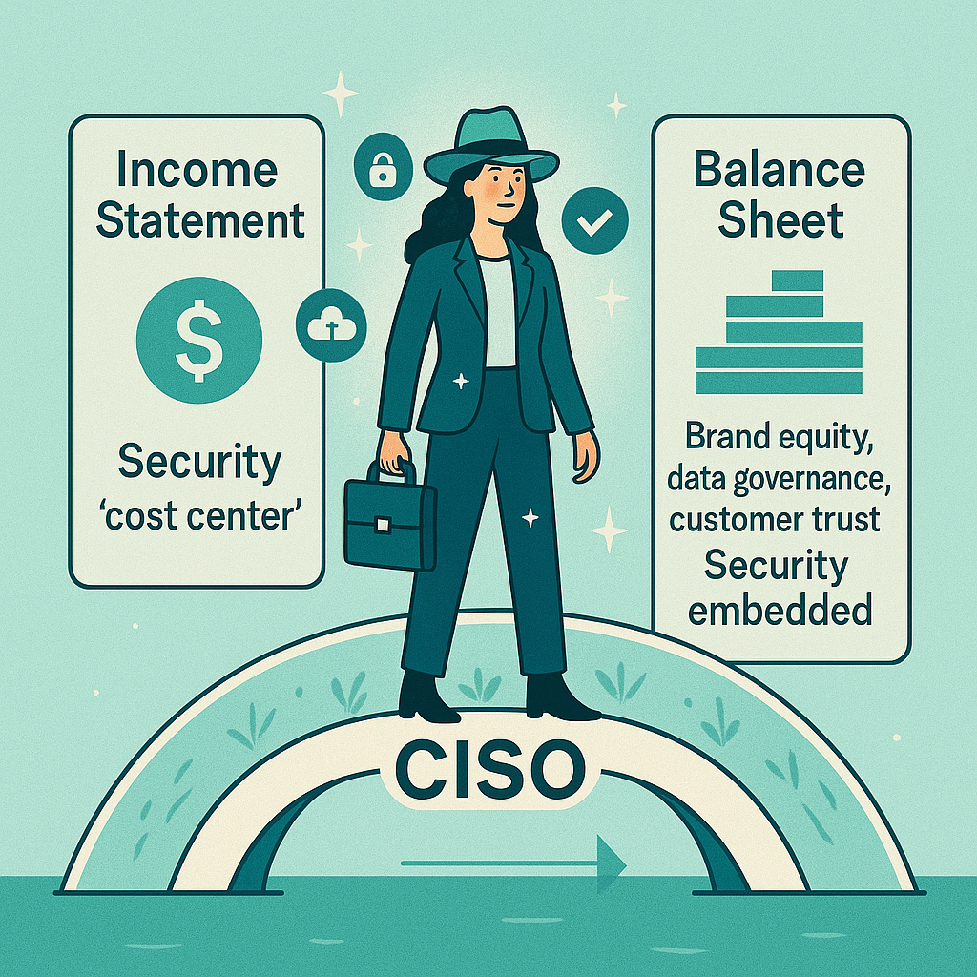
How Is ROI Viewed?
Current State:
Security is primarily viewed as OpEx — an operating expense — on the Income Statement, because it’s recurring spend (e.g. licenses, personnel, controls, consulting) associated with running the business. This is especially true in SaaS-heavy, software-defined organizations.
2030 Goal:
Security should no longer be seen merely as a cost of operations — it’s a long-term investment in digital trust and operational resilience. That aligns far more with Balance Sheet thinking than with burn-rate optimization.
As regulators and customers treat security as table stakes for participation, businesses must embed it into the foundation of their digital infrastructure — not bolt it on as an afterthought.
Notes:
✅ Traditional Accounting: Why Security Isn't Capitalized
Under current Generally Accepted Accounting Principles (GAAP), cybersecurity spending — whether for tools, services, or personnel — is generally treated as operating expense (OpEx) because it doesn’t create a separately identifiable asset that can be amortized or depreciated. Hence, it appears on the income statement, not the balance sheet.
But that view is incomplete when considered from a strategic value creation lens.
✅ The Strategic Shift: From OpEx to "Digital Trust Capital"
Your 2030 Goal — reframing security as a long-term investment in digital trust — aligns closely with recent research and industry direction:
Security as a differentiator:
A company that builds a robust, verifiable security posture is increasingly favored by customers, regulators, insurers, and partners.
This builds brand equity and can affect valuation multiples (especially in SaaS and fintech).
Fewer breaches = less erosion of goodwill:
As shown in the 2025 DSIR Report, material breaches are rare but extremely costly in terms of brand damage, legal liability, and trust erosion.
If a company avoids such events while competitors don't, its perceived resilience and trustworthiness contribute to positive brand differentiation.
Digital trust as an intangible asset:
While not traditionally reflected on the balance sheet, “digital trust” functions like goodwill — a premium customers are willing to pay or a discount investors may apply in its absence.
In M&A, acquirers may explicitly bake cyber maturity and breach history into their valuation model — indirectly converting security into goodwill.
✅ FAIR, HTMA, and Quantified Risk View
From a FAIR/“How to Measure Anything” perspective:
The absence of breaches reduces:
Probable Loss Magnitude (PLM)
Annualized Loss Expectancy (ALE)
This shows up not just as risk reduction but as capital preservation and reduced volatility.
When companies avoid breach-induced crises, they prevent erosion of brand, customer base, and market confidence — all contributors to goodwill during acquisitions or audits.
📈 Emerging Implication for Boards & Auditors
There is growing momentum — especially in NACD-aligned and SEC disclosure contexts — for viewing cyber resilience as a board-governed, value-driving asset rather than a tech department concern.
In this light, long-term breach avoidance should be considered a proxy for trust asset accumulation — not unlike brand, reputation, or loyal customer base.
🧩 Strategic Implication for CISOs
CISOs who frame security wins as "building digital goodwill" and reducing erosion of enterprise value will:
Align better with CFOs and valuation teams.
Help boards recognize security not as insurance, but as equity protection and value creation.
Bottom Line
Security is becoming a driver of enterprise valuation. While not yet reflected as a GAAP asset, its effect is felt in:
M&A premiums,
Brand equity,
Customer retention,
And increasingly, investor confidence.
So yes — a longer streak of breach-free operation can be credibly framed as an accumulation of digital goodwill, especially if security maturity is measurable, auditable, and strategically communicated.

Slide 17
Attacker Sophistication Scoring (STIX)
Score | Level | Description
5 | Innovator | Typically, criminal or state actors who are organized, highly technical, proficient, well-funded professionals working in teams to discover new vulnerabilities and develop exploits.
4 | Expert | Can focus on the discovery and use of unknown malicious code, are is adept at installing user and kernel mode rootkits, frequently use data mining tools, target corporate executives and key users (government and industry) for the purpose of stealing personal and corporate data. Actors in this category are very adept at IT systems and software development and are experts with security systems, defensive techniques, attack methods, and operational security.
3 | Advanced | These actors rely on others to find and identify weaknesses and vulnerabilities in systems, but can create their own tools, delivery mechanisms, and execution strategies.
2 | Intermediate | These actors rely others to develop the malicious tools and delivery mechanisms but can plan their own execution strategy. They are proficient in the tools they are using and how they work and can even make minimal modifications as needed.
1 | Minimal | These actors rely on others to develop the malicious tools, delivery mechanisms, and execution strategy and often do not fully understand the tool they are using or how they work. They also lack the ability to conduct their own reconnaissance and targeting research.
0 | None | Can carry out random acts of disruption or destruction by running tools they do not understand. Actors in this category have average computer skills.
Notes:
http://docs.oasis-open.org/cti/stix/v2.0/cs01/part1-stix-core/stix-v2.0-cs01-part1-stix-core.html#_Toc496709306

Slide 18
Why Attacker Sophistication Should Be a Core Metric in Incident Analysis
To truly understand the effectiveness of a cybersecurity program, it’s not enough to tally control implementations or count incidents. What matters is how we’re being attacked, how advanced those attackers are, and whether our controls are actually deterring or delaying capable adversaries.
Incident data, when paired with attacker sophistication levels, becomes a powerful tool for evaluating real-world control effectiveness. This lens helps address three persistent blind spots:
False confidence. Organizations often “pass” maturity assessments yet remain exposed to attackers using sophisticated methods. Controls may look strong on paper but prove ineffective against today’s threat landscape.
Misaligned resource allocation. When security programs are driven solely by audit checklists, controls are often overbuilt to stop low-skill attacks (e.g., commodity malware) while underperforming against high-skill threats (e.g., targeted credential theft or stealthy persistence). Incident data stratified by attacker sophistication enables smarter, risk-informed investments—grounded in actual exposure, not theoretical models.
Ineffective incident analysis. Most incident reports focus on what happened and what it cost. What’s often missing is how sophisticated the adversary was. If most successful breaches stem from low-complexity attacks, that’s not a validation of program strength—it’s a red flag that basic controls are underperforming. On the other hand, detecting and responding to high-complexity threats—even when incidents occur—signals maturity.
This is why longitudinal analysis of attacker sophistication across threat categories transforms cybersecurity from speculative threat modeling into observed, empirical risk analysis. It’s the difference between making decisions based on fear and assumptions—and leading with outcomes rooted in evidence.

Slide 19
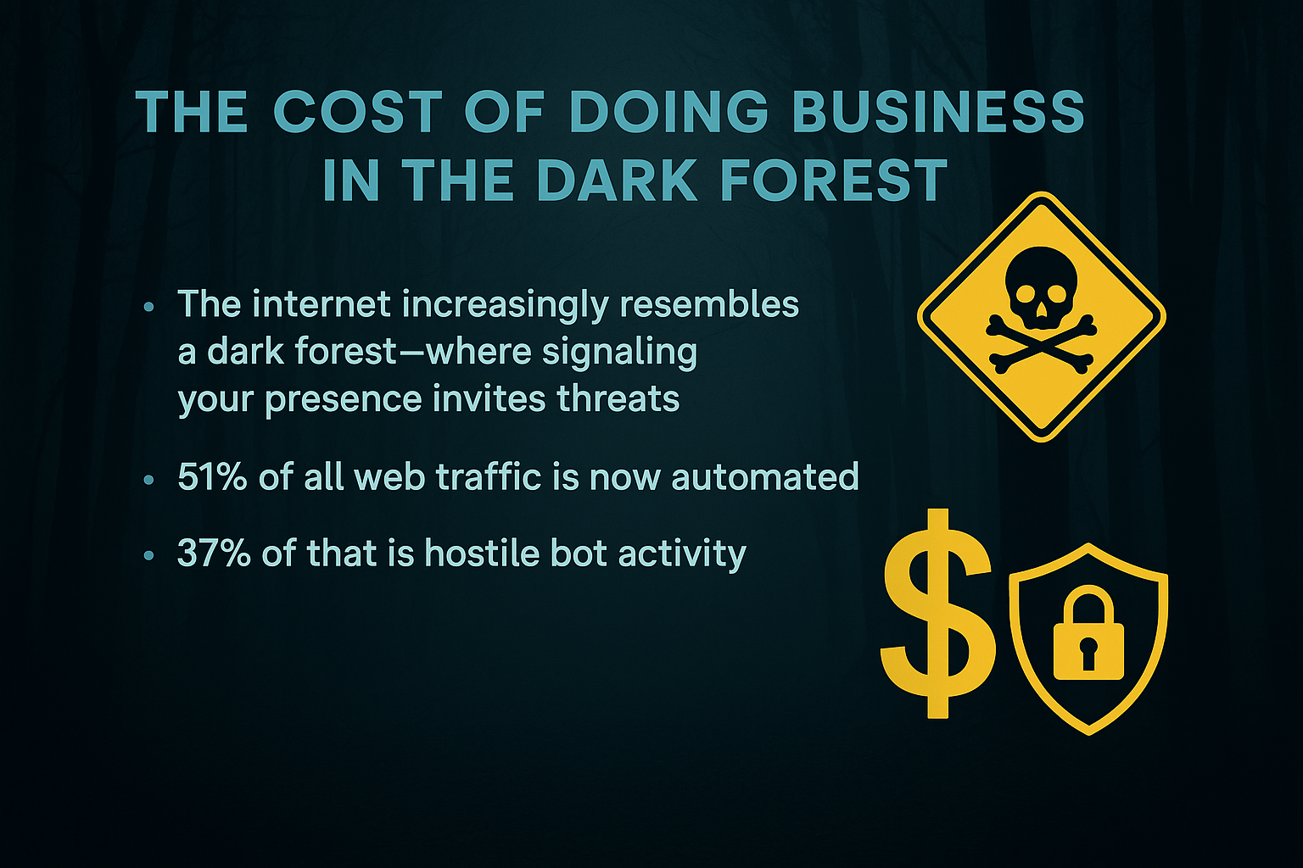
Notes:
Operating online today is like trading in pirate-infested waters. AI scraping, SaaS sprawl, and 3rd-party integrations drive Opex—not just for tooling, but for verification, containment, and control.

Slide 20
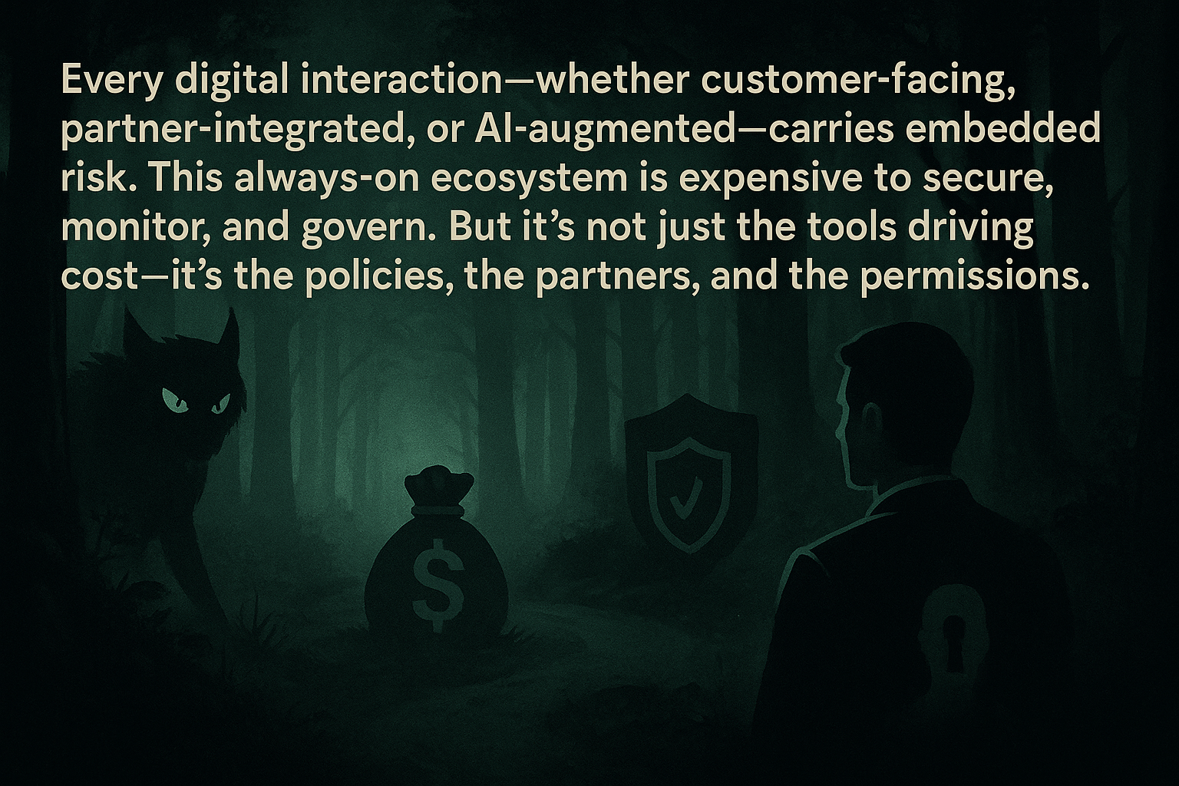
As the internet becomes the network and AI the co-worker, CISOs must help translate this risk-reality into cost structure strategy

Slide 21
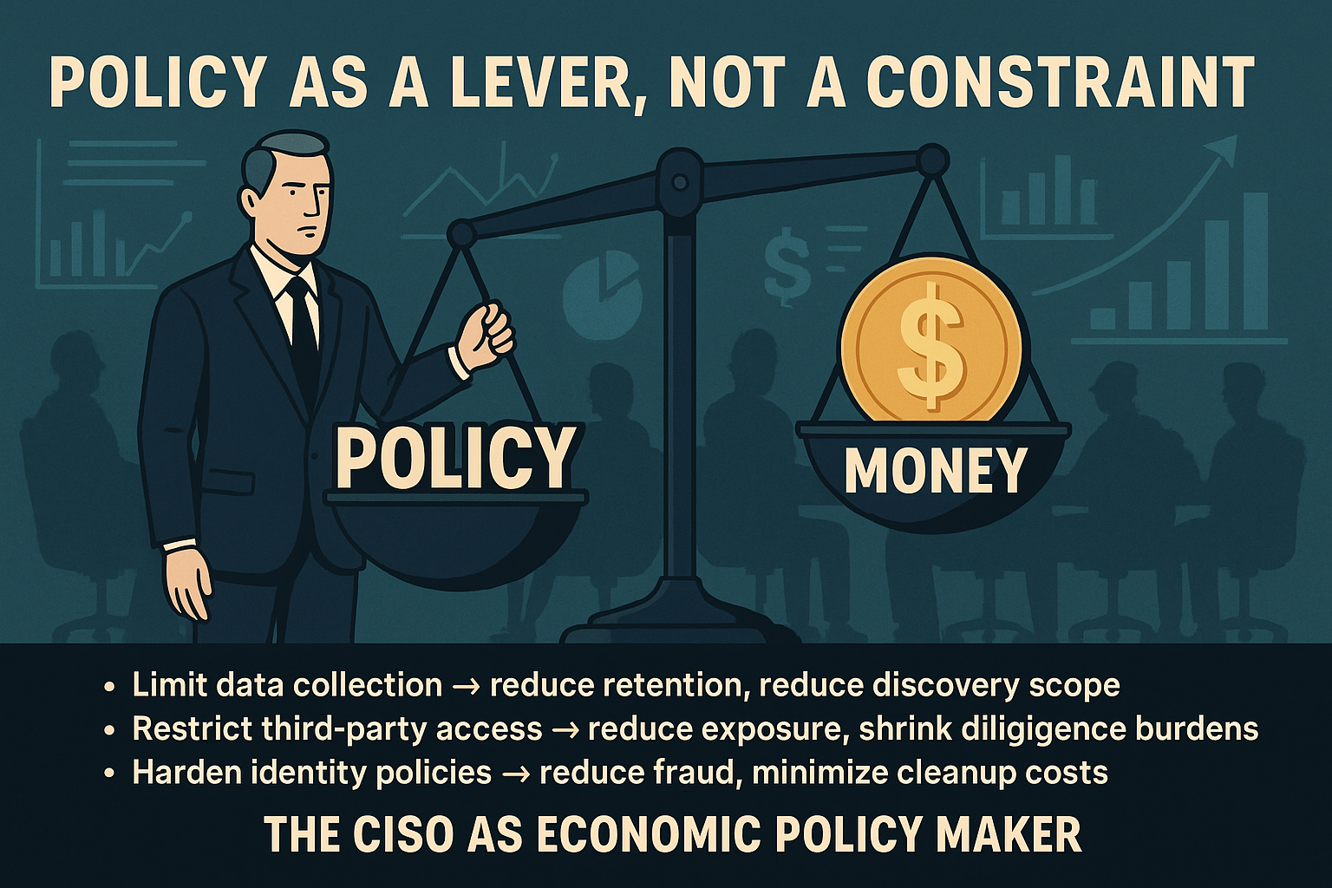

Slide 22
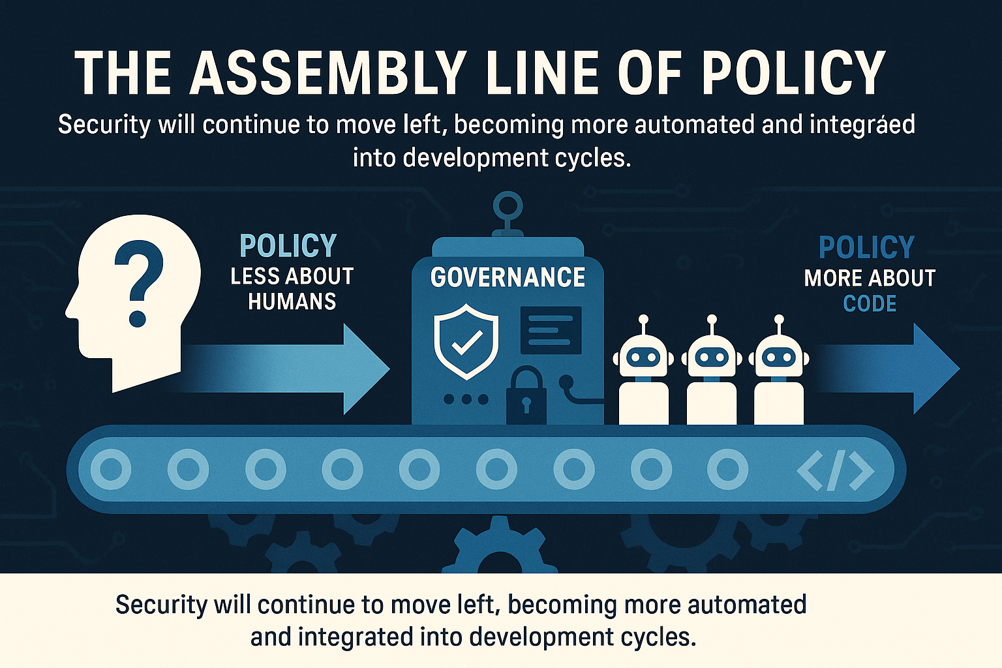

Slide 23
It’s not buyer beware. It’s buyer be aware.
Third-Party Risk:
27% of breaches now involve vendors - BakerHostetler 2025 Incident Response Report
There’s no magic bullet: real savings come from pre-selection diligence, contractual standards, and active offboarding
When breaches hit vendors, you're often dragged into disclosure, litigation, and remediation—regardless of your direct fault
Today’s app stores make it easy to install risk with a single click:
What data is accessed?
What terms are you agreeing to?
Who supports it if something breaks or is breached?
Overly permissive controls and silent liability shifts are common and AI is compounding everything:
It introduces non-human agents requesting access, processing sensitive data, and integrating with vendors
Many AI tools act as unsanctioned third parties—scraping, storing, and suggesting based on sensitive inputs
Without strict policy controls, you risk accidental data leakage or unauthorized model training

Slide 24
AI is not just a threat vector, it's a tool in our stack
Full Stack AI: From Metrics to Meaning
Custom GPT/Gem
Full Stack AI
Quant-first Org’s
Calculate Annualized Loss Expectancy (ALE) using real-time SOC, IR, and risk register data. Anyone can use FAIR now.
Enrich context with public financials (10-Ks), business strategy, and threat intelligence
Y Combinator is investing in this future. Every professional practice will be challenged and enhanced.
Startups like 1Ciso are pioneering this approach.
Modern Cyber Security doesn’t just defend, it delivers risk intelligence as a product.
Drive risk modeling, not fear-based posture
Translate security into business odds, like actuaries and underwriters
Enable execs and boards to verify, challenge, and align to your story

Slide 25

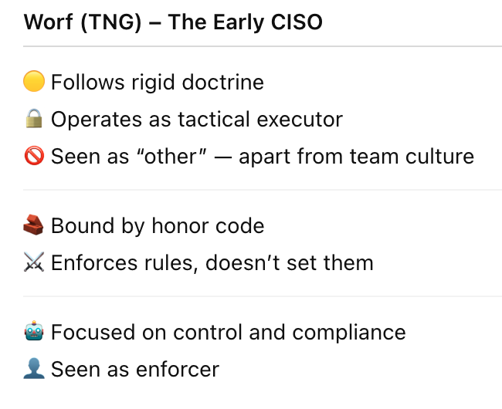
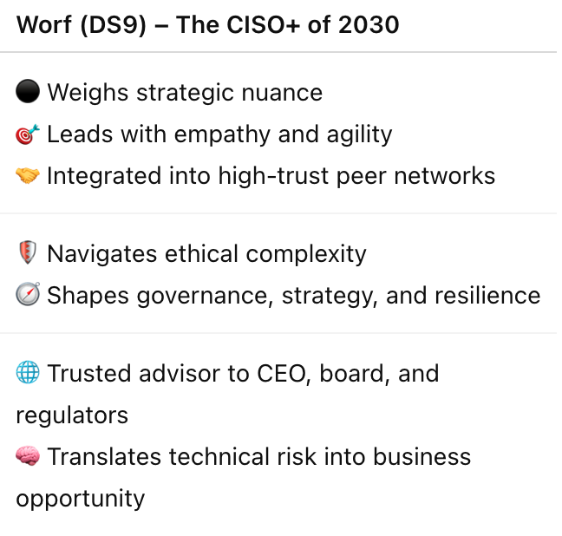
From Tactical Officer to Strategic Architect
Notes:
Worf (TNG): Stiff, formal, slightly apart from the crew. Tactical role, rule follower. Rarely makes or influences high-level decisions. Idealizes Klingon culture, yet is alienated from it. Uncomfortable in either world.
Worf (DS9): Celebrated team member, emotionally connected, deeply respected. Finds strength in hybridity. Influences Klingon politics while loyal to Federation values.
CISO (2025): Often perceived as a “Department of No” or post-breach scapegoat. Torn between IT and compliance, limited influence beyond InfoSec. Checks compliance boxes. Focuses on controls and maturity scores.
CISO (2030): Seen as a catalyst for secure innovation. Builds trust with peers, leads table-top exercises, and becomes the connective tissue between legal, tech, ops, and the board. Embraces being both a technologist and a business leader. Helps shape policy, SEC filings, and cross-functional collaboration. Accepted by both the tech and exec worlds. Navigates gray zones — balancing privacy, speed-to-market, legal risk, FTC/SEC scrutiny, and national security interests. Becomes part of fiduciary-level decision-making.

Slide 26
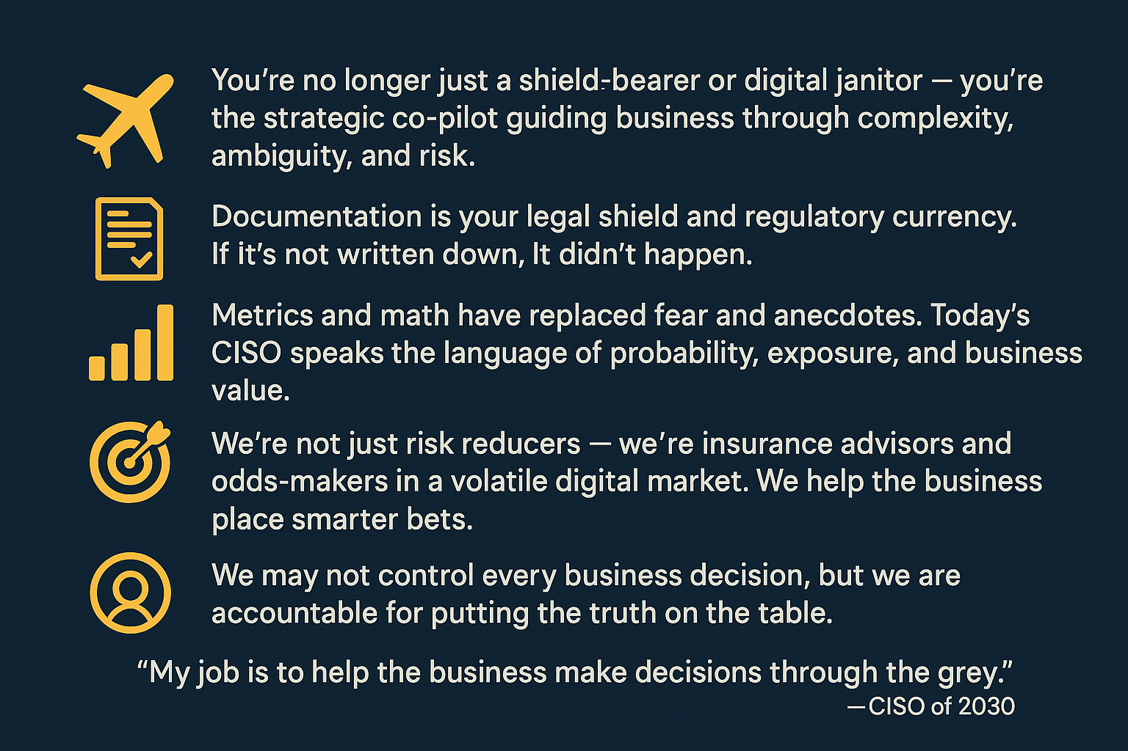
We Don’t Ship Dashboards. We Ship Decisions.

Slide 27
🔍 References & Further Reading
Books
The Phoenix Project — Gene Kim, Kevin Behr, and George Spafford
How to Measure Anything in Cybersecurity Risk — Douglas W. Hubbard & Richard Seiersen
The GC + CISO Playbook — Shawn E. Tuma
Industry Reports & Papers
2025 Data Security Incident Response Report — BakerHostetler
NACD Director’s Handbook on Cyber-Risk Oversight
RSAC: What Top CISOs Include in Updates for the Board
Definitive Boardroom Guide on Cybersecurity Governance — Digital Directors Network (DDN)
Professional Communities & Organizations
ISACs — Sector-specific threat sharing
Local peer groups for advisory and knowledge sharing
NACD — A growing credential focus for CISOs
Notes:
CISO – Cybersecurity Leader Job Description — Phil Venables
philvenables.com/post/ciso---cybersecurity-leader-job-description

