Slide 1
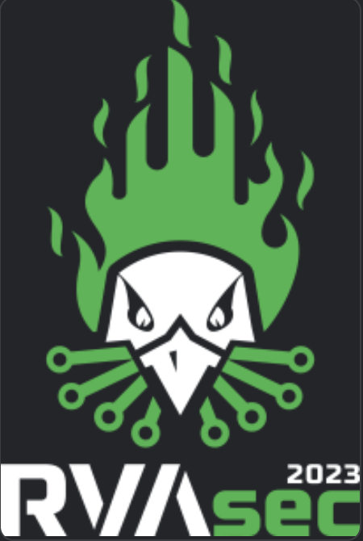
Top 5 CISO Findings Report – 2022

Slide 2
$ Whoami
Longtime RVASec Attendee/Supporter
OWASP Boston Chapter Leader
Encourager
Evolving Mentor
Recovering CON Organizer
Interests: Grey-Zone and underserved communities
Mark Arnold
VP of Advisory Services
Twitter: @lotusebhat
LinkedIn:
Notes:
Intersection of religion, disinformation, infoOps,

Slide 3
Quick Agenda
Countdown 5 Top Findings
Recommendations and Reimagination
Summary

Slide 4
Do we need more lists?
Everyone, every org
We know it’s bad
The Data (pl.) have a story

Slide 5
Verticals
Finance
Healthcare
Manufacturing
Hospitality & Recreation
Retail
Utilities & Energy
Legal/Law
Sports Entertainment
Notes:
Small business, Mid-Market with some Critical infrastructure.

Slide 6
Countdown
5

Slide 7
Asset Management Blues Financial Services, Healthcare, Manufacturing, Retail
Organizations Lack effective Asset Management
Spoofing
Tampering
Financial Loss
Higher Insurance Costs
Brand Management
Notes:
that Impact Business: Asset management is about track organization's physical, electronic, social assets – data. This can include physical assets such as equipment, buildings, and properties, and electronic assets such as computers and data. Other targets include intangible assets such as intellectual property and goodwill. Assets that have not been properly managed or protected can lead to thefts or financial losses, higher insurance costs or policy cancellations. Related legal problems may include copyright infringement.
Additionally, organizations lack full visibility into their hardware assets and software in OT/Cloud/DevOps

Slide 8
“We are waiting on procuring our X before improving our asset management.”
This Photo by Unknown Author is licensed under CC BY-SA

Slide 9
Countdown
4

Slide 10
Seeing Red: Vulnerabilities Financial Services, Healthcare, Manufacturing, Retail
Organizations remain challenged in their efforts to Discover Vulnerabilities & Patch in a timely manner (i.e., ahead of threat actors)
Notes:
One common mistake involves not scanning all systems for vulnerabilities, including the network, servers, workstations, and applications. Another concern involves not setting clear priorities for fixing those vulnerabilities.

Slide 11
Patching DELAYS
The lack of effective & timely patching opens the door to cyberattacks

Slide 12
Verizon DBIR 2022
Credentials
Phishing
Botnets
Exploiting vulnerabilities
Notes:
There are four key paths leading to your estate: All four are pervasive in all areas of the DBIR, and no organization is safe without a plan to handle each of them.

Slide 13
“We only do bi-yearly third-party testing”
This Photo by Unknown Author is licensed under CC BY-SA

Slide 14
Tenable’s not working …
This Photo by Unknown Author is licensed under CC BY-NC
This is me
This Photo by Unknown Author is licensed under CC BY-NC
This is “what I’d like to be” me
Notes:
Swapping out tech for tech does not solve operator & ROI problems

Slide 15
Countdown
3

Slide 16
Blind Spots All verticals
Organizations continue to Lack Proper Logging & Monitoring leading to blind spots
Repudiation
Impact Incident Response
Notes:
organizations lack full visibility into their hardware assets and software in IT/OT/Cloud/DevOps
systems because they do not collect logs to track when events happened within their networks, what happened, and who was involved. This lack of using logs can lead to damaging shortcomings for regulatory compliance and a heightened risk of security breaches.

Slide 17
Countdown
2

Slide 18
Insecure Configurations Financial Services, Healthcare, Manufacturing, Retail
Default and Insecure Configurations Persist
Spoofing
Tampering
Repudiation
Notes:
: Default configurations are dangerous because they are well-known by attackers and thus easy to exploit. In addition, default configurations are often not optimized for security, such as in cases in which unencrypted communications are allowed
Unnecessary apps, disable any unnecessary services, change default account usernames and passwords, and close or secure unnecessary port

Slide 19
“We mostly exploit misconfigurations these days in tests more than anything with a small % being lack of patches or new vulns.”
This Photo by Unknown Author is licensed under CC BY-NC-ND

Slide 20
Countdown
1

Slide 21
Dataflow Grey Areas All Verticals
Organizations Lack Data Flow Diagrams
Spot Anomalous Risks
Implement Countermeasures
Notes:
What does my data do?
It is critical to know where data comes from, where it goes, and what processing is done along the way. Getting a handle on these data flows enable organizations to quickly spot anomalous security risks and implement mitigation measures.
Common methods for documenting data flow information include Data Flow Diagrams (DFDs), swim-lane diagrams, activity diagrams, and process maps for data flowing through applications and infrastructure

Slide 22
CASE STUDY
0

Slide 23
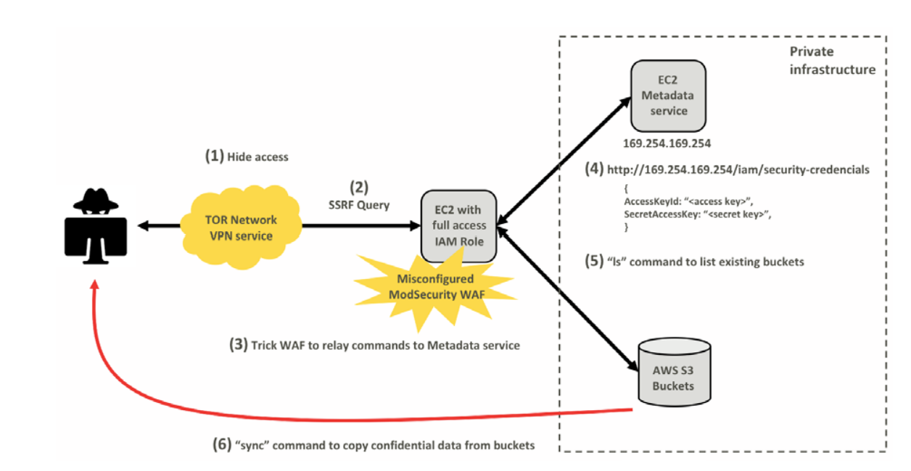
Capital One Breach, 2019
Notes:
MIT SLOAN SCHOOL of MANAGEMENT A Case Study of the Capital One Data Breach (Revised) Nelson Novaes Neto, Stuart Madnick, Anchises Moraes G. de Paula, Natasha Malara Borges Working Paper CISL# 2020-16 March 2020
Repudiation – As the attacker hid their identity using TOR (The Onion Router), malicious actions could not be traced backed to the individual that caused it thus leading to Repudiation.
Spoofing – With SSRF, attacker impersonated themselves as the WAF tricking the server to use its permission to access the Metadata service and access the credentials that they did not originally have access to.
Escalation of privilege - WAF did not need access to S3 buckets but was misconfigured and given elevated access not following the principle of least privilege
Information Disclosure – Leakage of WAF credentials that allowed attacker to use that credential and impersonate as WAF (spoofing)

Slide 24
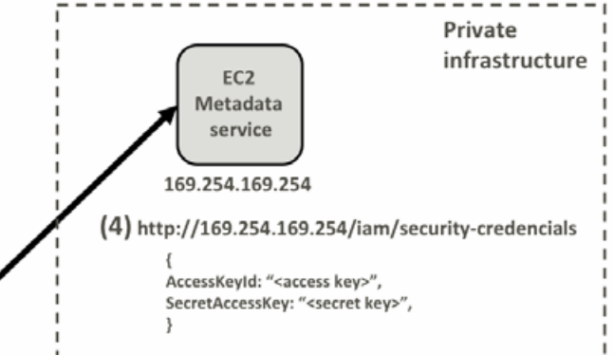
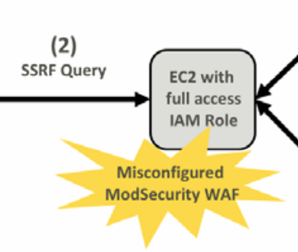
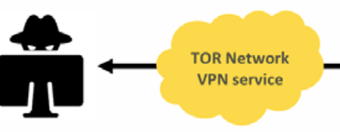
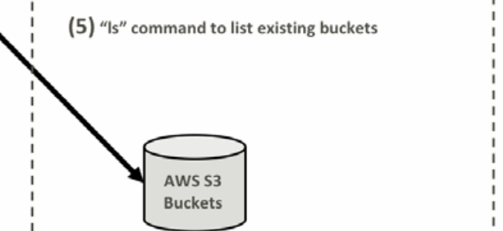
Capital One Breach, 2019
DOS
Repudiation
EOP
(1) Hide Access
Tampering
Information Disclosure
Escalation of Privilege
Spoofing
(3) Trick WAF to relay commands to Metadata Service
Information Disclosure
(6) Sync command to copy data from Buckets
Notes:
MIT SLOAN SCHOOL of MANAGEMENT A Case Study of the Capital One Data Breach (Revised) Nelson Novaes Neto, Stuart Madnick, Anchises Moraes G. de Paula, Natasha Malara Borges Working Paper CISL# 2020-16 March 2020
Attacker used anonymizing service TOR (The Onion Router) to hide their identity and mask their IP address.
Attacker had deep knowledge of how the AWS infrastructure functions and of a vulnerability in the ModSecurity WAF that allowed SSRF (Server-Side Request Forgery) attack.
SSRF attack allowed the attacker to trick the vulnerable server into executing new http commands using server’s permissions to access resources that the attacker should not have direct access to. Resource in this case was the AWS Metadata service.
The AWS metadata service is a crucial part of the AWS infrastructure that allows services to obtain temporary credentials. By launching the SSRF attack on the WAF the attacker was able to connect to the metadata service and obtain credentials (AccessKeyId and SecretAccessKey) the metadata service would provide to the WAF.
By using the credentials, the attacker ran the “ls” command multiple times, which returned a complete list of all AWS S3 Buckets of the compromised Capital One account ("$ aws s3 ls");
Lastly, the attacker used the AWS “sync” command8 to copy nearly 30 GB of Capital One credit application data from these buckets to the local machine of the attacker ("$ aws s3 sync s3://bucketone."). This command gave the attacker access to more than 700 buckets, according to the FBI report.
The misappropriated temporary credentials could be used from any public virtual private cloud (VPC). Therefore, the attacker was able to use the stolen credentials to directly gain access to private and confidential resources. If the use of these credentials had been limited to VPCs owned by Capital One, the attack could have been prevented.
STRIDE Elements:
Repudiation – As the attacker hid their identity using TOR (The Onion Router), malicious actions could not be traced backed to the individual that caused it thus leading to Repudiation.
Spoofing – With SSRF, attacker impersonated themselves as the WAF tricking the server to use its permission to access the Metadata service and access the credentials that they did not originally have access to.
Escalation of privilege - WAF did not need access to S3 buckets but was misconfigured and given elevated access not following the principle of least privilege
Information Disclosure – Leakage of WAF credentials that allowed attacker to use that credential and impersonate as WAF (spoofing)
More Info Disclosure – Attacker impersonated as WAS, ran commands and gained access to S3 buckets that leaked more unencrypted critical credit card data.
Please see these links for more info:
https://web.mit.edu/smadnick/www/wp/2020-16.pdf
https://securityboulevard.com/2020/12/understanding-the-2019-capital-one-attack/

Slide 25
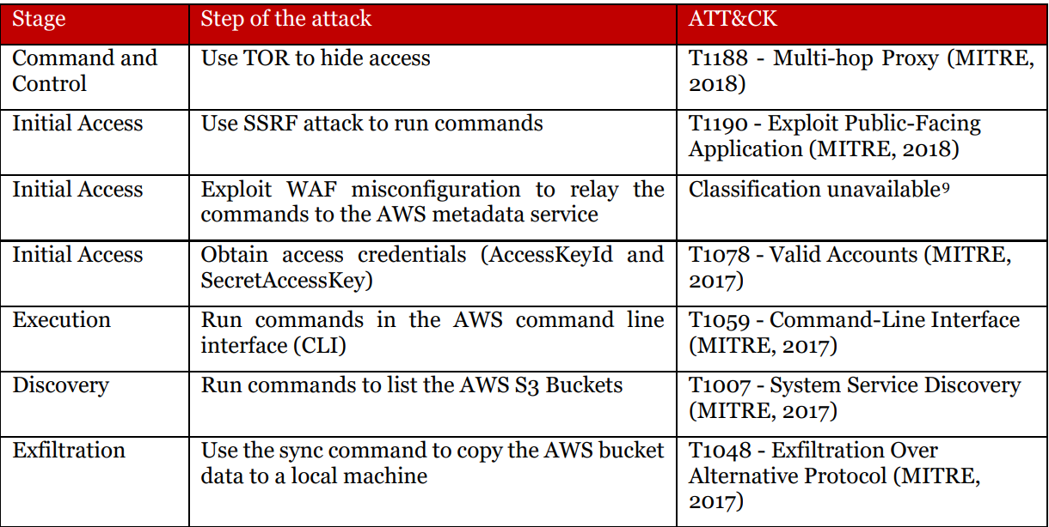
Capital One Breach, 2019

Slide 26
Capital One Breach, 2019

Slide 27
Notes:
Underwhelming for some. Overwhelming for most.

Slide 28
Collaboration, Capacity, Capability

Slide 29
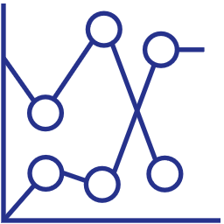
Everyone Has A Hand
Who
What
Where
When
As with all elements of security, everyone has a hand in it
Security programs consist of process, and outcomes
Security outcomes of threat modeling will be everywhere
primary security efforts should be baked in early
Notes:
Someone with a business understanding of the app will be needed for threat/risk classification. Product Owners/Product Managers also verify that security requirements are met appropriately, with support from the architect
The architect probably has a larger role in the threat model, and may lead the exercise – they want to validate the design is created in a fundamentally secure way
Developers will have a deeper knowledge of specific flows and can help guide the process and answer questions about their area of expertise
Testers use the findings as a road map for security testing, and help to guide the security components and their implementation
But everyone should be involved, and should know how different elements of the application impact what they work on. They all bring specific viewpoints that helps to give a complete view of the system
Devs: know what feeds into, and out of, what they develop
QA: Know where different information resides, and in what form – make sure that those rules are followed and can’t be bypassed
Speaker Notes:
There are 4 different questions to consider when we are starting with the process of threat modeling. The Who, What, Where, and When?
Who – as with all elements of security and all areas of development, every single person has a hand in this
As we go through and determine what threats and risks, we have we must determine how bad those things are versus the thing we accept or mitigate. To do this we must have someone who understands the business (i.e., product owners/managers) can hold this scope.
The architect has a huge role in modeling as well. Traditionally the architect is the steward who leads the threat modeling exercise because of their knowledge of their total of the application.
Developers who have a deep knowledge of a specific workflow of a subset of the application can help guide the process through their areas of expertise.
What – threat modeling is a process, but it is also a series of outcomes. What did we identify while performing our threat model? What are the next steps?
Where – the outcomes will be everywhere inside the secure software development lifecycle
When – the primary effort of threat modeling should be done as early as possible in our process (preferably the design phase).
Also worth emphasizing is that, while threat modeling does add an additional set of steps to our development process, and those steps take time, that time is more than paid back when we look at the SDLC as a whole. By reducing the number of findings in security testing (both manual and automated), the number of findings from pentests, the number of faults identified in production, the number of archer findings, etcetera, we save a huge amount of time by short-circuiting the rework that we may otherwise have to do redesigning and reimplementing workflows.

Slide 30
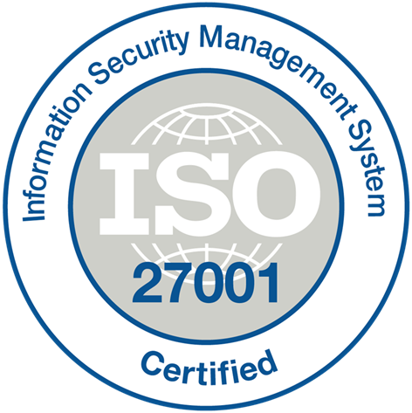
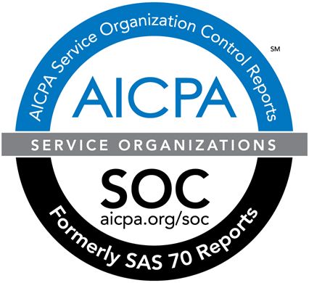
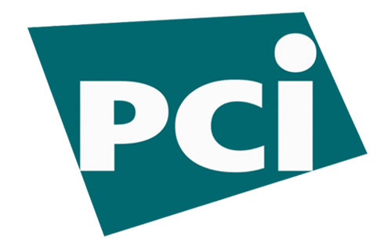
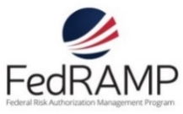
A Framework Anyone?
ISO 27001
SOC 1 Type 2
SOC 2 Type 2
PCI DSS Level 1
Cloud Controls Matrix
ISO 27018
Content Delivery and Security Association
Shared
Assessments
FedRAMP JAB P-ATO
HIPAA / HITECH
FIPS 140-2
21 CFR
Part 11
FERPA
DISA Level 2
CJIS
IRS 1075
ITAR-ready
Section 508 VPAT
European Union
Model Clauses
EU Safe Harbor
United Kingdom
G-Cloud
China Multi
Layer Protection Scheme
China
GB 18030
China
CCCPPF
Singapore
MTCS Level 3
Australian Signals
Directorate
New
Zealand
GCIO
Japan
Financial Services
ENISA
IAF

Slide 31
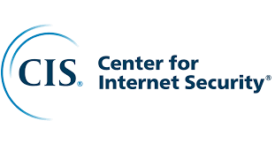
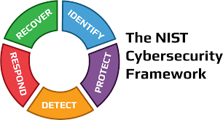
Choose a Framework

Slide 32
NIST Framework
1

Slide 33
NIST Framework
2
Asset/Patch/
Vuln Mngmnt
Vulnerability/
Patch Gaps
Configuration Issues
Visibility
Data Flow Diagrams
1

Slide 34
NIST MAPPINGS
2
Asset/Patch/
Vuln Mngmnt
Vulnerability/
Patch
Configuration Issues
Visibility
Data Flow Diagrams
1
3
External VA
External PT
Red Team
RT w/Persist
Web App
Internal PT
Insider Threat
Physical
Notes:
What this Is
Holistic Assessment of Information Security Controls, People, Processes, and Technology
Physical, Social, Electronic landscapes
If an employee or contractor went rogue, what could they do?
Assessment of internal preventative and detective controls
What to Provide
Known IP Addresses, Subnets, and Domain Names
List of Users In-Scope for Email, IM, and Voice Phishing
Building Locations for Physical Entry
Letter of Authorization
What to Expect
“By Any Means Necessary” Less about exploiting CVEs, more about systemic design issues
Leveraging multiple sources of information for compound attacks
Next Steps
Review internal processes and technologies
Defensive Control Tuning
Preventative and Detective Physical Controls
Employee Training

Slide 35
Internal/External
What this Is
A validation of patching
What to Provide
Known IP Addresses, Subnets, and Domain Names
What to Expect
Scanning
Next Steps
Review discovered assets, vulns,
Internal Processes
Asset management
Manual Testing

Slide 36
Red Team/Physical Assessment
What this Is
A validation of Incident Response Processes
What to Provide
Known IP Addresses, Subnets, and Domain Names
What to Expect
“Sparring” with Defensive Team
Next Steps
Review Physical Security Processes
Tune Incident Response Processes
“We’re in your network. Get us out.”
List of Users In-Scope for Email, IM, and Voice Phishing
Living in the environment, knowing we’re being hunted

Slide 37
Identify, Rank, Quantify Risks
Rank Risks (e.g., DREAD, EPSS) https://www.first.org/epss/model)
01
Quantify Risks (e.g., FAIR)
02
Threat Modeling
03
Notes:
Factor Analysis of Information Risk (FAIRTM) is a practical framework for understanding, measuring and analyzing information risk, and ultimately, for enabling ...

Slide 38
Summary

Slide 39
Addressing the Top 5 VCISO Findings
Select a relevant framework and align
01
Conduct a Gap Analysis
02
Discover Issues
https://github.com/vz-risk/VCDB/issues
03
Test & Validate Assumptions; Rank Risk
(e.g., FAIR, DREAD, EPSS)
04
Wash, Rinse, Repeat
05

