Slide 1
A Game Theoretic Model of Computer Network Exploitation Campaigns
Robert Mitchell
mitchellrr@mitre.org*
*The author’s affiliation with The MITRE Corporation is provided for identification purposes only, and is not intended to convey or imply MITRE’s concurrence with, or support for, the positions, opinions or viewpoints expressed by the author.
Approved for Public Release; Distribution Unlimited. Case Number 18-1312

Slide 2
Disclosure
This briefing is based on work I created while at Sandia National Laboratories (SNL)
The SNL product is publicly available at http://ieeexplore.ieee.org/document/8301630/

Slide 3
Agenda
Motivation
Threat Model
Introduction To Game Theory
The Basics Of Our Game
Extensive Form Game
Nash Equilibrium
Information Sets
Parameters
Applications
Conclusions

Slide 4
Motivation
Recent cyber events
  US Democratic National Committee (DNC) hack
  Banner Health Personally Identifiable Information (PII) spill
  Dyn Domain Name System (DNS) Distributed Denial of Service (DDoS)
  San Francisco Municipal Transportation Agency (MTA) ransom
  WannaCry pandemic
Get inside the adversary’s tactical loop
Support needed for strategic and tactical decisions

Slide 5
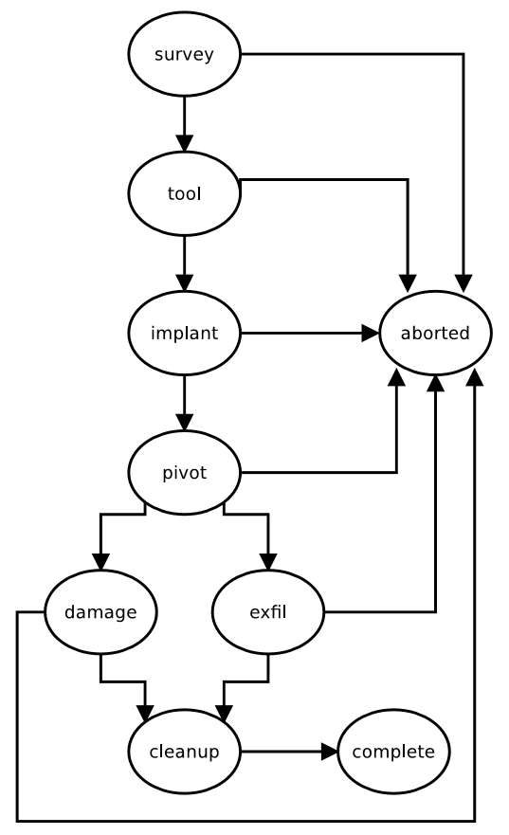
Threat Model
Sophisticated adversary
Attacker’s goal:
private data theft
Attacker’s objective:
avoid detection
Contrast with Computer Network Attack (CNA) campaigns

Slide 6
Introduction to Game Theory
Other approaches
  Closed form math, stochastic modeling, simulation, emulation
Considers collusion among and competition between rational players
  Payoffs must be complete: any two can be ranked and transitive
Variants
  Static/dynamic, complete/incomplete information, symmetric/asymmetric, zero/general sum
Popular examples
  Prisoner’s dilemma, stag hunt, Cournot competition
Widely used in economics

Slide 7
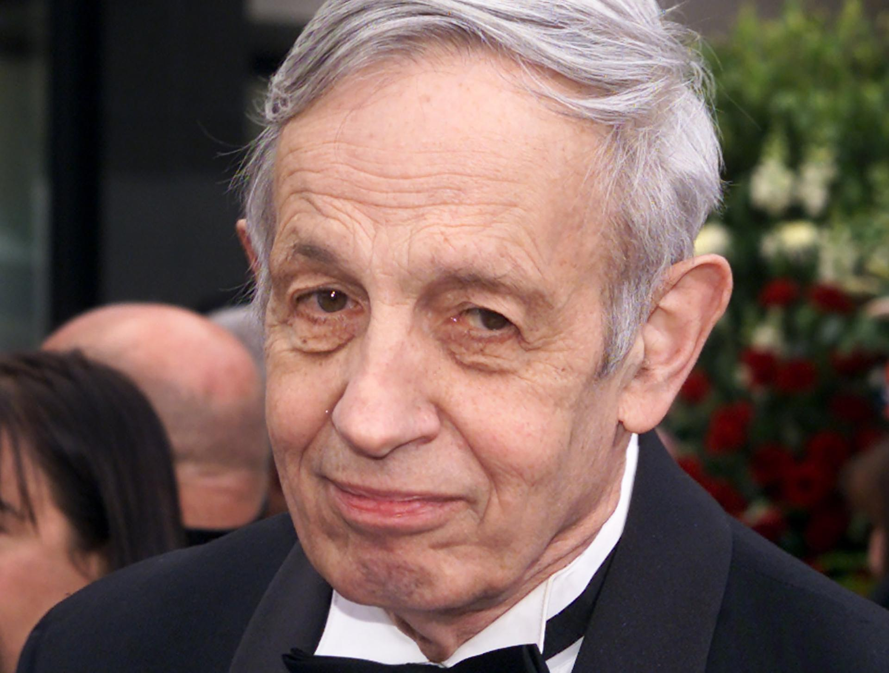
John Nash
Notes:
John Nash won a Nobel Prize in economics for his game theory work.
He was born in 1926 in Bluefield, WV.
John Nash graduated from Princeton, and worked there and at MIT.
Unfortunately, he died in a car accident in 2015.

Slide 8
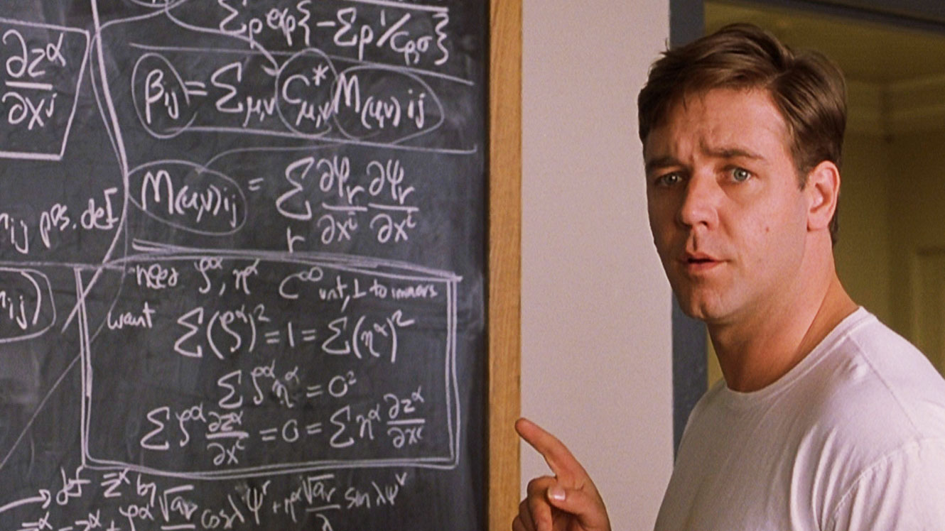
Not John Nash
Notes:
Russell Crowe starred in a movie about John Nash’s life in 2001.

Slide 9
The Basics Of Our Game
Players
  Attacker, nature, defender
Information
  Attacker: all payoffs, all previous moves
  Defender: all payoffs, all previous moves
Actions
  Attacker: quit or proceed
  Nature: detect or miss
  Defender: passive or active response
Payoffs
  Function of parameters and strategies

Slide 10
Why Tempt Fate?
Why would the defender not actively respond at an early stage?
We can tease out additional tools
  Defenders gain intelligence
  Attackers must write new tools
Competing force
  Make the call that could give away the store

Slide 11
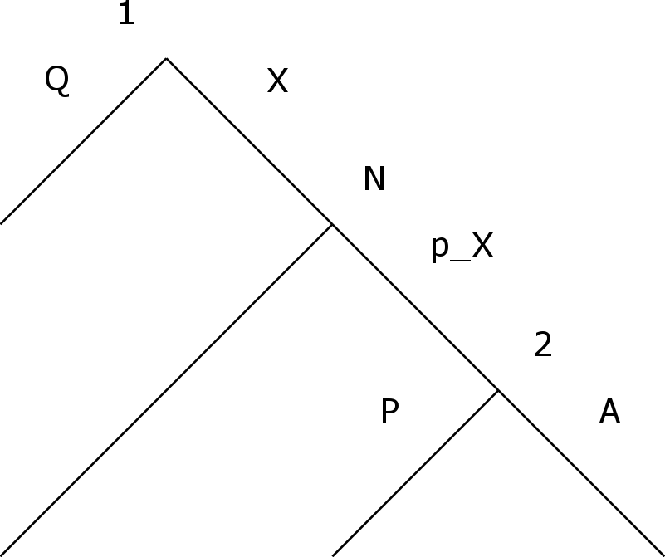
Extensive Form Game - One Stage
Notes:
This single stage game will allow us to build up to the more complicated full campaign game.
The vertices are labeled to indicate the player who moves: 1 is the attacker, N is nature and 2 is the defender.
The edges are labeled with the player’s strategy: Q indicates quit, X indicates the attacker proceeds with stage X, p_X is the probability the defender detects the stage, P indicates a passive defender response and A indicates an active defender response.

Slide 12
Extensive Form Game
Notes:
This picture is hard to read, but the basic idea is that the campaign level game is a hierarchical composition of the stage games from the last slide.
This is an ambitious game: there are 48 possible outcome and 512 strategy sets.

Slide 13
Extensive Form Game - Payoffs
u_{i}(o): payoff to player i of outcome o
Outcome 0
  u₁(o₀) = no stages funded, no private data harvested
  u₂(o₀) = no active response, no private data spilled, no tools burned
Outcome 36
  u₁(o₃₆) = five stages funded, private data harvested
  u₂(o₃₆) = no active response, private data spilled, no tools burned
Outcome 47
  u₁(o₄₇) = five stages funded, no private data harvested
  u₂(o₄₇) = active response to exfil, no private data spilled, four tools burned

Slide 14
Extensive Form Game - Payoffs
v_{i}(s): expected payoff to player i given strategy set s
s = (s₁, s₂)
Timid Attacker
  s₁ = (Q,*,*,*,*) s₂ = (*,*,*,*)
  v_{i}(s) = u_{i}(o₀)
Curious Attacker, Cagey Defender
  s₁ = (S,Q,*,*,*) s₂ = (P,*,*,*)
  v_{i}(s) = (1 - p_{S}) u_{i}(o₁) + p_{S} u_{i}(o₂)
Curious Attacker, Paranoid Defender
  s₁ = (S,Q,*,*,*) s₂ = (A,*,*,*)
  v_{i}(s) = (1 - p_{S}) u_{i}(o₁) + p_{S} u_{i}(o₃)

Slide 15
Nash Equilibrium
Solution concepts
  Restrict the set of possible outcomes to a subset of reasonable ones
  Help explain why games play out like they do
  Find the “hot spots”
Basic ideas behind a Nash equilibrium
  A strategy profile where each player’s strategy is the best response to the opponent’s strategy
  Finite games will always have at least one Nash equilibrium
  May not be sequentially rational

Slide 16
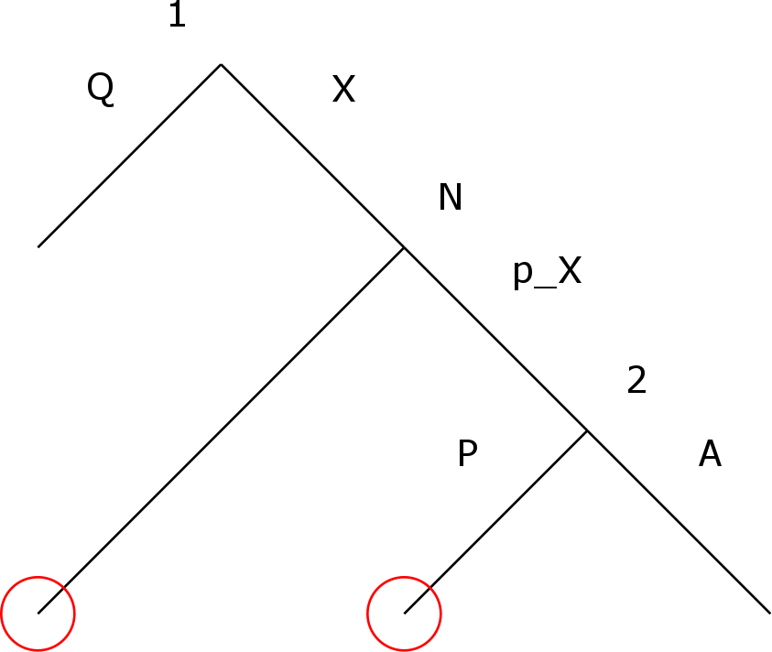
Information Sets
Notes:
Information sets are collections of nodes that a player cannot distinguish between.
For example, in this stage game, the attacker does not know if the defender failed to detect the attack or the defender responded passively.

Slide 17
Parameters
Too many
Attacker facing parameters
  Costs of surveillance, tooling, implantation, movement and exfiltration
  Reward of obtaining private data
Defender facing parameters
  Costs of active response to surveillance, implantation, movement and exfiltration
  Rewards of detecting surveillance, implantation, movement and exfiltration
  Probabilities of detecting surveillance, implantation, movement and exfiltration
  Cost of spilling private data

Slide 18
Applications
Managers
  Study investment decisions
  Study defensive measures and policies
Incident handlers
  Forecast impact of tactical responses
  Identify TTPs that make attacks unprofitable
  Channelize the attacker

Slide 19
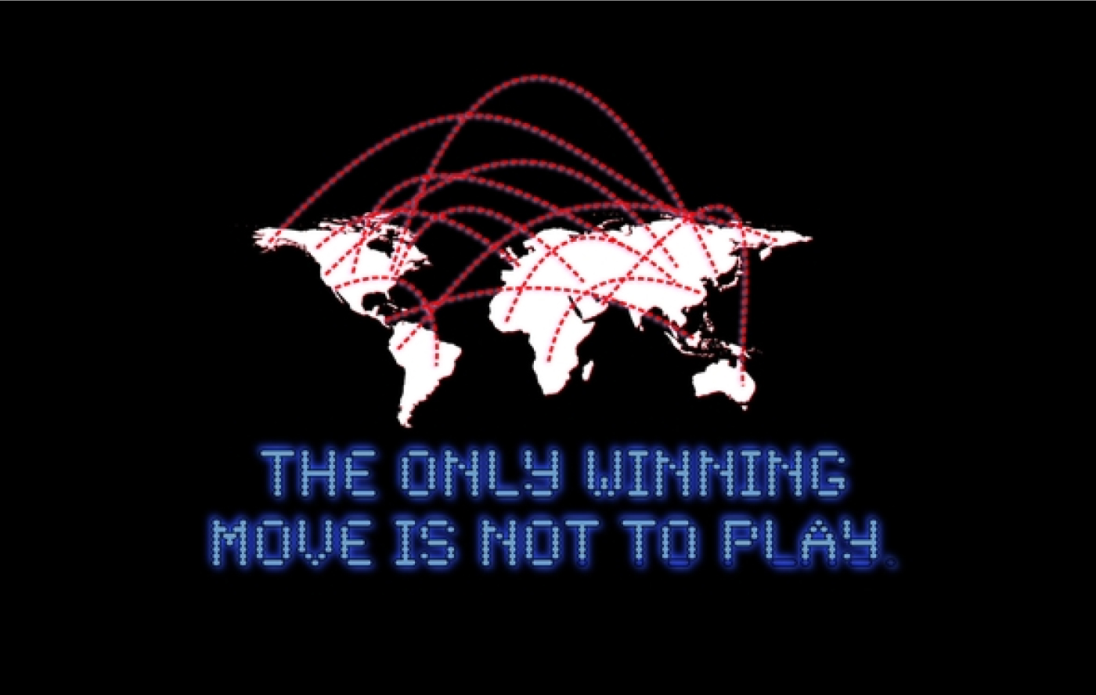
Blue Team Goal
Notes:
Creating an impenetrable system is an unrealistic goal for economic, technical and operational reasons, but defenders can prepare the battlefield in a way that makes campaigns unprofitable for attackers.

Slide 20
Conclusions
Contributions
  Campaign-level dynamic complete-information CNE game
  Software that finds Nash equilibria of this game
Future work
  Consider Computer Network Attack (CNA)
  Enhance the movement phase to be a repeated game
  Continuous, instead of discrete, defender response
  Consider different player types (risk averse vs. greedy)
  Consider subgames

Slide 21
Summary
Motivation
Threat Model
Introduction To Game Theory
The Basics Of Our Game
Extensive Form Game
Nash Equilibrium
Information Sets
Parameters
Applications
Conclusions

Slide 22
A Game Theoretic Model of Computer Network Exploitation Campaigns
Robert Mitchell
mitchellrr@mitre.org*
*The author’s affiliation with The MITRE Corporation is provided for identification purposes only, and is not intended to convey or imply MITRE’s concurrence with, or support for, the positions, opinions or viewpoints expressed by the author.
Approved for Public Release; Distribution Unlimited. Case Number 18-1312

