Slide 1
What is Cyber Insurance? Are You Covered?
Kara Owens, Managing Director, Global Cyber Underwriting Executive
Lou Botticelli, Director, Cyber and Professional Liability
RVASEC - May 22, 2019
Notes:
KO

Slide 2
Lou Botticelli
Director, Cyber and Professional Liability
Markel Assurance
Direct: 212-898-6637
lbotticelli@MarkelCorp.com
Kara Owens
Managing Director, Global Cyber Underwriting Executive
Markel Corporation
Direct: (804) 864-4174
Cell: (929) 313-6533
kcowens@markelcorp.com
Notes:
KO

Slide 3
Agenda
Standalone Cyber Insurance Policy
Purchasing a Cyber Insurance Policy
Cyber Marketplace
Claims Trends
Cyber Across Traditional Insurance Product Lines
Emerging Issues
Notes:
KO- ask audience whether or not they purchase cyber insurance by a show of hands

Slide 4
Standalone Cyber Insurance Policy
1st Party Coverages
3rd Party Coverages
Business Interruption
Network Security Liability
Contingent Business Interruption
Privacy Liability
Data Pre-Event and Post-Event Response
Fines and Regulatory Costs
Data Recovery
Cyber Extortion
System Failure
Media
Notes:
Lou – give examples of each

Slide 5
Standalone Cyber Insurance Policy
Coverage Trends
Traditional such as Bodily Injury, Physical Damage, Product Liability, Terrorism
Preventative Shutdown and Betterment
Social Engineering
Reputational Harm Business Income
Notes:
Lou - Give examples of each

Slide 6
Standalone Cyber Insurance Policy
Data Pre-Event and Post Event Services – Vendors
Pre-Event / Risk Management Services
Response readiness
Online cyber security education
Network vulnerability scanning
Post-Event Providers
Forensics
Law firms
Credit monitoring
Public relations
Notes:
Lou

Slide 7
Purchasing a Cyber Insurance Policy
Distribution Process
Original Company (Prospective Insured)
Broker / Agent
Insurance Carrier
Policy Issuance Process
Broker / Agent Works with Prospective Insured on Communicating Risk Posture
Underwriter at Carrier Reviews Risk
If Underwriter Approves Risk, Policy is Issued
Notes:
Lou: - KO to add Marsh’s report and the process

Slide 8
Purchasing a Cyber Insurance Policy
INSURED
Risk Management
Data and Network Security
Terms and Conditions
Privacy
# and sensitivity of data
Privacy policy
Chief Privacy Officer
Compliance with regulations
User access controls
Vendor management
Business continuity plan
Employee training
Disaster recovery plan
Coverages requested
Nature of Industry
Pricing
Retention
Loss history
Network security policy
Encryption
Firewalls, logging, etc.
Physical security
Chief Security Officer?/ IT Staff
Underwriting Process
Notes:
Lou

Slide 9
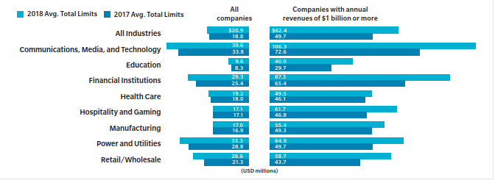
Purchasing a Cyber Insurance Policy
How much limit should you buy?
Source: Marsh 2018 Insurance Trends Report
Notes:
Lou:

Slide 10
Cyber Marketplace
Standalone Cyber Premium
$3.5B - $4.5B estimated global premium in 2017
110 carriers, top 15 have 80% of premium (source PRA)
Key players include AIG, Beazley, Chubb, Axis, AXA XL
Source: Advisen, Betterley Risk Consultants
Notes:
KO

Slide 11
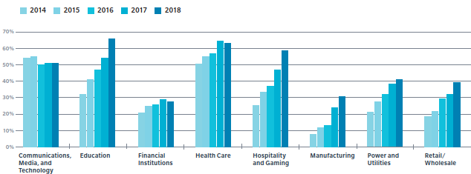
Cyber Marketplace
Demand / Growth
Most industries purchasing
Buyers of all sizes and personal lines coming…
Regulatory requirements and Third party requirements
#1 Board issue
Increased limits
Insureds and brokers realizing coverage gaps in traditional insurance lines
Source: Marsh 2018 Insurance Trends Report
Notes:
KO

Slide 12
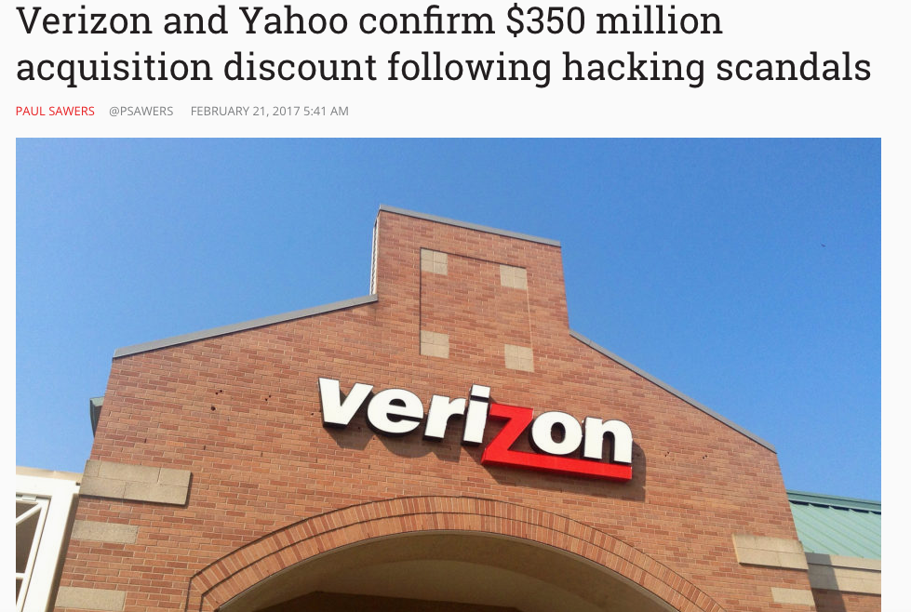
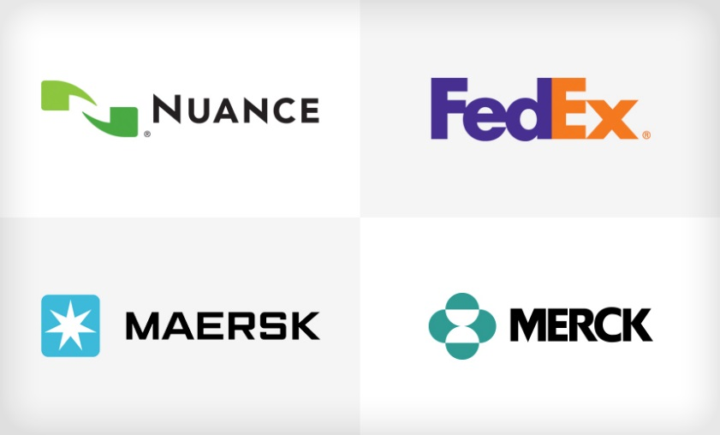
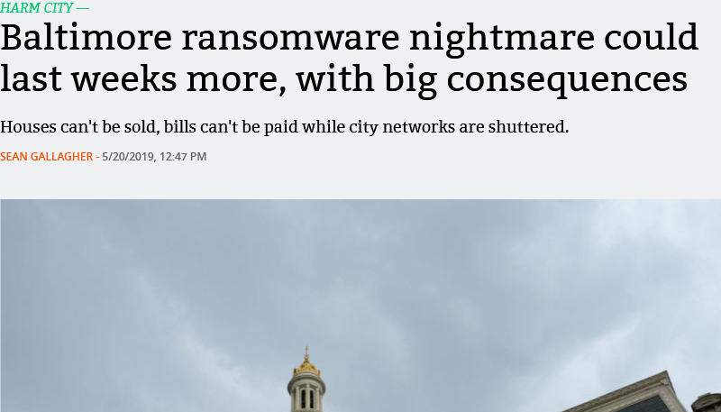
Claims Trends
Notes:
KO

Slide 13
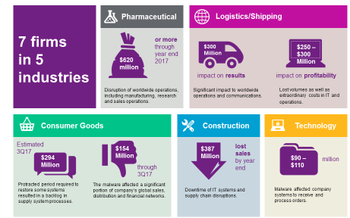
Claims Trends
NotPetya: Financial and Operational Impacts
Source: Willis Towers Watson
Notes:
KO

Slide 14
Cyber Across Traditional Insurance
Silent / Non-Affirmative Cyber
What is it?
Insurance policies that do not explicitly include or exclude coverage for cyber risk
Examples exist in Property, Casualty, Professional and Management Liability, Marine, etc.
A few high profile cases involving claims submitted into traditional insurance lines stemming from cyberattacks
Zurich / Mondelez – NotPetya claim
AIG / Merck – NotPetya claim
Notes:
KO

Slide 15
Cyber Across Traditional Insurance
Potential Exposures
Loss of Intellectual Property
Property damage
Business interruption
Reputational damage
Fines/penalties/regulatory actions
Bodily injury
Extortion
Breach of contract
D&O and transactional liability
Product liability and recall
Stock drops, loss of profits
Costs to notify/breach response costs
Lost data
Loss of monies transferred
“Cyber attacks may stem from a wide array of actors, affect all industries and result in varying levels of damage to data, critical systems, physical property, and even disrupt business continuity. For this reason, cyber risks can trigger a variety of insurance solutions.”
Source: CRO Forum Report – “Cyber Resilience – The Cyber risk challenge and the role of insurance”
Notes:
KO

Slide 16
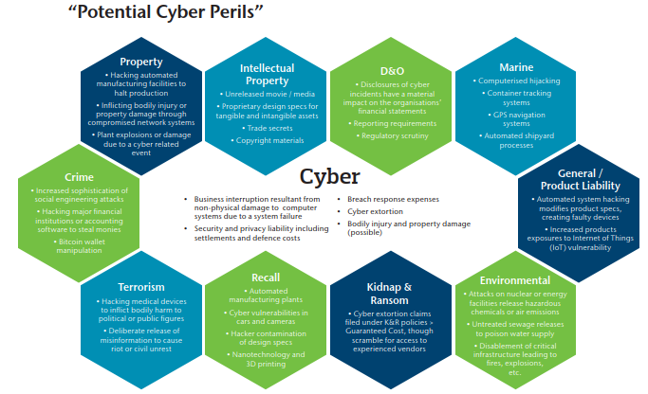
Cyber Across Traditional Insurance
Source: AON
Notes:
KO

Slide 17
Emerging Issues
Bodily Injury
Mobile Apps
Telematics
IoT
Physical Damage
Biometrics
Aviation
& Marine
Social
Engineering
Critical
Infrastructure
Supply Chain
Risk
Cloud Computing
Cyber Terrorism
Political Hacking
Crypto
Notes:
KO

Slide 18
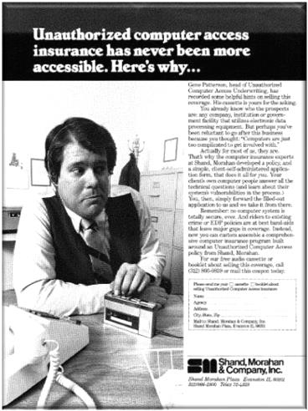
Cyber @ Markel
Notes:
High tech technology

Slide 19
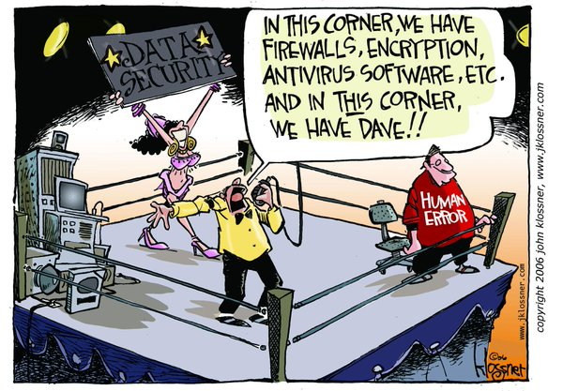
Q&A?

