Slide 1
Cybersecurity Zero to Hero with CyberChef
Jonathan Glass

Slide 2
Script for the next ~50 mins
Disclaimers
Introduce Me/CyberChef
Discuss the Value
Walkthrough a Few Recipes
Small, Medium, Large
Advanced Use Cases
Building Custom Operations
Potential for Integration
Interacting with Active Content
Lessons Learned

Slide 3
Slide Legal made me make
The views that I express are my own and do not necessarily represent
those of the Federal Reserve Bank of New York or the Federal Reserve System
those of the University of Richmond School of Professional and Continuing Studies
sound cybersecurity advice in general.
View at your own risk

Slide 4
I refuse to tell you which is which

Slide 5
Introductions

Slide 6
Jonathan Glass
Federal Reserve (Present)
Malware Analyst
Local and National Incident Responder
Forensic Analyst
University of Richmond School of Professional and Continuing Studies (Present)
Adjunct Instructor
Digital Forensics
Malware Analysis
Black/Blue Hat Python
10 years Cybersecurity
9 years USAF
GCIH, GAWN, GCFA, CISSP, CEH, MODOK, MCSE, GPYC
BS in InfoSec, MBA
http://jon.glass
email@jon.glass
@GlassSec

Slide 7
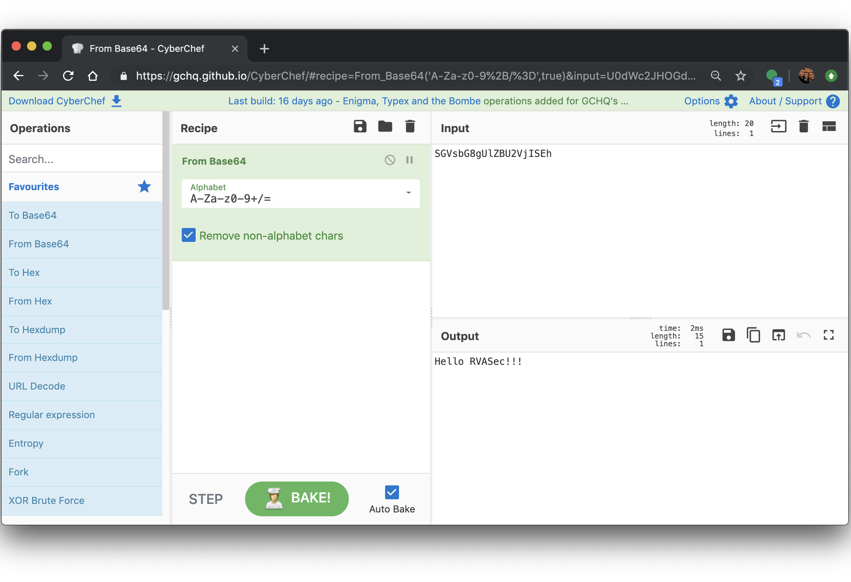
CyberChef
https://gchq.github.io/CyberChef/
The Cyber Swiss Army Knife - a web app for encryption, encoding, compression and data analysis

Slide 8
How does it work?
1
4
2
3
Notes:
How it works
There are four main areas in CyberChef:
The input box in the top right, where you can paste, type or drag the text or file you want to operate on.
The output box in the bottom right, where the outcome of your processing will be displayed.
The operations list on the far left, where you can find all the operations that CyberChef is capable of in categorized lists, or by searching.
The recipe area in the middle, where you can drag the operations that you want to use and specify arguments and options.

Slide 9
Powerful Operations
From/To Hex
From/To Base64
URL Encode/Decode
Regular Expression
XOR Brute Force
Decode Text
CSV to JSON
JSON to CSV
RC2, RC4, DES, Triple DES, AES Encrypt/Decrypt
Bitwise operations
HTTP request
JPath Expression
Strings
Extract Filepaths
Extract EXIF
Zip/Unzip
Tar/Untar
All the Hashes
Syntax Highlighting
Script Beautify
Render Image
XKCD Random Number
300+ and growing!

Slide 10
Value of CyberChef

Slide 11
Value of CyberChef
Reduces the entry threshold for Cybersecurity tasks
Drag and Drop operations
Menu of things to try
Web GUI
Solid platform to demonstrate programming concepts
Functions, Order of operation, data types…
Visualize data manipulation step by step
Trick students into coding with RegEx

Slide 12
Value of CyberChef
Serverless and Static
Runs client side
Nothing to install
Cross-browser compatibility
Parses HTTP GET Parameters
Recipes can be bookmarked in browser with input data
Post URLs to Blogs with steps, comments, and input data
Not overly difficult to customize
Free!

Slide 13
REAL STATISTICS…probably not made up.

Slide 14
Intro to Digital Forensics
Basic tasks easier in CyberChef but Python becomes very necessary.
Intro to Malware Analysis
Small tasks can be combined to get big results but Python is still needed for most analysis
Black Hat Python
Some tasks might be easier but we use Python for everything so…¯\_(ツ)_/¯
Work
Wide variety of tasks, most are easier with Python until complexity reaches critical point where it really doesn’t matter what I am using. :D

Slide 15
Small Recipes Using CyberChef
Tons of value from the quick operations

Slide 16
Base64 Decode

Slide 17
Unzipping a Password Protected Zip File

Slide 18
Combining ‘Unzip’ and ‘From Base64’

Slide 19
Resolving a List of Domain Names

Slide 20
YARA? Sure!

Slide 21
Medium Recipe using CyberChef
Deobfuscating Emotet v4 Downloader

Slide 22
Space Reserved for Emotet
MUMMY SPIDER is a criminal entity linked to the core development of the malware most commonly known as Emotet or Geodo.
The phishing campaign by MUMMY SPIDER consisted of a malicious macro-enabled Microsoft Word document sent as an email attachment.
When recipients opened the weaponized document and macros are enabled on the machine (which is quite typical), an obfuscated PowerShell command was launched.
https://www.information-age.com/ecrime-cyber-network-123482383/

Slide 24
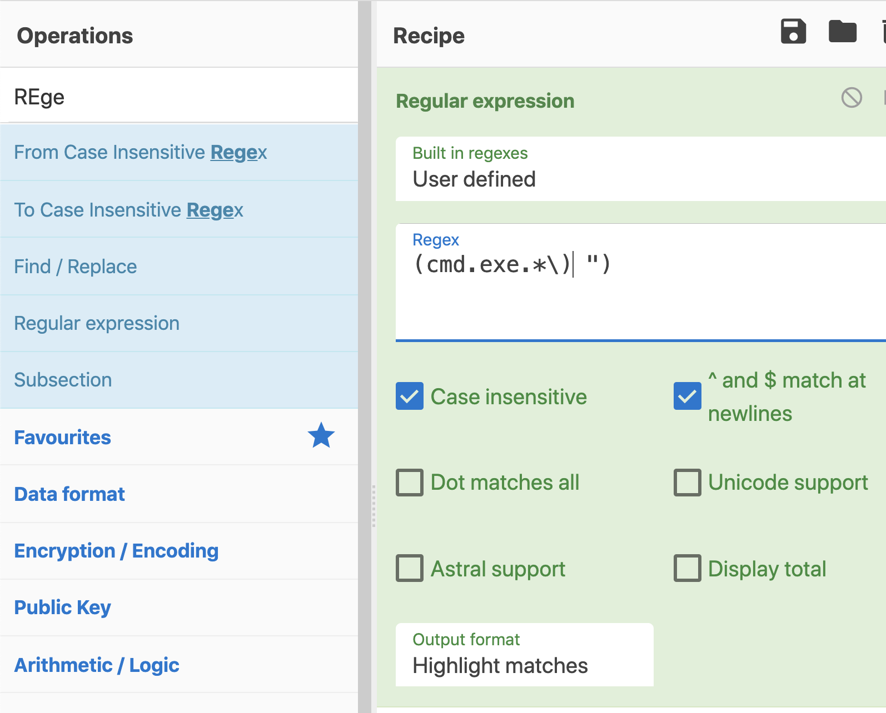
Grab RegEx Operation
I use RegEx for as much as possible
You should too

Slide 26
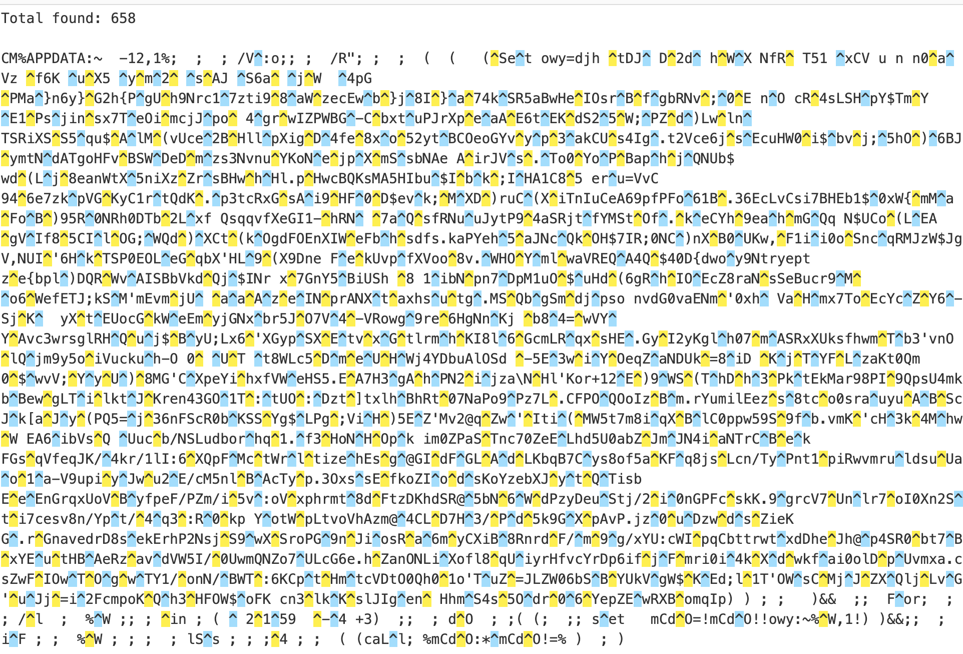
Too Many Carets(^)!!!
We should remove the DOS Obfuscation to get a better picture of this mess

Slide 29
#1 Sets an environment variable filled with #2 mostly gibberish.
#3 loops backward from the end and grabs every 4th character.
#1
#2
#3

Slide 30
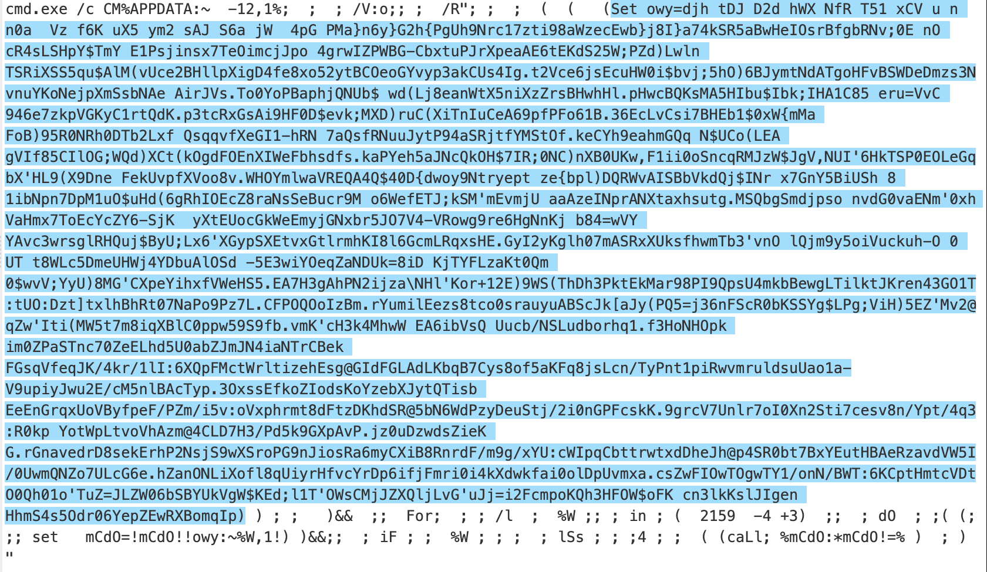
More RegEx to Capture the Obfuscated Code

Slide 31
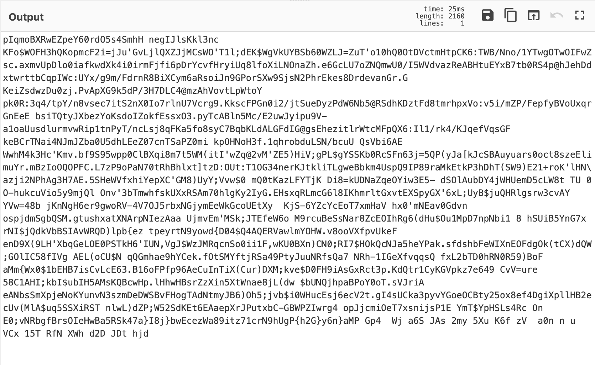
Reverse The Obfuscated Code

Slide 32
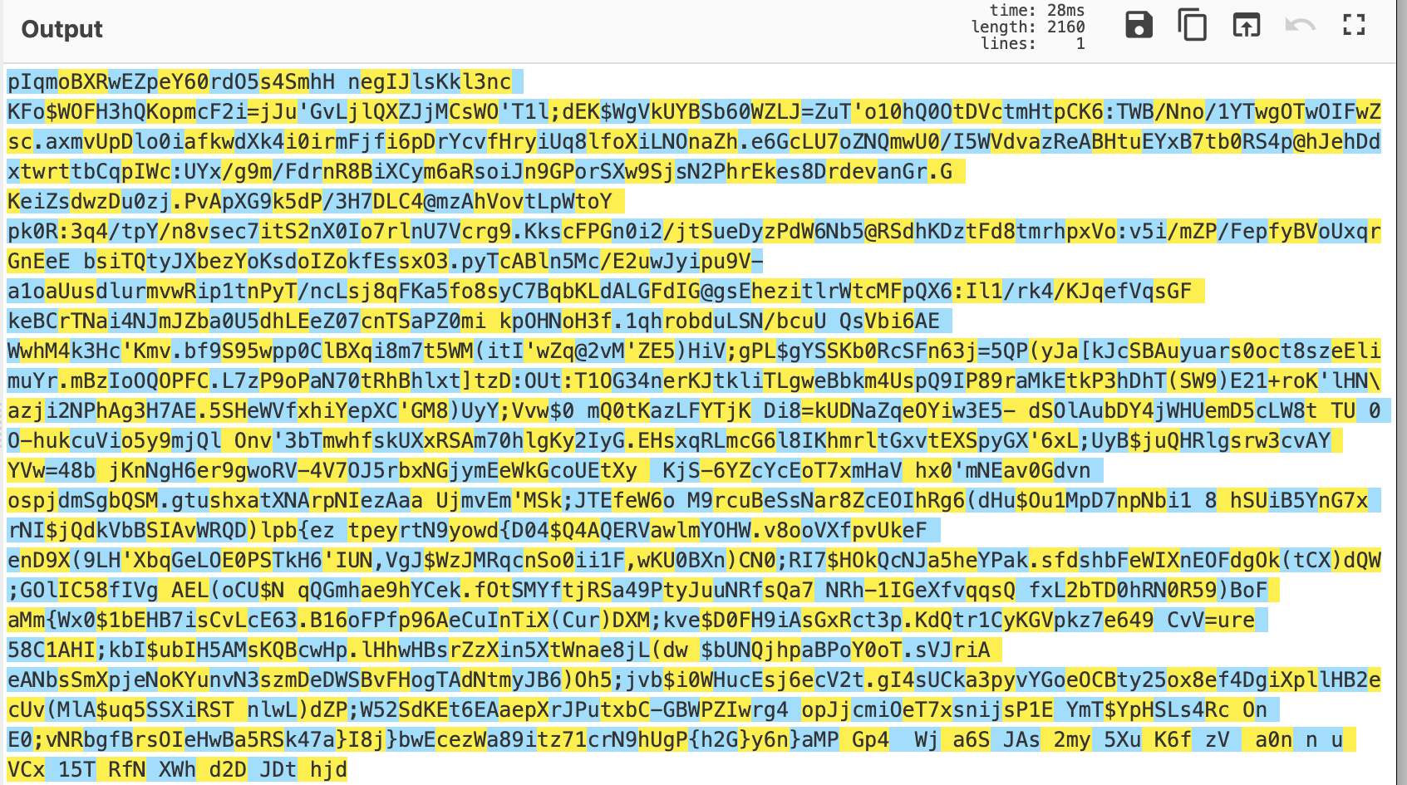
More RegEx! “(.)…”
Capture the first character, skip 3, repeat

Slide 33
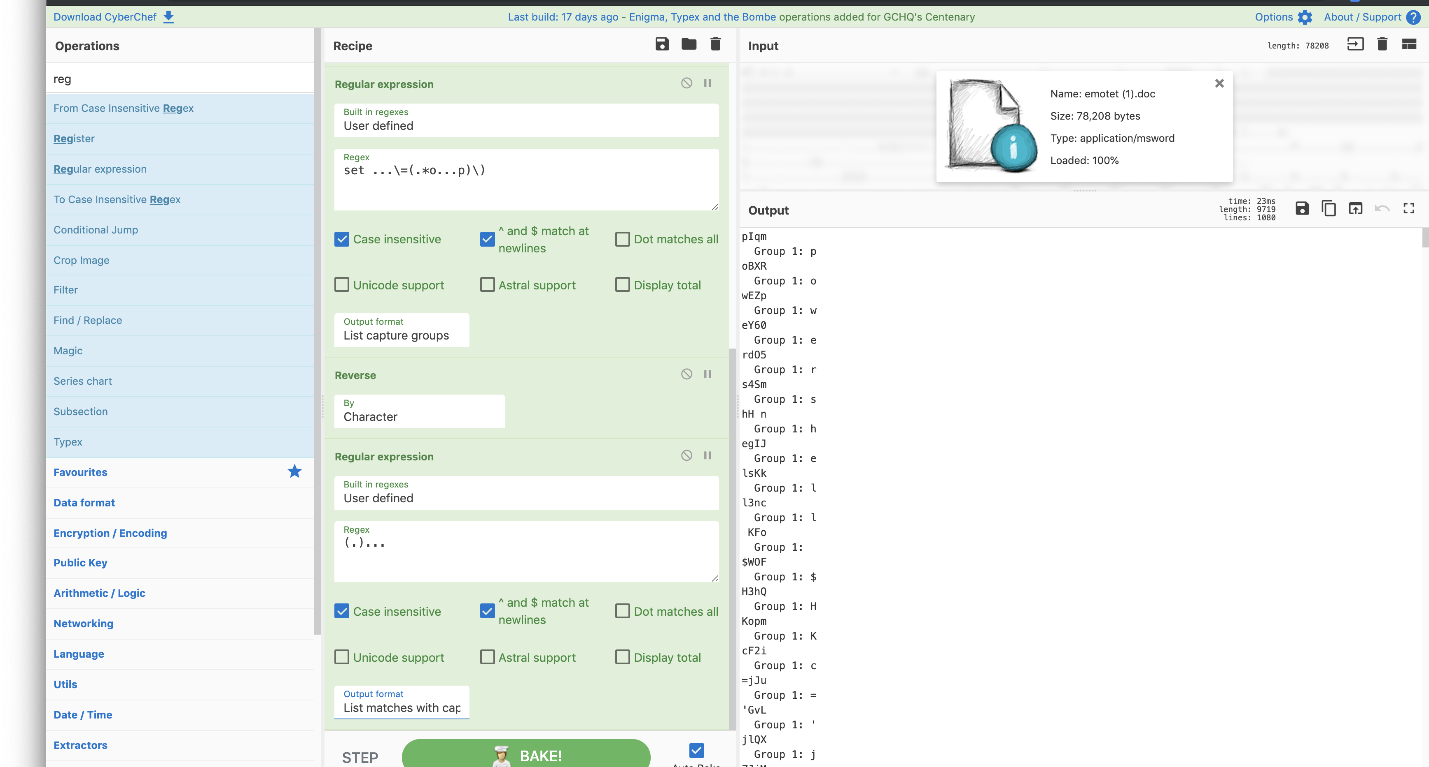
A Pattern Emerges!!!

Slide 34
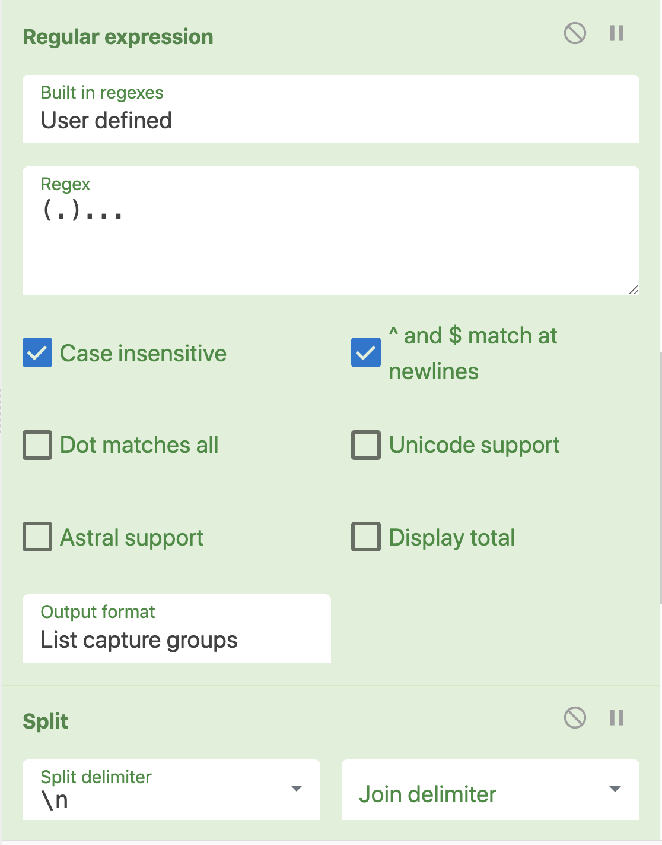
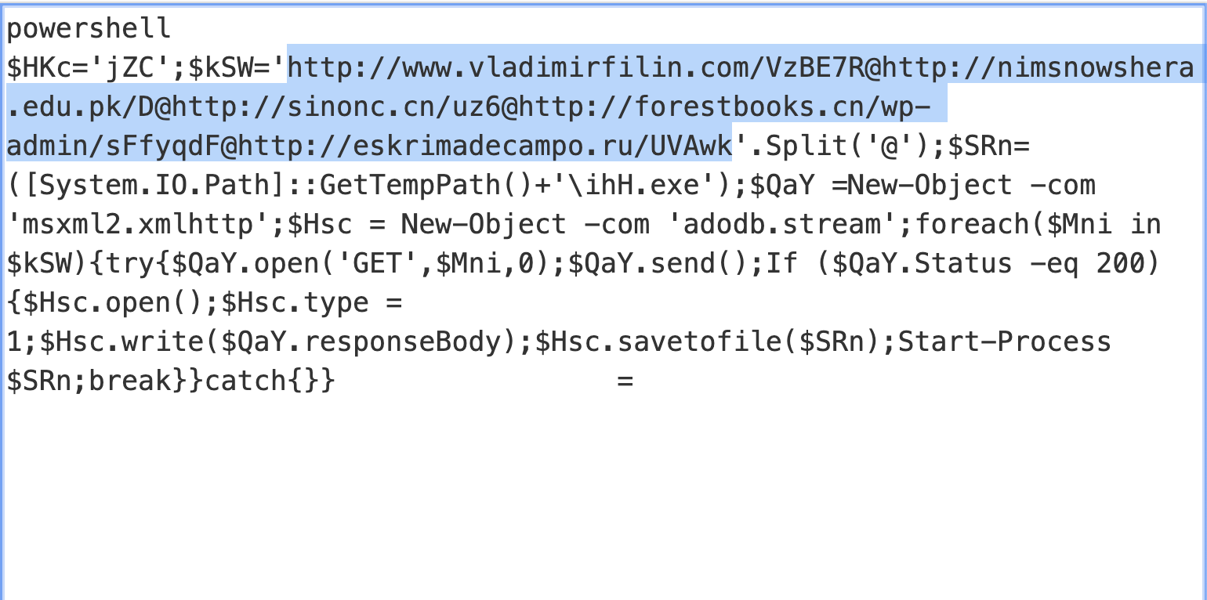
Now we have deobfuscated code for the downloader!!!

Slide 35
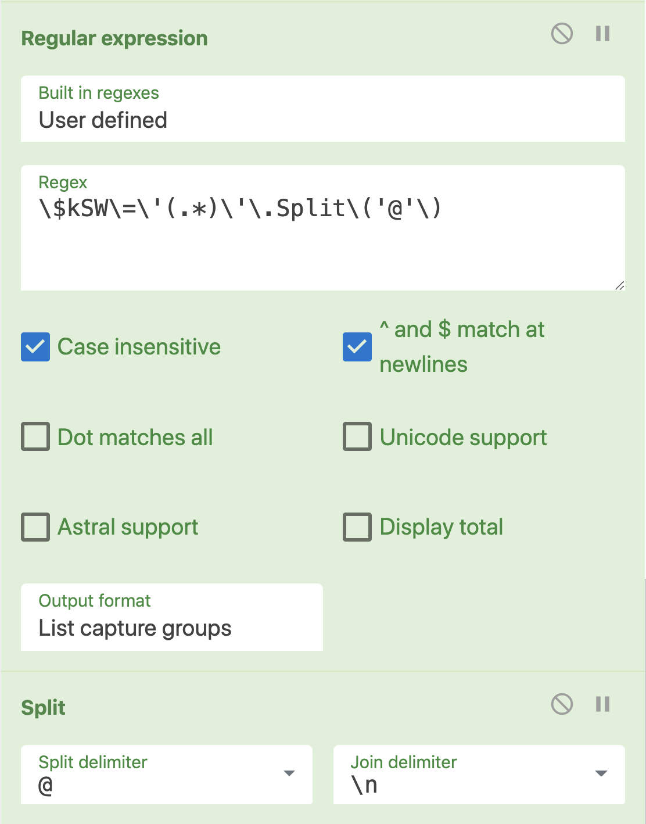
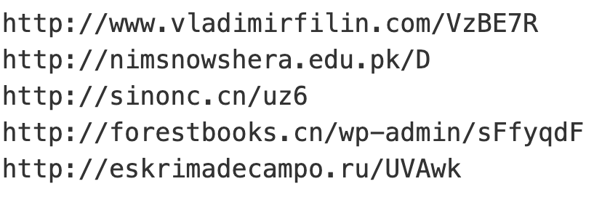
One final round of RegEx and using the Split Operator…
We have FIVE glorious C2 addresses for the price of one!

Slide 36
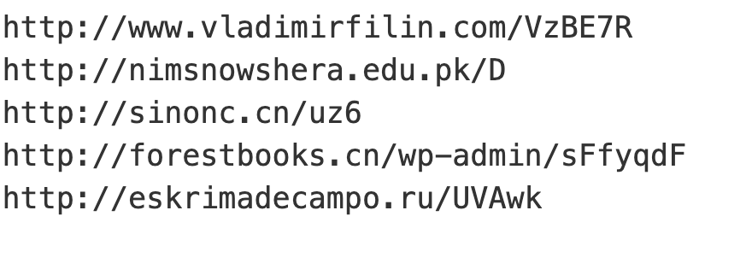
Structure from chaos in 8 Drag and Drop operations

Slide 37
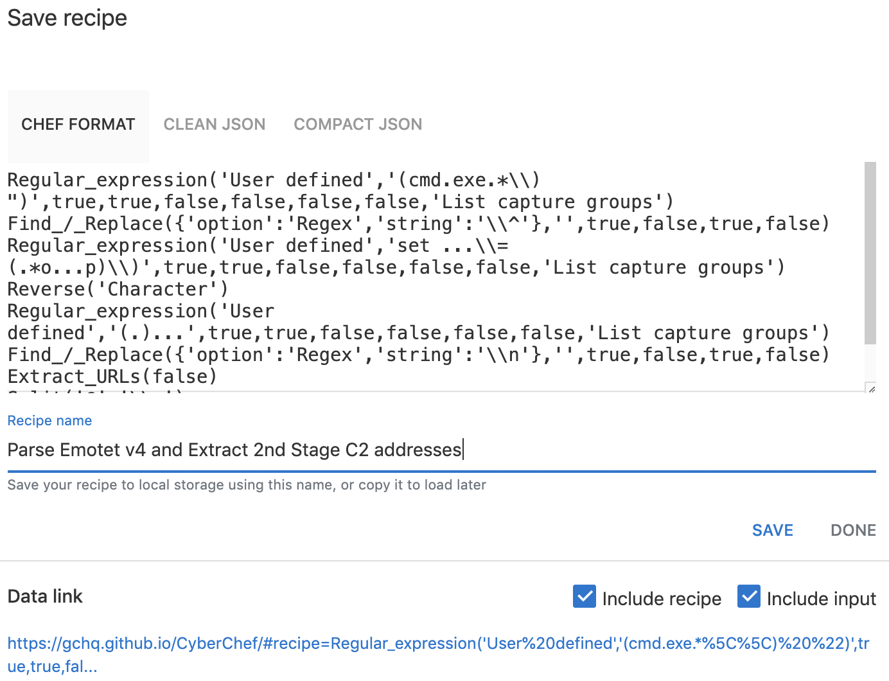
Not only easy but, repeatable!
Recipes can be saved to local storage for reuse, be given as gifts, or exchanged for beer.
Data Links can be stored as bookmarks

Slide 38
Large Recipes using CyberChef
Building a Parser for Windows Recycle Bin Metadata

Slide 39
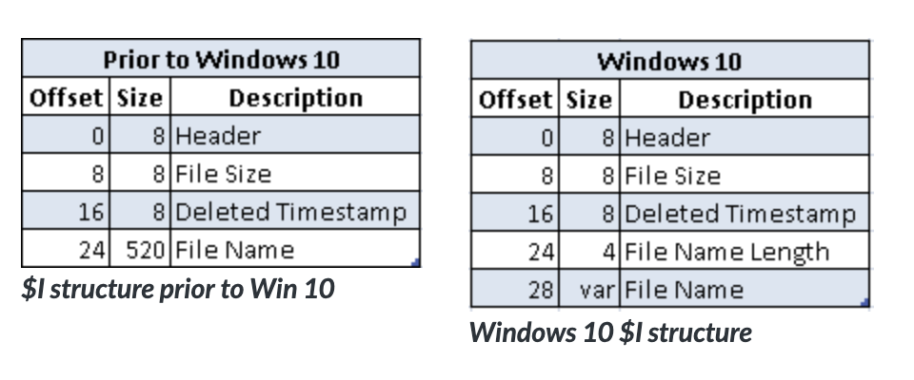
Parsing Windows Recycle Bin Metadata
Why? The simplest forensic artifact I can think of

Slide 40
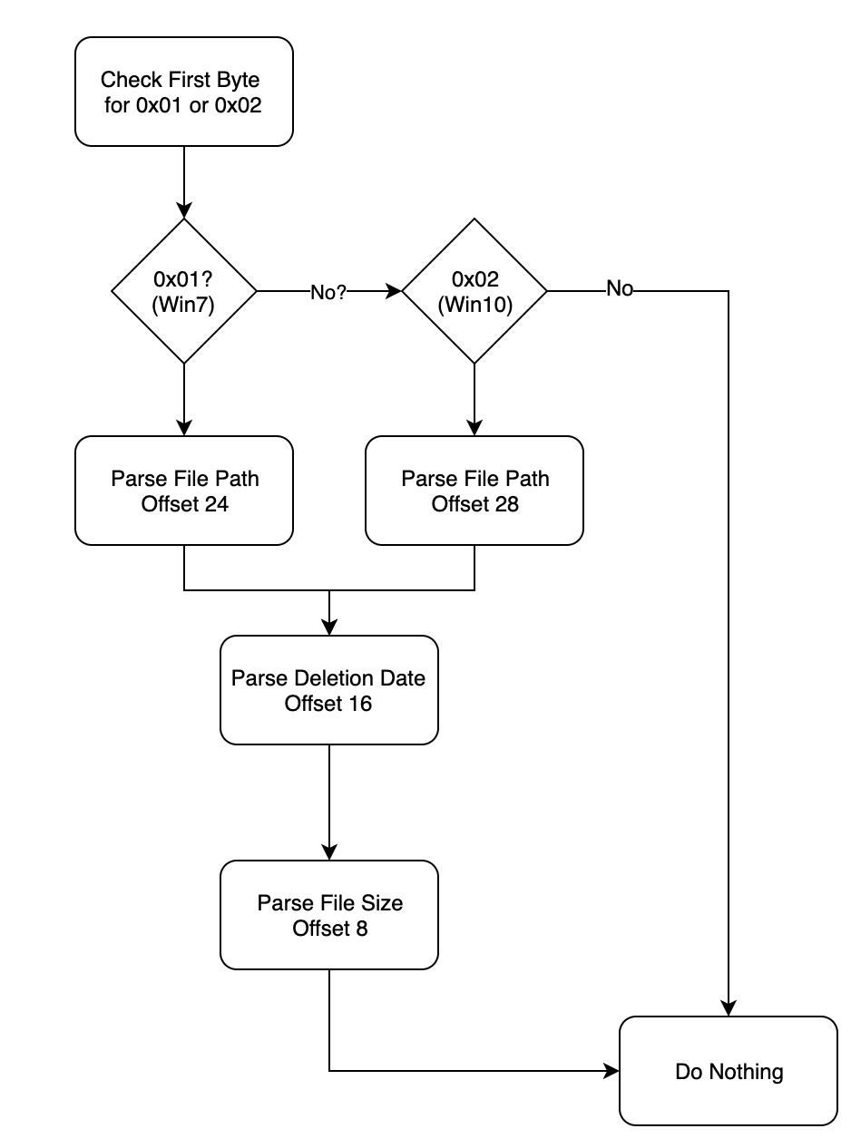
Using Native CyberChef to Parser Recycle Bin Meta
The idea is fairly simple as far parsers go

Slide 41
The Reality Ends Up being ~24 Steps
Conditional_Jump('^(\\x01|\\x02)',true,'Error',10)
Find_/_Replace({'option':'Regex','string':'^(\\x02.{23})(....)'},'$1',false,false,false,false)
Subsection('^.{24}(.*)',true,true,false)
Decode_text('UTF16LE (1200)')
Find_/_Replace({'option':'Regex','string':'^(.*).'},'\\nDeleted File Path: $1',false,false,false,false)
Merge()
Subsection('^.{16}(.{8})',false,true,false)
Swap_endianness('Raw',8,true)
To_Hex('None')
Windows_Filetime_to_UNIX_Timestamp('Seconds (s)','Hex')
From_UNIX_Timestamp('Seconds (s)')
Find_/_Replace({'option':'Regex','string':'^(.* UTC)'},'\\nFile Deletion Time: $1',true,false,true,false)

Slide 42
Merge()
Subsection('^.{8}(.{8})',true,true,false)
To_Hex('None')
Swap_endianness('Hex',8,true)
From_Base(16)
Find_/_Replace({'option':'Regex','string':'^(.*)'},'\\nDeleted File Size: $1 bytes',true,false,true,true)
Merge()
Find_/_Replace({'option':'Regex','string':'^.{8}'},'******** WINDOWS RECYCLE BIN METADATA ********',true,false,false,false)
Jump('Do Nothing',10)
Label('Error')
Find_/_Replace({'option':'Regex','string':'^.*$'},'This doesn\'t look like a Recycle Bin file to me ',true,false,true,false)
Label('Do Nothing')

Slide 43
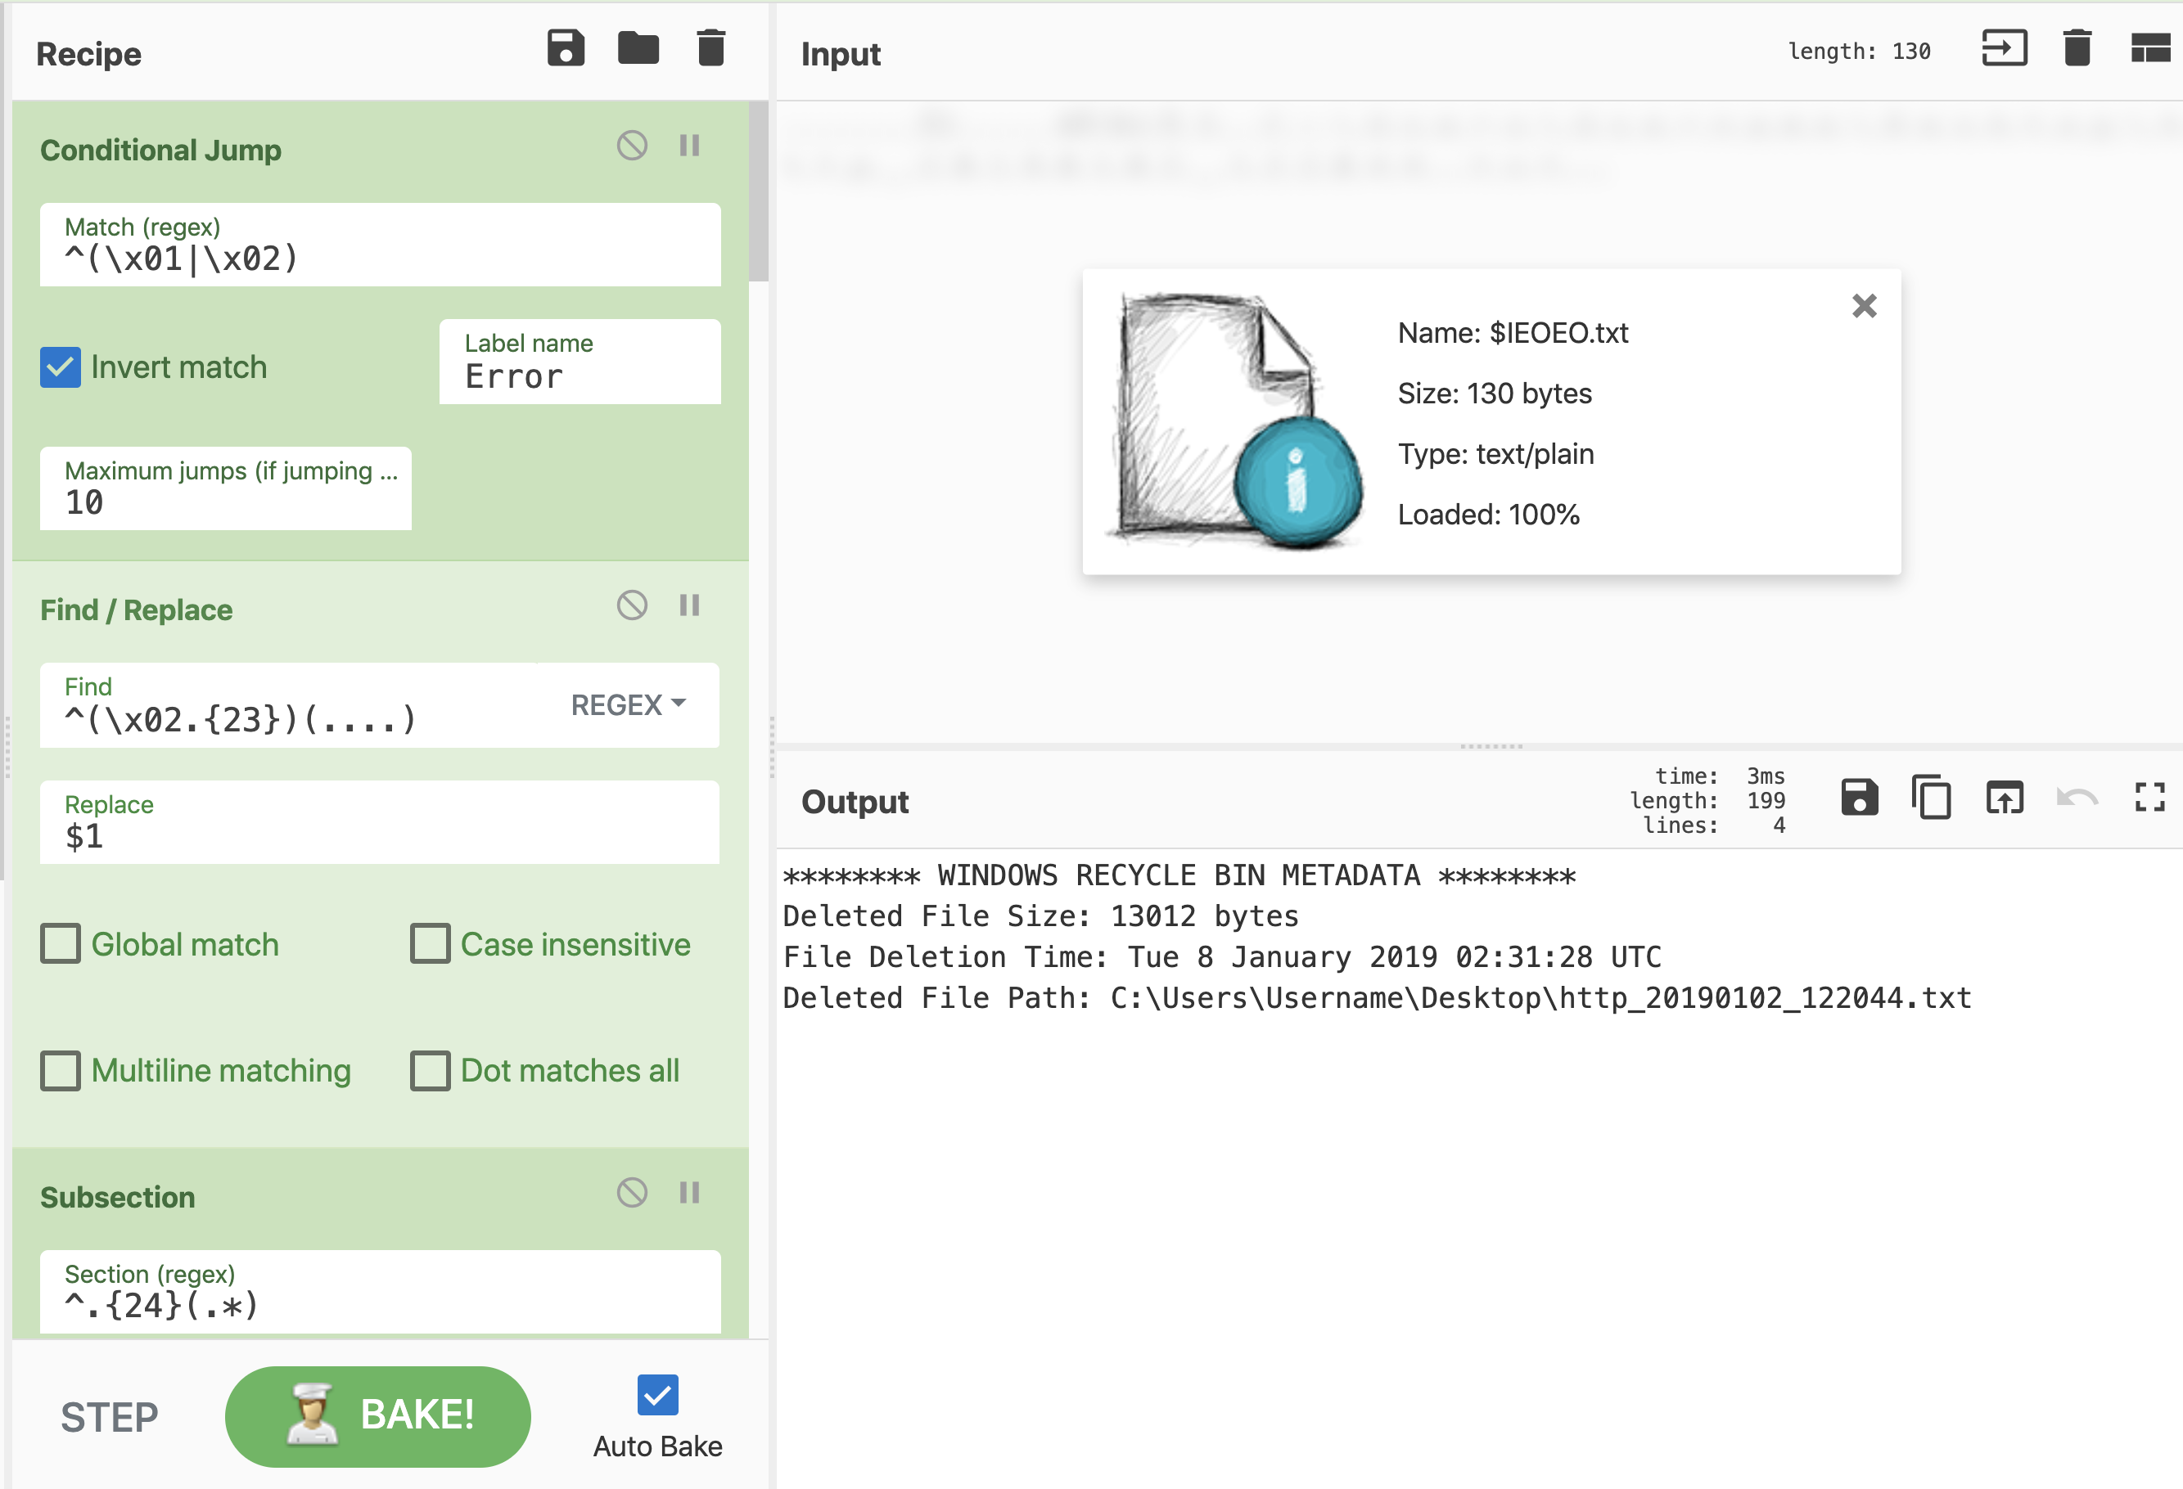

Slide 44
Advanced Use Cases
Building Custom Operations
Potential for Integration
Interacting with Active Content

Slide 45
Before you sell your soul to JavaScript…
Rolling your operations can be really helpful but…
How good is your JavaScript writing really?
If you are going to be coding to do DFIR work, you probably should just be using Python
Better Community support
Better memory management
Better Syntax
Now that you have been cautioned…
LET’S LOOK AT AN EXAMPLE I DID JUST TO PROVE IT COULD BE DONE!

Slide 46
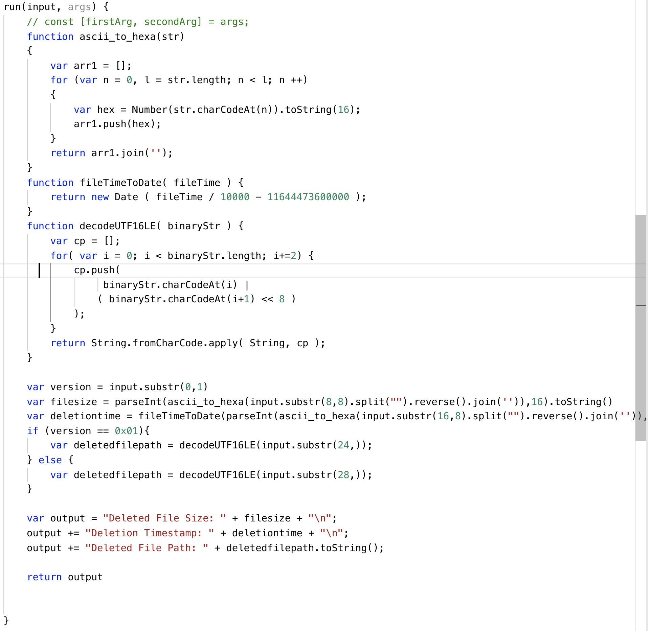
Coding Time!
A Windows RecBin Parser in JavaScript
Features:
Converting Windows FILETIME object to Date
Converts UTF-16LE File Path to UTF-8
Converts LE File size to decimal
Overall, not horrible.
Probably could be written better if I am being honest but it works

Slide 47
Output is fairly clean…

Slide 48
Potential for Integration

Slide 49
How to get CyberChef to talk to VirusTotal… at your own risk
Download CyberChef
Open Chrome with web protections turned off
“--disable-web-security”
HTTP Request Operation
https://www.virustotal.com/vtapi/v2/file/download?apikey=yourkey &hash=yourhash
https://stackoverflow.com/questions/3102819/disable-same-origin-policy-in-chrome

Slide 50
Download Samples

Slide 51
VirusTotal Query Reports

Slide 52
Interacting with Live Content
Not for the faint of heart
Recommended for Sandboxes Only

Slide 53
Hand to Hand Combat with Malicious JavaScript

Slide 54
Lessons Learned
Tips and Tricks

Slide 55
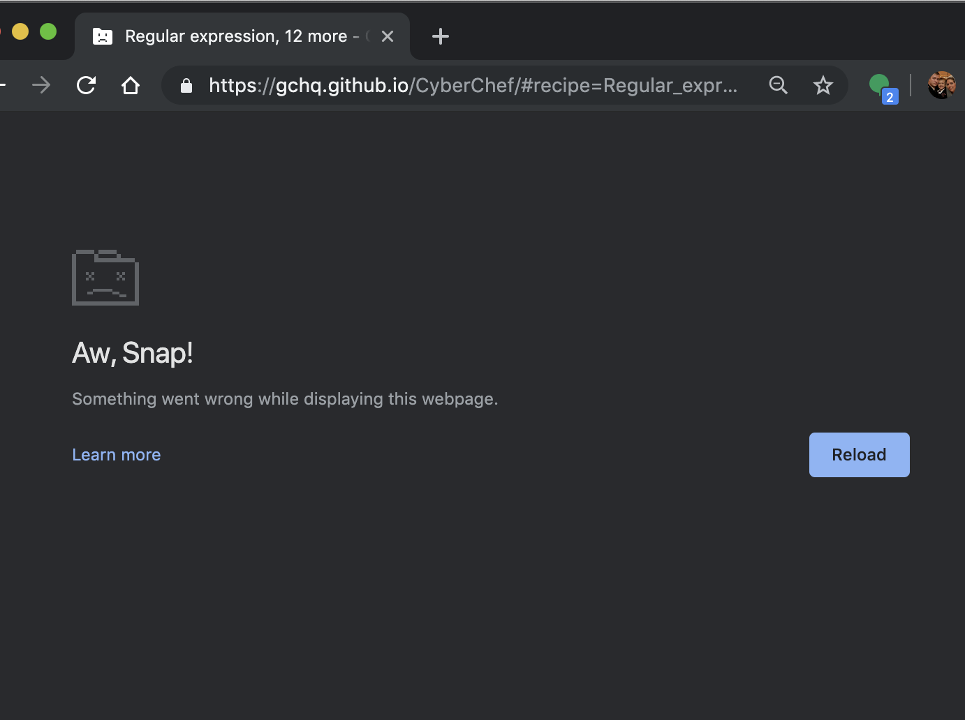
Not ideal for everything
Memory management being what it is, don’t be surprised if a large file knocks it over.
Don’t parse a whole $MFT
Don’t parse a whole memory dump
Take Bytes, Drop Bytes, and RegEx can help make the data more manageable but they aren’t miracle workers.
Use the right tool for the right job.

Slide 56
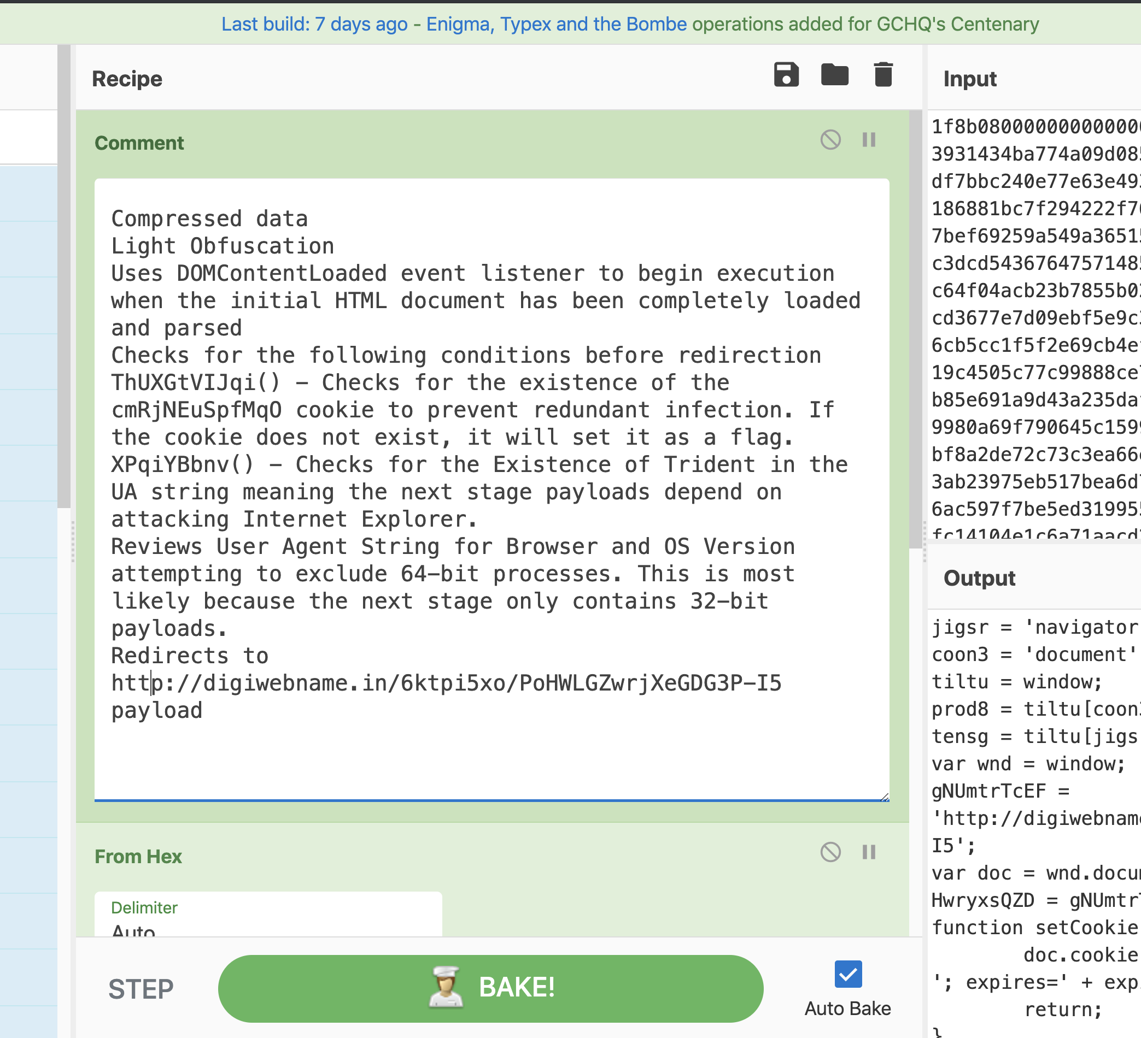
Use The Comment Field Like Notepad
Helps to not have to switch back and forth to take notes.
Comments do not effect the operation but can be saved into the Recipe!
Comment Early and Comment Often

Slide 57
Mind Meld with Your Friends!

Slide 58
Turn off “Auto Bake” unless you need it
Auto Bake runs the recipe whenever anything changes in the input or the recipe
Can cause issues when designing steps

Slide 59
The Value
Practical Applications
Data Manipulation
Deobfuscation Malware
Forensic Artifact Parsing
Advanced Use Cases
Building Custom Operations
Potential for Integration
Interacting with Active Content
Lessons Learned

