Slide 1
Code Signing: A Security Control That Isn’t Secured
Eddie Glenn
May 23, 2019

Slide 2
How many work for companies that develop & provide software to third parties, like customers?
How many work for companies that rely on software for internal infrastructure?
How many know what code signing is?
How many work closely with your software development organization to protect code signing identities?
How many actively protect your code signing machine identities?

Slide 3
Why should you and your organization care about code signing?
After all, it’s been around since the 1990’s

Slide 4
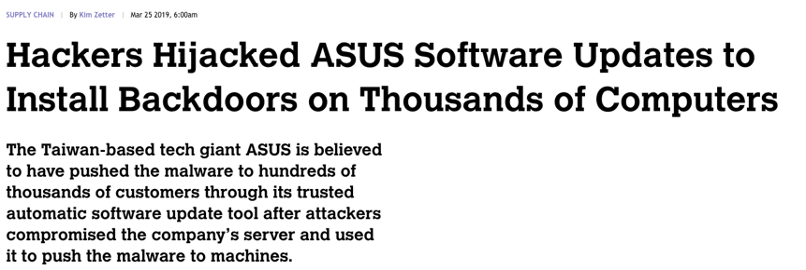
Operation ShadowHammer
In January 2019, Kaspersky Labs reported an ASUS compromise that they named Operation ShadowHammer.
Source: motherboard.vice.com
Notes:
Good references:
https://www.thesslstore.com/blog/code-signing-compromise-installs-backdoors-on-thousands-of-asus-computers/
https://motherboard.vice.com/en_us/article/pan9wn/hackers-hijacked-asus-software-updates-to-install-backdoors-on-thousands-of-computers

Slide 5
The Mechanics of Operation ShadowHammer
ASUS updates are digitally signed (code signed) to show they originate from ASUS and have not been tampered with by a third party.
ASUS Live Update
server
Live Updates
Most ASUS computers are configured to automatically install updates as long as they have a valid digital signature.
ASUS computers
Source: motherboard.vice.com,
thesslstore.com
Notes:
Good references:
https://www.thesslstore.com/blog/code-signing-compromise-installs-backdoors-on-thousands-of-asus-computers/
https://motherboard.vice.com/en_us/article/pan9wn/hackers-hijacked-asus-software-updates-to-install-backdoors-on-thousands-of-computers

Slide 6
The Mechanics of Operation ShadowHammer
ASUS stored at least two private code-signing keys on this server.
ASUS Live Update
server
Hackers broke into the ASUS Live Update Server and discovered the private code-signing keys
Live Updates
Live Updates
1 MILLION COMPUTERS IMPACTED
They inserted malware into a legitimate ASUS update and then code-signed it with the private keys
Client computers saw the valid, signed update and automatically installed it. Their computers became infected with the hackers malware.
ASUS computers
Notes:
Good references:
https://www.thesslstore.com/blog/code-signing-compromise-installs-backdoors-on-thousands-of-asus-computers/
https://motherboard.vice.com/en_us/article/pan9wn/hackers-hijacked-asus-software-updates-to-install-backdoors-on-thousands-of-computers

Slide 7
The Impact of Operation ShadowHammer
What is the potential impact of this on ASUS’s business?
Lost Revenue
Lost Market Share
Hit on Brand Reputation
Liability
Regulatory Fines?
ASUS Live Update
server
Live Updates
Live Updates
ASUS computers
Notes:
Good references:
https://www.thesslstore.com/blog/code-signing-compromise-installs-backdoors-on-thousands-of-asus-computers/
https://motherboard.vice.com/en_us/article/pan9wn/hackers-hijacked-asus-software-updates-to-install-backdoors-on-thousands-of-computers

Slide 8
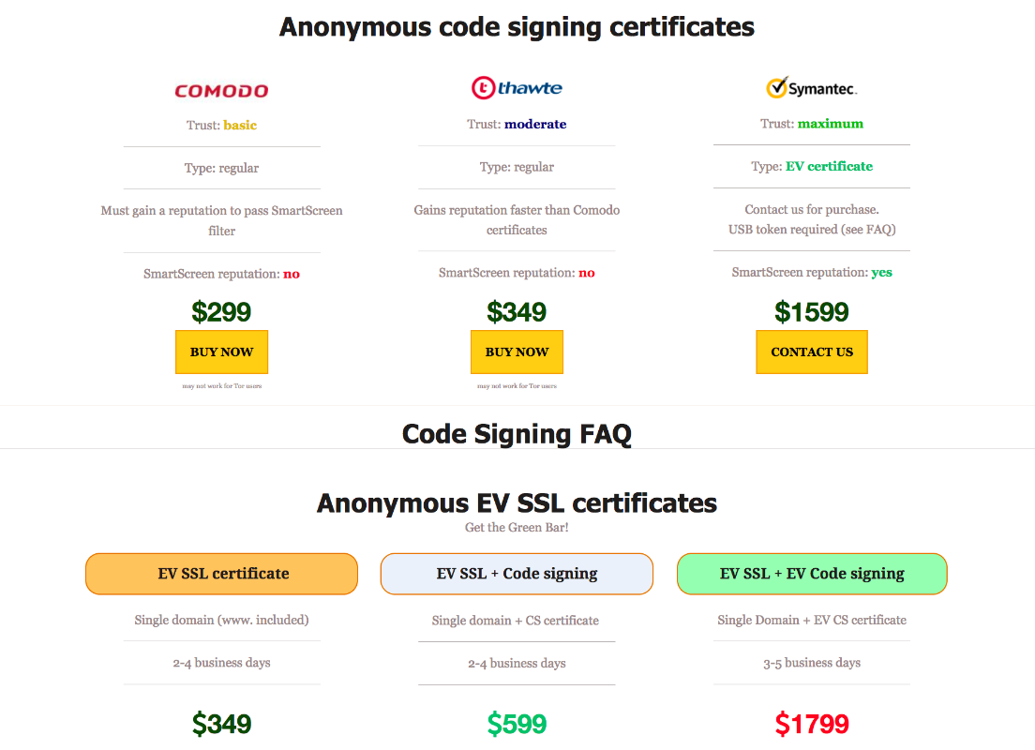
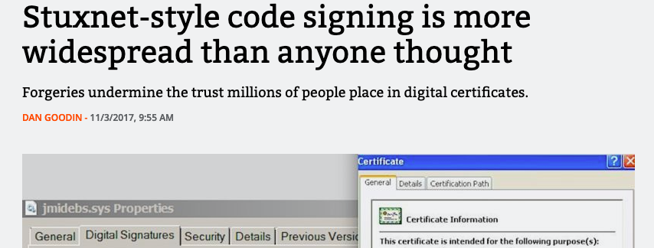
ASUS Is Just the Latest Incident
THE THREAT TO BUSINESSES IS REAL.
The protection of code-signing keys and certificates is critical to protecting today’s businesses.

Slide 9
ALL BUSINESSES ARE NOW SOFTWARE BUSINESSES
CODE IS CRITICAL
TO YOUR BUSINESS
Software for Digital Transformation
All businesses are now software businesses
Software for Internal Infrastructure
Software as Your Product

Slide 10
Agenda
1
Code signing business risks
2
A code signing refresher
3
5 common challenges that businesses face
4
5 best practices to secure your code-signing process
Summary/Conclusions
Notes:
During this session, you’ll learn about code signing

Slide 11
//
What Is Code Signing?
During this session, you’ll learn about code signing:

Slide 12
What Is Code Signing?
A technique that uses a certificate-based digital signature to “sign” computer executables (code) to:
Verify the author’s identity
Ensure that code has not been changed or corrupted since it was signed

Slide 13
Code-Signing Certificates and Keys:
Equivalent to a birth certificate for the code
Forged or stolen birth certificates can cause huge problems
Unprotected code signing certificates and keys can cause even bigger problems
Even though code signing has been around for decades as a means to protect code, their keys and certificates are more vulnerable than ever

Slide 14
What is Code?
Anything That Can Execute on a Computing Device
Computer Programs, Drivers, Firmware, ISO
Mobile Apps and Software
Code
Shell Scripts
Operating Systems
Application Containers

Slide 15
Why Sign Code?
SCENARIO 1: Externally Distributed Code
Protect the software that you deliver to your customers
They know it comes from you
They know that it hasn’t been modified by a third party
Protect your business
Prevent cybercriminals from distributing malware in your company’s name
Notes:
https://www.istockphoto.com/photo/young-businessman-analyze-stock-report-on-notebook-screen-concept-of-digital-screen-gm855066494-140610965

Slide 16
Why Sign Code?
SCENARIO 2: Internally Used Code
Protect your business
Only software from trusted sources can be used by employees
Identifying trusted code by adding your own signature to third-party code
Critical software infrastructure is protected by malicious or accidental modification

Slide 17
Inadequate Security Can Cause Big Problems
TLS/SSL Certificates
Code Signing
Expire after a period of time
Assigned to a specific IP address
Code, if timestamped when signed, NEVER expires
Code-signing certificates are assigned to your ORGANIZATION
Anyone can use your keys to sign ANYTHING, including malware
A code-signing certificate is essentially a “wildcarded SSL/TLS certificate”
If stolen, the damage is minimal. The thief can’t do much with the certificate.
If stolen, a hacker can sign malware with your keys and distribute on the internet. And it’s there forever.
And it appears to be legitimate code originating from your business.
What kind of damage could that do to your business?

Slide 18
A 1990’s Problem
SW Dev Co
How will the user know which is the authentic software that is safe to download?
The Internet
Malicious 3rd Party

Slide 19
A 1990’s Solution – Code Signing
Signed code indicates who the real author is and that code hasn’t been modified since it was signed
Certificate Authority
SW Dev Co
The Internet
Malicious 3rd Party

Slide 20
A 2019 Problem
Certificate Authority
SW Dev Co
Which is the correct/safe code to download?
Thousands of developers
Thousands of signing operations a week
Multiple development environments & processes
DevOps & Agile
The Internet
Malicious 3rd Party

Slide 21
Software Development in 2019
PKI Admin
Division of Labor
Team Work
Collaboration
Scalability
Security
Accountability
Secure and control access of private keys and enforce policies on the keys and certificates issued to projects
Project Manager
Administer and control the membership of the project and its associated certificates, users, processes for signing
Developers
Sign software without obtaining a copy of private key and certificate

Slide 22
How do enterprises cope?
DEVELOPER: “I need a cert and private key, please.”
DEVELOPER: “Here’s my code. I need it signed ASAP!”
Insecure private keys.
Private key sprawl.
Slow response.
Increased resources.
Frustration.
PKI Admin: “Here’s your order. Please keep it safe. Have a nice day.”
PKI Admin: “Ok, we’ll do it & get back to you sometime next week. Have a nice day.”

Slide 23
Code Signing Process: 5 Common Challenges

Slide 24
Challenge 1: Private Key Sprawl and Security
Enterprises have hundreds or thousands of developers, developing hundreds or thousands of apps and versions of apps
Where are all of the code signing private keys stored?
Are they secure?
Have any been compromised?
Who has access to private keys?

Slide 25
#2: Lack of Visibility Into What Has Been Signed
What code has been signed?
Where did the certificate come from? Was it the correct certificate?
Is code internally signed? Or signed with an external certificate?
Who signed?

Slide 26
#3: Lack of Governance and Control Over Signing
Are code signing processes defined?
Is there compliance with defined code-signing processes?
Are only authorized people signing?
Are the right certificates being used?
Did proper approvals occur?

Slide 27
#4: Lack of Automation
Process of certificate issuance, acquisition and renewal is a manual process
Labor intensive, time consuming, error prone and hard to track
Developers use automated tools to build their software and want automated tools to sign their software
Certificate revocation is tedious to do without automation

Slide 28
#5: Your Group Isn’t Involved with Code Signing
Your development organizations keep you at arm’s length because they don’t want to be slowed down
There are many different development organizations, often distributed globally

Slide 29
BONUS: Your Group Has Become the Bottleneck
You have code-signing processes that are considered cumbersome and slow by agile development organizations
You have a limited staff that can’t respond to all requests in a timely manner
You’re a single group supporting many different development groups

Slide 30
A digital signature is no longer enough…
Businesses need to secure their code signing process
Notes:
https://www.istockphoto.com/photo/signing-contract-lease-or-settlement-for-acquisition-apartment-lease-insurance-bank-gm1065782140-285008745

Slide 31
//
Securing Your Code-Signing Process
5 Best Practices

Slide 32
Securing the Code-Signing Process
Centrally Secure All Private Keys
Know Who Has Signed What, Where, When and With What Certificate
Control Who Has Access to Sign, Who Needs to Approve, etc.
Provide an Automated, Low-Hassle Solution for Your Dev Teams
Show Compliance

Slide 33
Centrally Secure All Private Keys
Private keys used for code signing are machine identities that must be protected in central, secure locations:
An HSM for EV
Cryptographically secure location for OV
They should not be stored on
Developers’ personal workstations …
Nor build servers …
Nor web servers …
Centrally Secure All Private Keys
Notes:
https://www.istockphoto.com/photo/high-angle-view-of-office-worker-working-on-computer-gm860536912-142429259
https://www.istockphoto.com/photo/female-it-engineer-working-in-server-room-gm971101242-264528676

Slide 34
Know Who, What, Where and When
Always have an inventory of code that is signed
Know who signed what code
Know what certificates were used to sign code
Know who approved
Know when it was signed
FOR ALL OF YOUR COMPANY’S SIGNED CODE
If your team was asked how many code-signing certificates are in use, would you know?
If you discovered malware on the internet signed with one of your certificates, how quickly could you track down the responsible group?
If your development teams use certificate authorities of their choice, would you even know where to start looking?
Do you know which development teams are code signing?
Are you able to provide a complete audit report of who signed what and when?
Know Who Has Signed What, Where, When and With What Certificate
Notes:
https://www.istockphoto.com/photo/vintage-detective-looking-through-a-magnifier-gm501362758-81289913

Slide 35
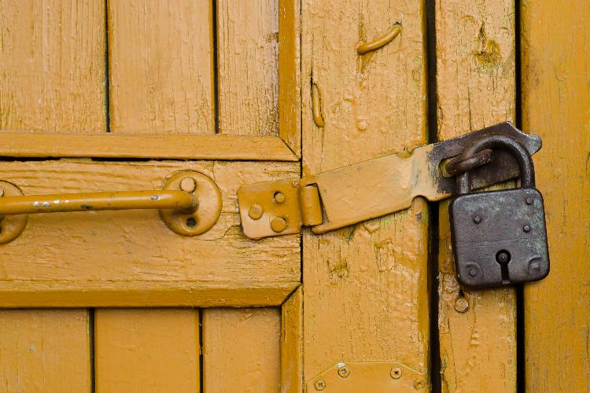
Control Access and Define Workflows
Define, implement, and enforce code-signing workflows
Define who has access to use specific private keys
Define who has approval rights to approve when private keys are used
One size may not fit all
Create different workflows for the different types of projects being signed
Automation is key to implementing, enforcing and getting people to WANT to use the platform
Control Who Has Access to Sign, Who Needs to Approve, etc.
Notes:
https://www.istockphoto.com/photo/old-padlock-on-a-yellow-wooden-door-gm958503362-261728030

Slide 36
Be a Source of Value to Your Development Teams
Learn what drives them, what their concerns are, what their issues are
Do you ever feel at odds with your development organizations?
Do they think that your team slows them down?
Do they think you just add more “rules”?
Do they resist your team’s attempts at better process?
Provide an Automated, Low-Hassle Solution for Your Dev Teams
Notes:
https://www.istockphoto.com/photo/old-padlock-on-a-yellow-wooden-door-gm958503362-261728030

Slide 37
#1 Priority:
Get Quality Code out Quickly
Multiple Development Teams, Different Development Tools
Don’t Mess with My Development Tools!
Don’t Slow Me Down!
Usually not CS or PKI Experts
Development Organization

Slide 38
Be a Source of Value to Your Dev Teams
Learn what drives them, what their concerns are, what their issues are
Provide an Automated, Low-Hassle Solution for Your Dev Teams
Offer a code-signing solution that adds value for them:
Seamlessly integrates with their existing tools
No added effort on their part
Works as quickly as signing does for them today
Eliminates the hassle of their teams tracking certificates, keys, knowing about PKI, etc. —all of that is done automagically for them
CREATE A WIN-WIN SITUATION!
Notes:
https://www.istockphoto.com/photo/old-padlock-on-a-yellow-wooden-door-gm958503362-261728030

Slide 39
Be Able to Show Compliance
When you follow the previous strategies, you end up with:
Private keys stored in a secure, central location
Knowing who has signed what, with what key, who approved, when it was signed, etc.
Knowing workflows are being enforced with required approvals and that they can be varied as project needs vary
Knowing your development teams are not straying from company policy because you have provided them a solution that adds value for them
And the ability to report on all of your company’s code-signing activities
Be Able to Show Compliance
Notes:
https://www.istockphoto.com/photo/old-padlock-on-a-yellow-wooden-door-gm958503362-261728030

Slide 40
Summary
Solving Your Challenges
Stopping private key sprawl
Insecure private keys
No visibility
No accountability
No automation
Best Practices
Centrally secure all private keys
Know who, what, where, when
Control access
Automate & support dev teams
Show compliance

Slide 41
Thank You
Eddie Glenn
eddie.glenn@venafi.com

