Slide 1
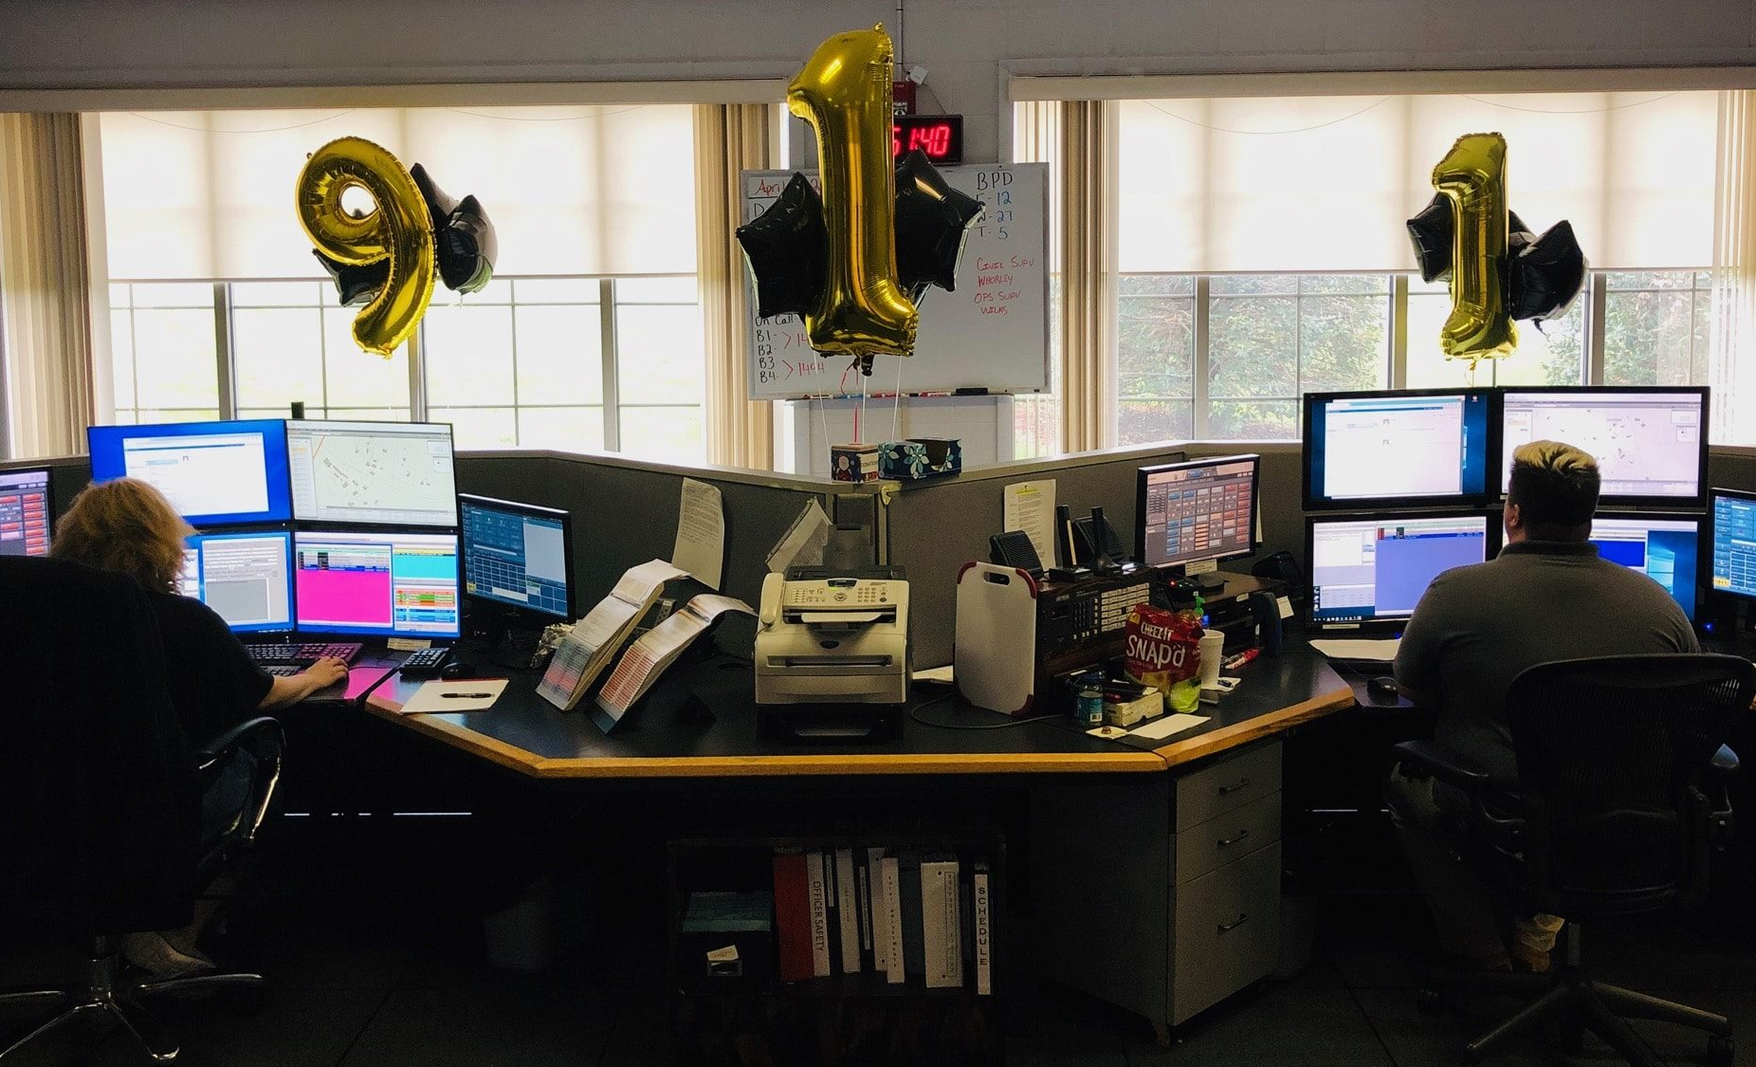
Secure 911 and Protecting our First Responders
Christine Giglio
CAD Administrator
Department of e-911 communications
Bedford County, VA

Slide 2
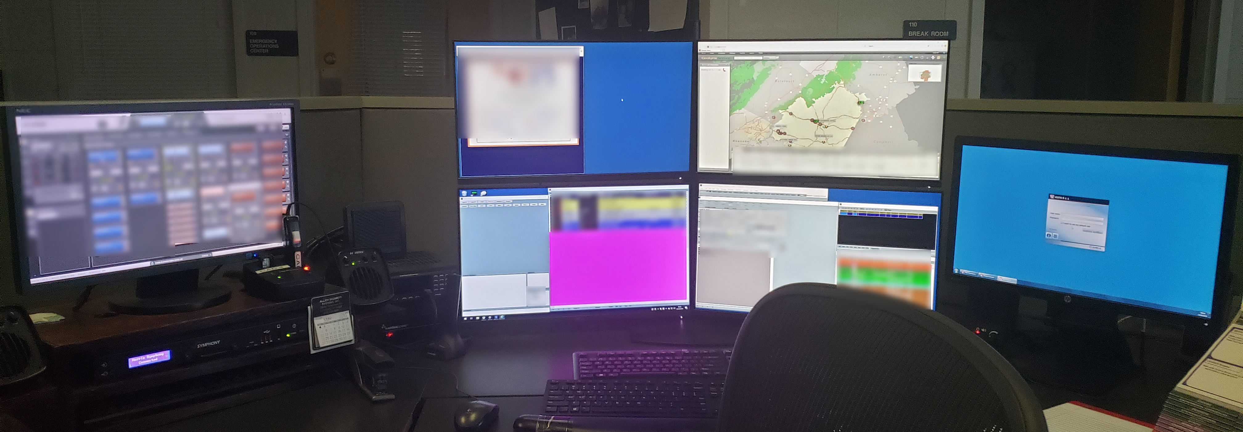
WHAT IS 9-1-1 MADE OF?

Slide 3
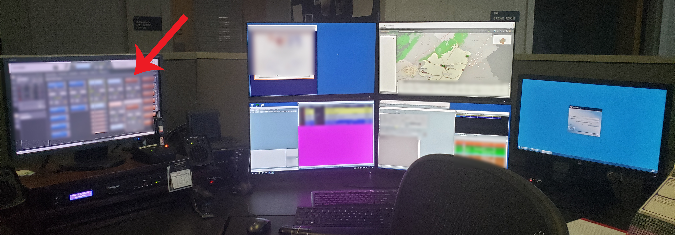
RADIO

Slide 4
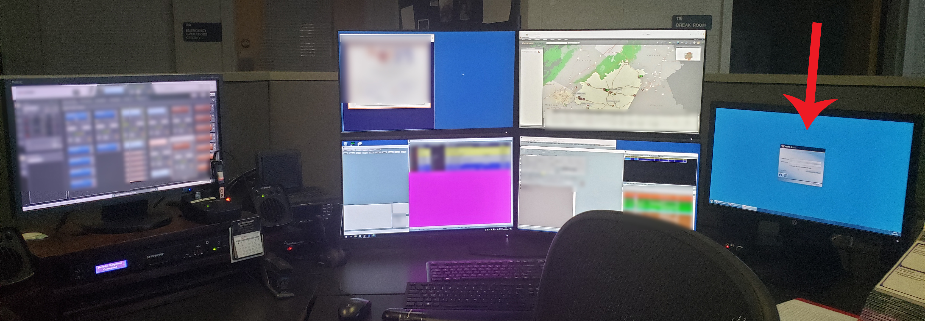
PHONE

Slide 5
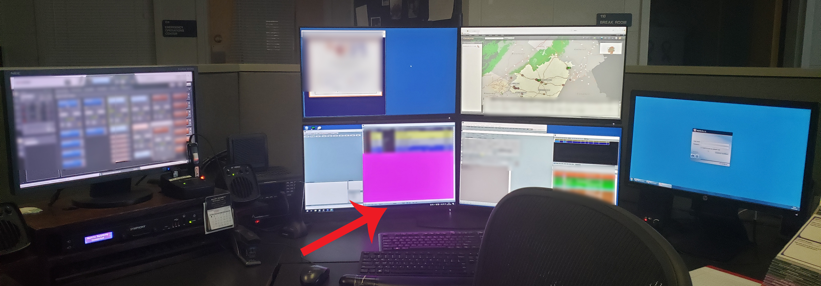
COMPUTER AIDED DISPATCH

Slide 6
PHONE SYSTEM
911 LINES | NON-EMERGENCY/ ADMIN LINES
PUBLIC SWITCHED TELEPHONE NETWORK (PSTN) / E-911/911 WIRELESS TRUNKGROUPS WIRELINE TRUNKGROUPS | ANALOG WILL STAY ANALOG AFTER NG 911 CONVERSION
NEXTGEN 911 (NG 911) EMERGENCY SERVICES IP NETWORK (ESInet) VoIP

Slide 7
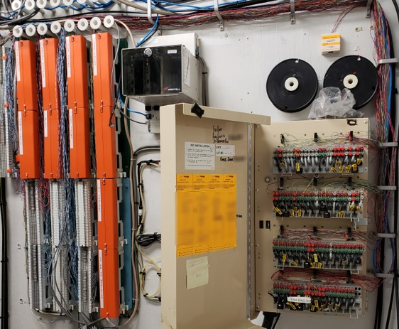
TELEPHONY DENIAL OF SERVICE
TDoS

Slide 8
TELEPHONY DENIAL OF SERVICE
TDoS
IT’S EASIER THAN YOU THINK!

Slide 9
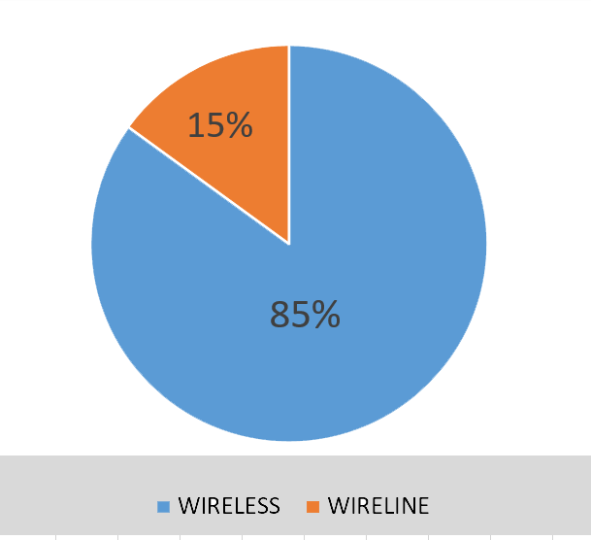
TDoS
911 LINES

Slide 10
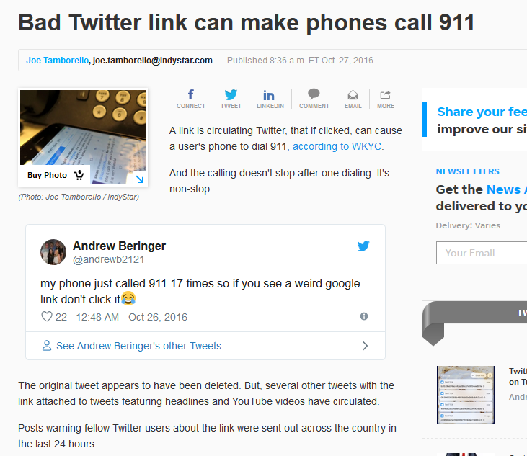

Slide 11
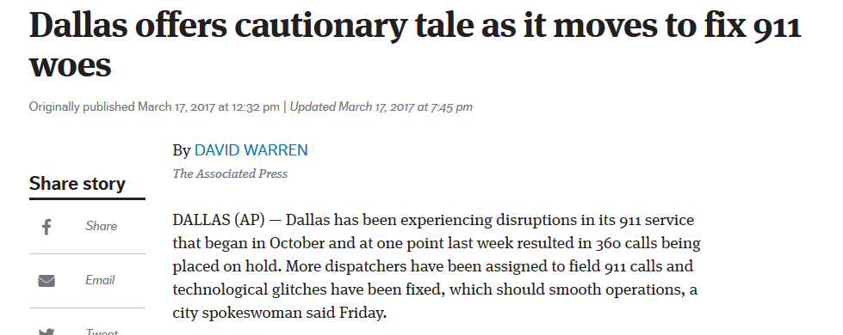

Slide 12
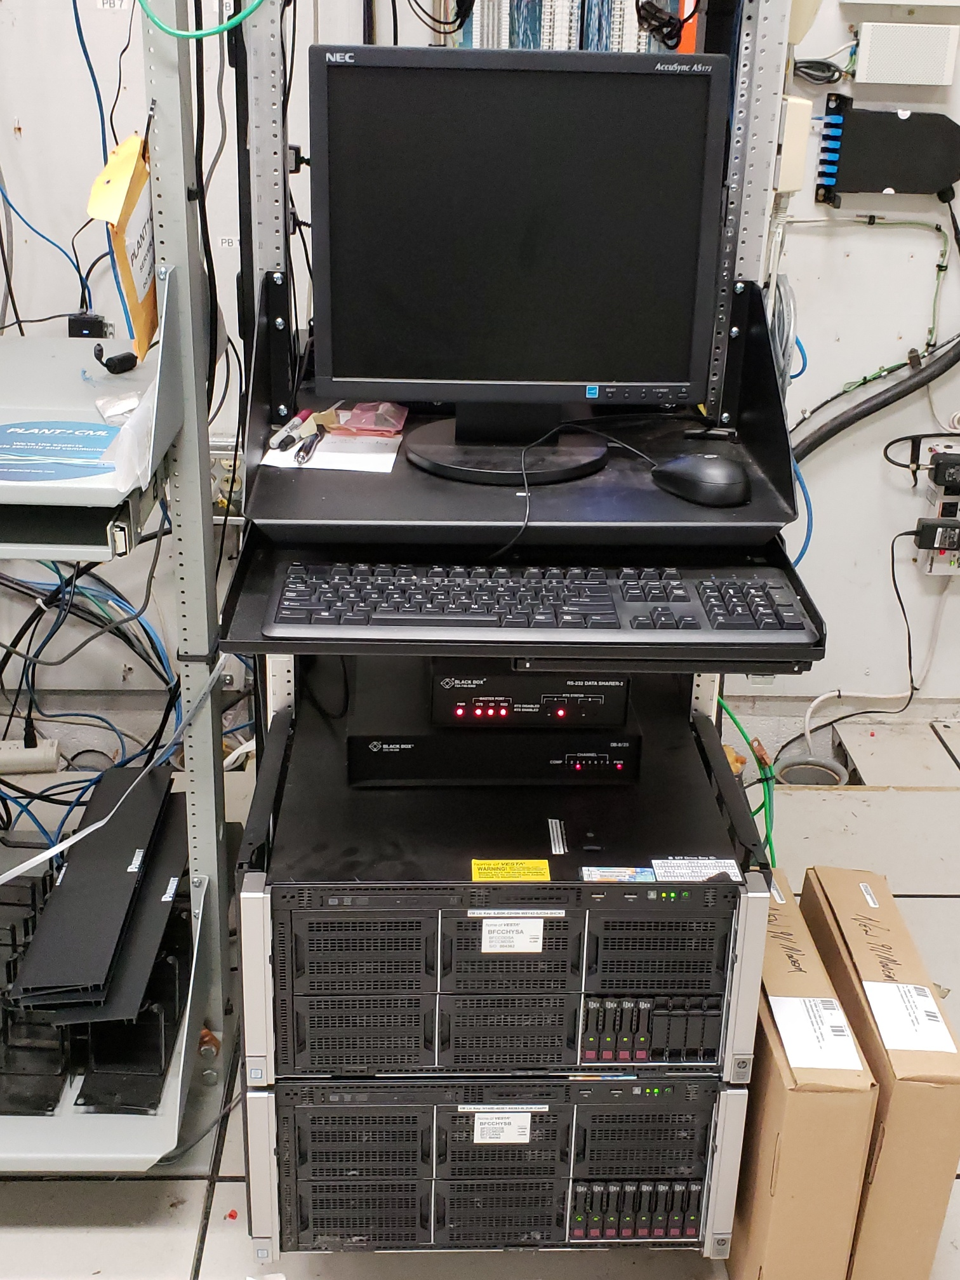
TDoS
NON-EMERGENCY LINES

Slide 13
TDoS
NON-EMERGENCY LINES
THESE PHONE LINES
ARE ALSO IMPORTANT

Slide 14
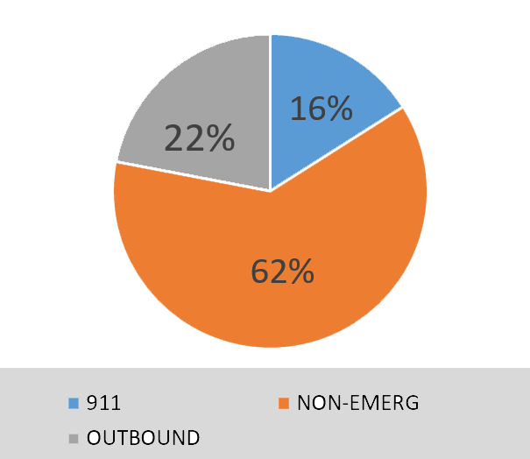
TDoS
NON-EMERGENCY LINES

Slide 15
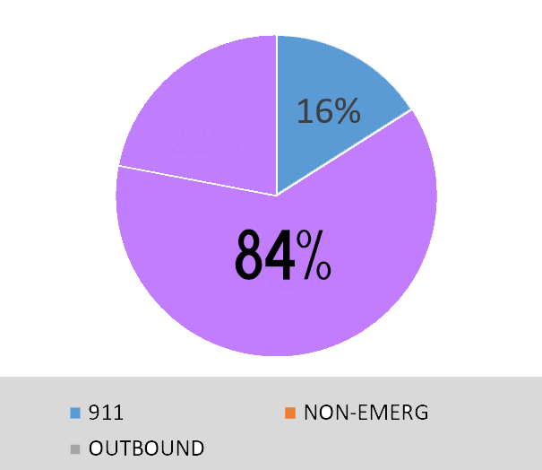
TDoS
NON-EMERGENCY LINES

Slide 16
TDoS
NEXTGEN 911
SAME RISKS
MORE BENEFITS

Slide 17
COMPUTER AIDED DISPATCH
CAD NETWORK
CAD | LAW ENFORCEMENT/ CJIS
MAPPING – GIS SOCIAL SECURITY NUMBERS MEDICAL INFO (EMS CALLS) | SOCIAL SECURITY NUMBERS ACTIVE INVESTIGATIONS WARRANTS
INTERNAL ALI UNITS FOR STATE/LOCAL PD | CRIMINAL JUSTICE INFORMATION SYSTEM (CJIS)

Slide 18
PHONE SYSTEM CAD NETWORK
AUTOMATIC NUMBER IDENTIFICATION (ANI)
AUTOMATIC LOCATION IDENTIFIER (ALI)
TEXT TO 911 MESSAGES
VIDEO
PICTURES

Slide 19
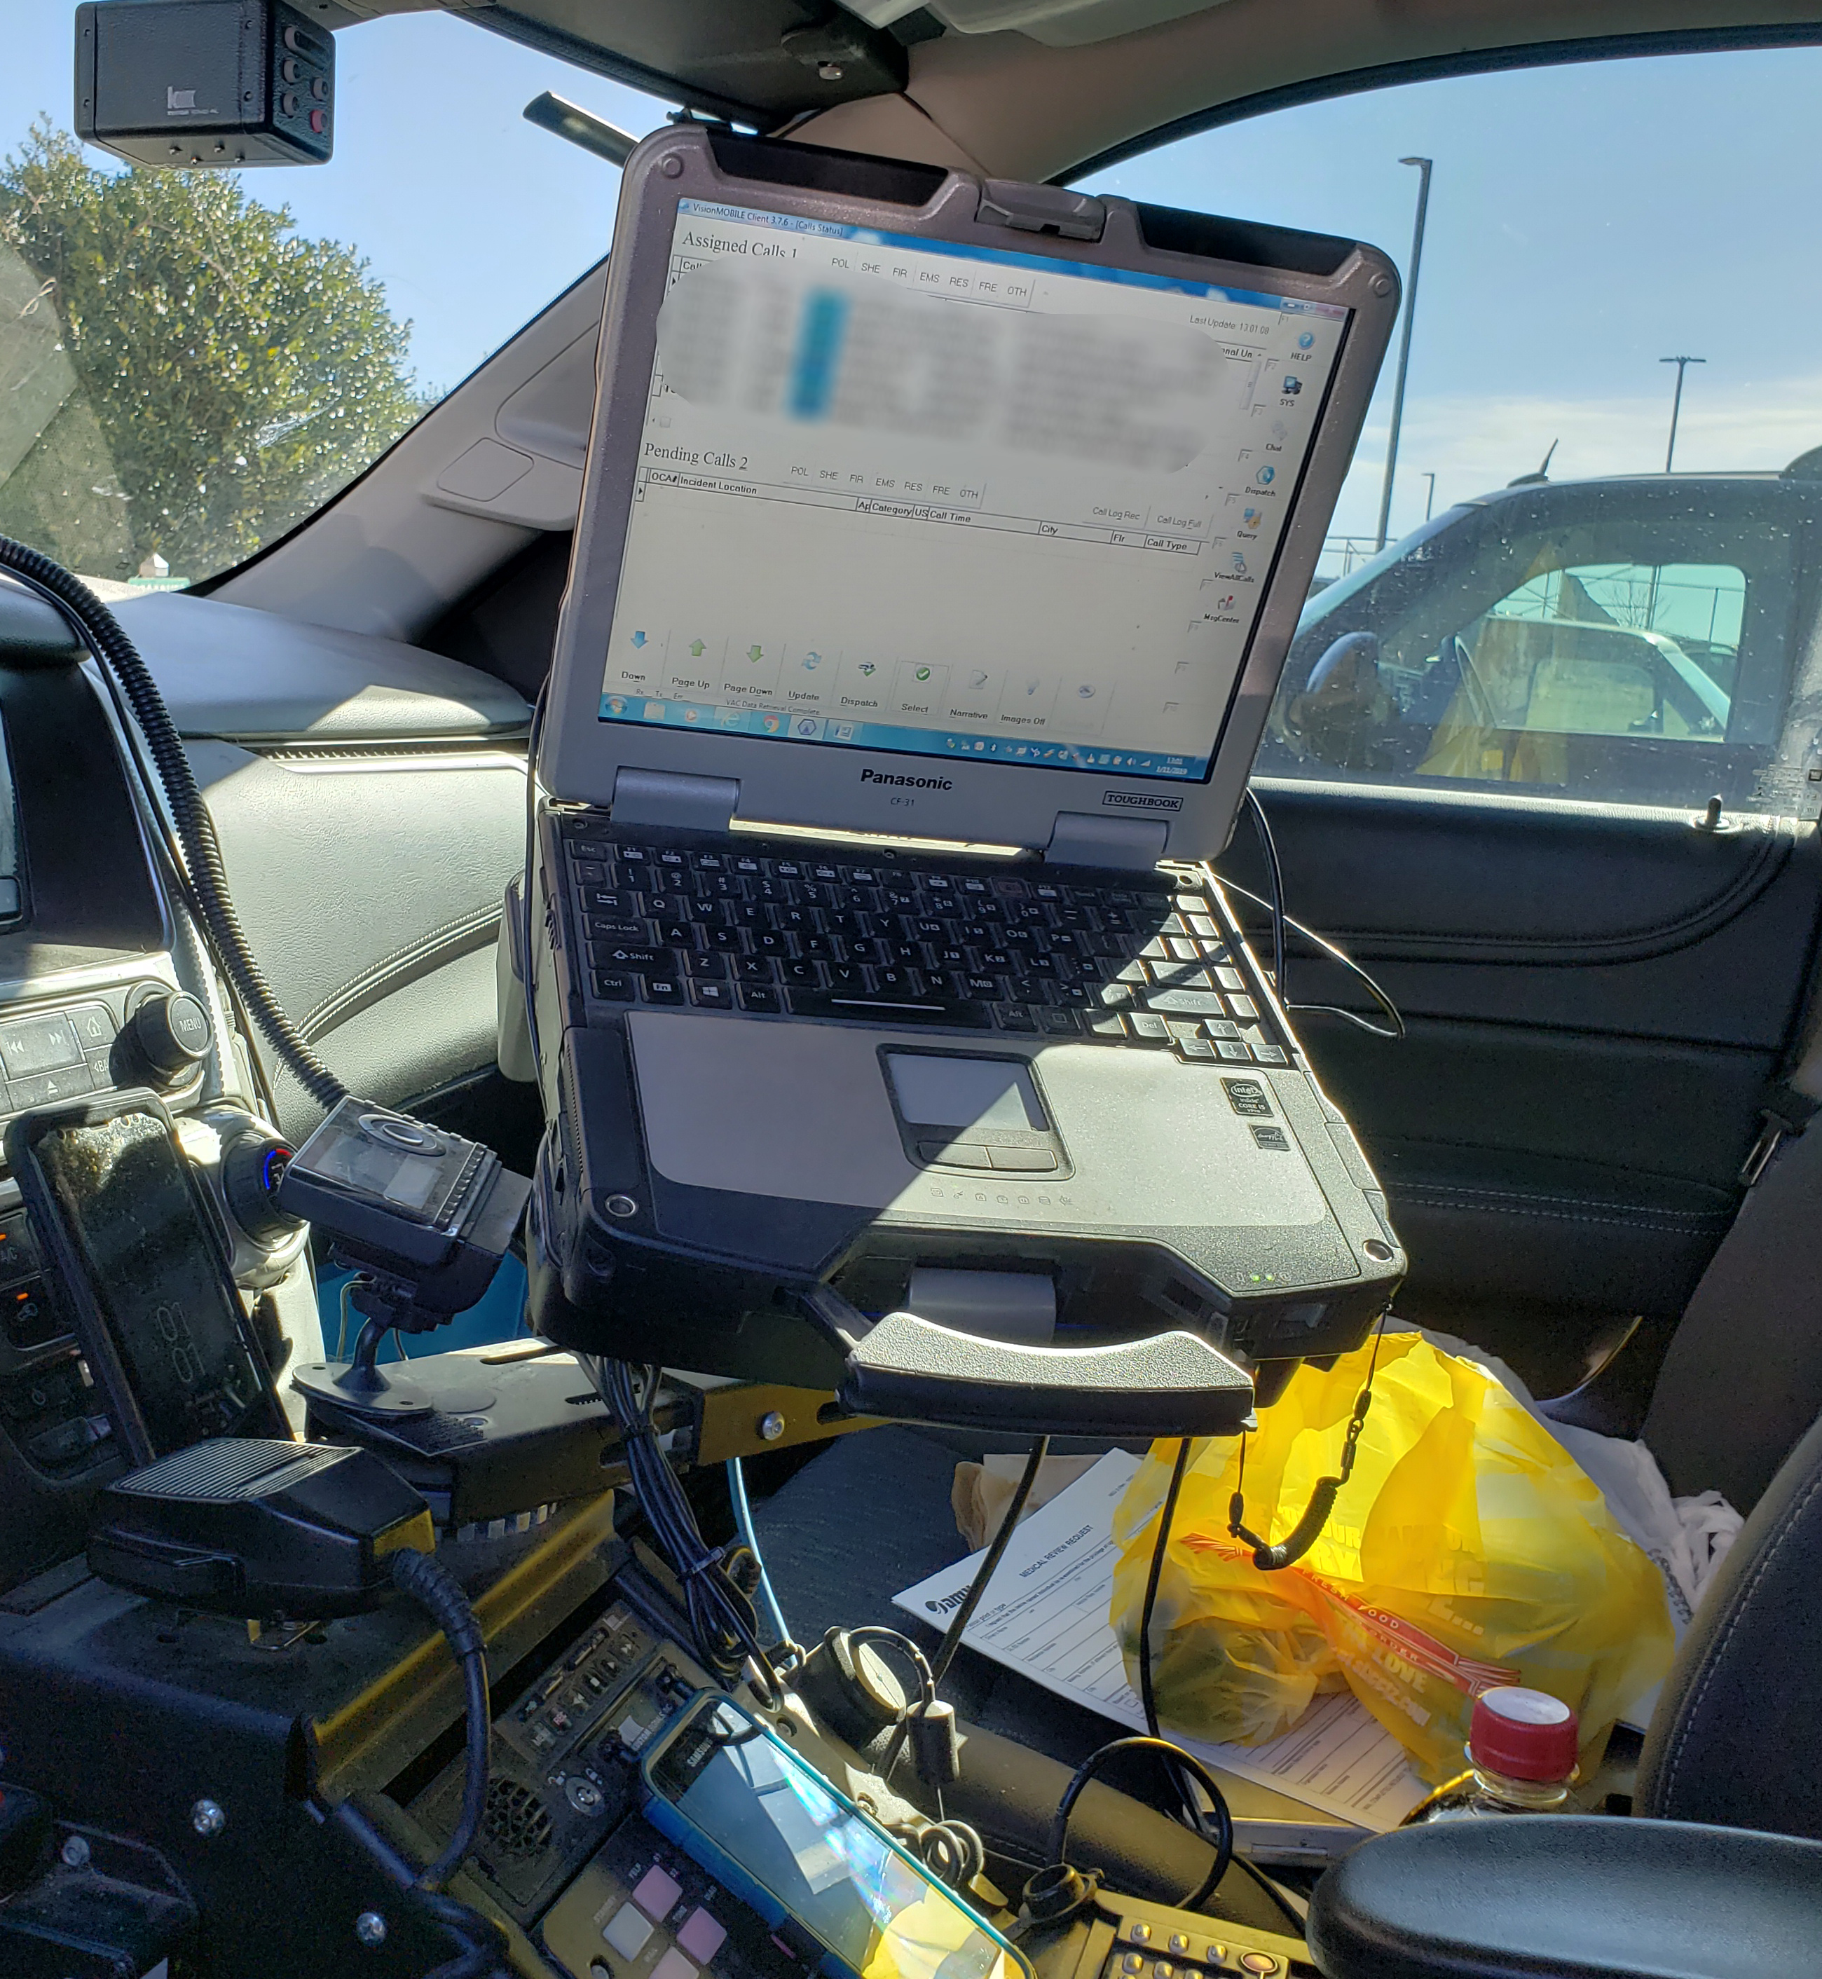
BIGGEST THREAT TO CAD NETWORK - IMHO
MOBILE DATA TERMINAL
CAN BE FOUND:
- LEO VEHICLES
- EMS/FIRE VEHICLES
- HOME
- MCDONALDS
- WHO KNOWS?

Slide 20
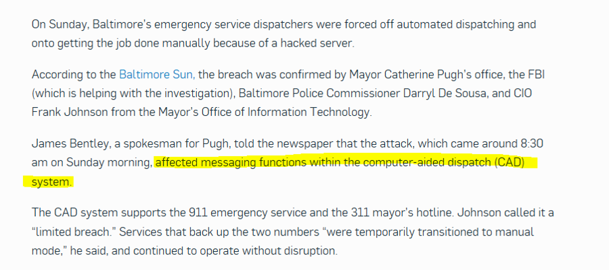

Slide 22
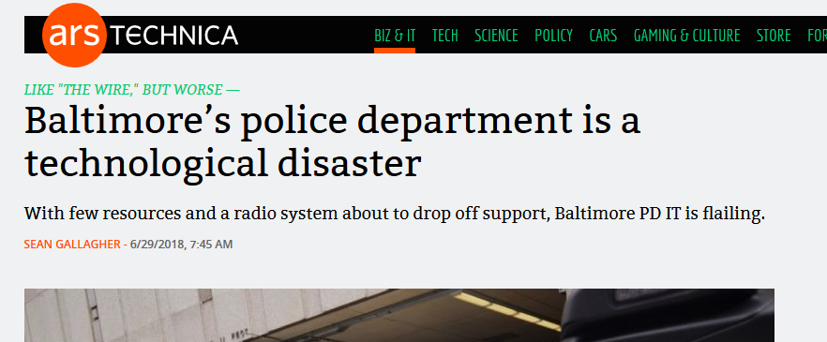

Slide 23
SWATTING/PRANK/HOAX 9-1-1 CALLS

Slide 24
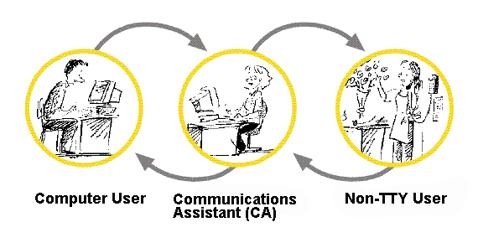
TTY RELAY
VoIP

Slide 25
HARASSMENT/BULLYING

Slide 26
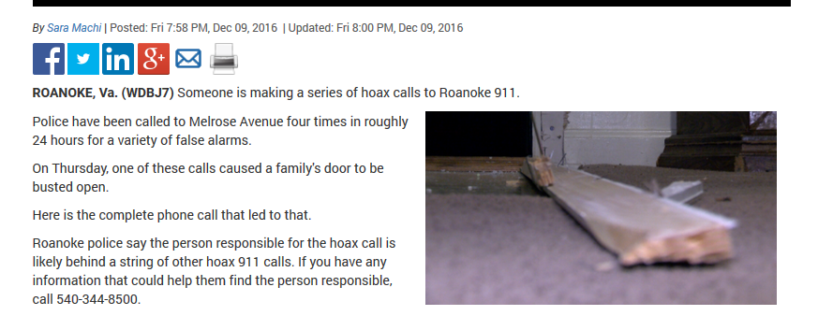
RESULTS IN PROPERTY DAMAGE

Slide 27
DEATH OF CITIZEN OR FIRST RESPONDER

Slide 28
SOCIAL MEDIA
IS NOT
EMERGENCY
SERVICES

Slide 29
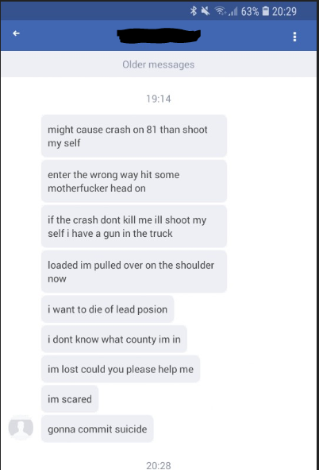

Slide 30
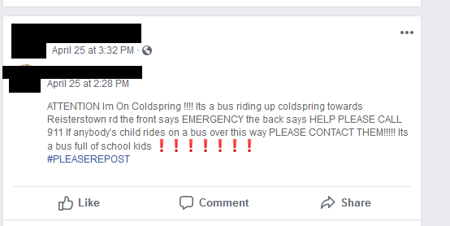

Slide 31
OTHER RISKS TO FIRST RESPONDERS
USE HOAX CALLS TO MANIPULATE RESOURCES
USING THE FREEDOM OF INFORMATION ACT TO OBTAIN INFORMATION
SECURITY OF THE BUILDING DISPATCERS ARE IN

Slide 32
AUDIO FROM FOIA REQUEST

Slide 33
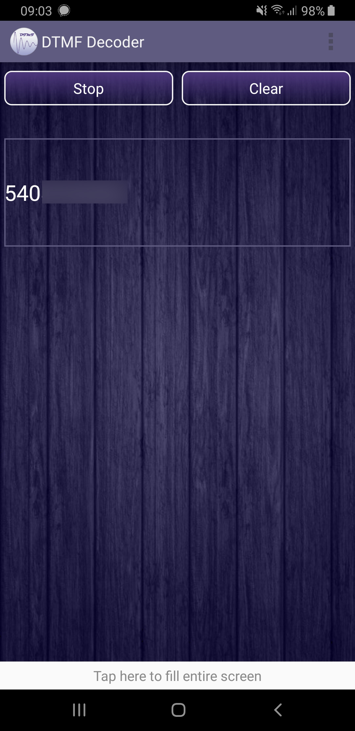

Slide 34
PHYSICAL SECURITY
OFTEN OVERLOOKED
DISPATCHERS ARE BUSY
LOTS OF SERVICE PEOPLE

Slide 35
SEPTEMBER 2018

Slide 36
