Slide 1
AWS SURVIVAL GUIDE 2.0

Slide 2
HELLO!
Before we get started, let’s chat about recent events…

Slide 3
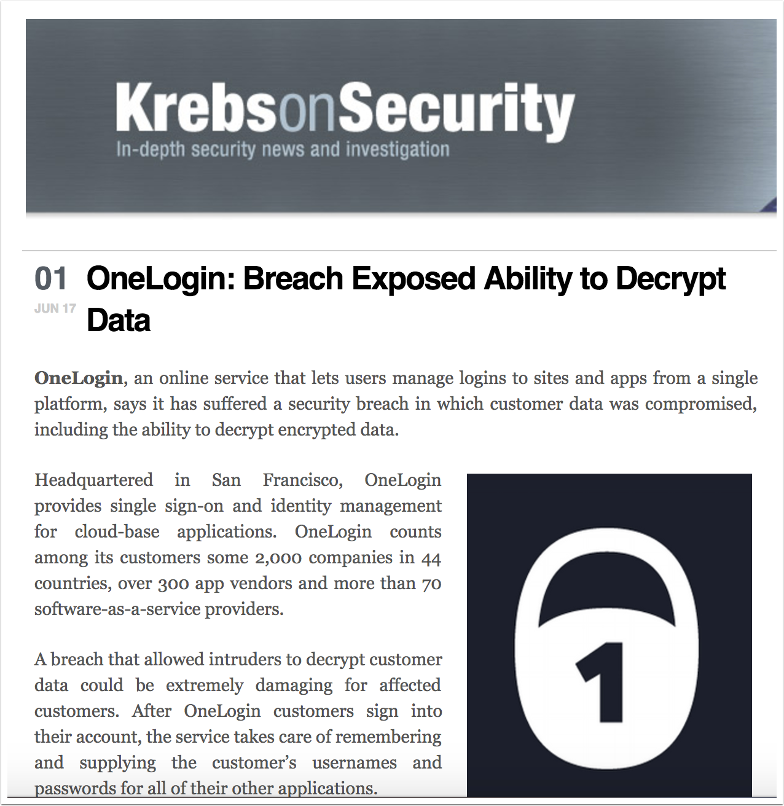
AWS Key
“Our review has shown that a threat actor obtained access to a set of AWS keys and used them to access the AWS API from an intermediate host with another, smaller service provider in the US.”

Slide 4
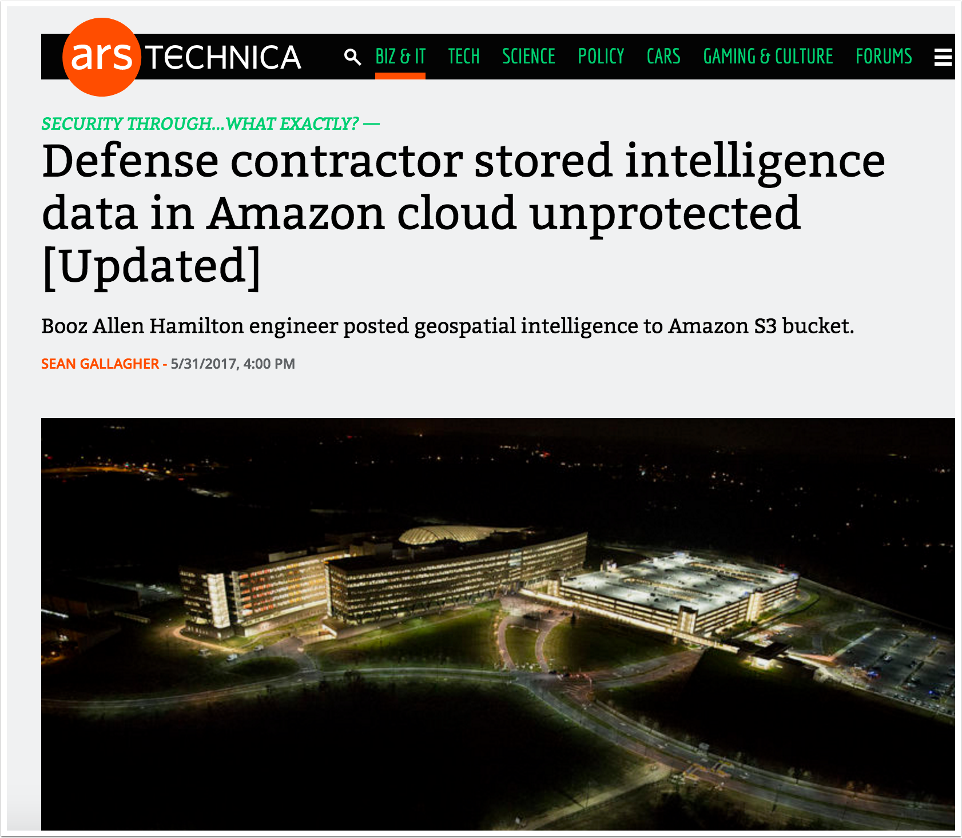
S3 Bucket Permissions
“On May 24, Chris Vickery, a cyber risk analyst with the security firm UpGuard, discovered a publicly accessible data cache on Amazon Web Services' S3 storage service that contained highly classified intelligence data.”

Slide 5
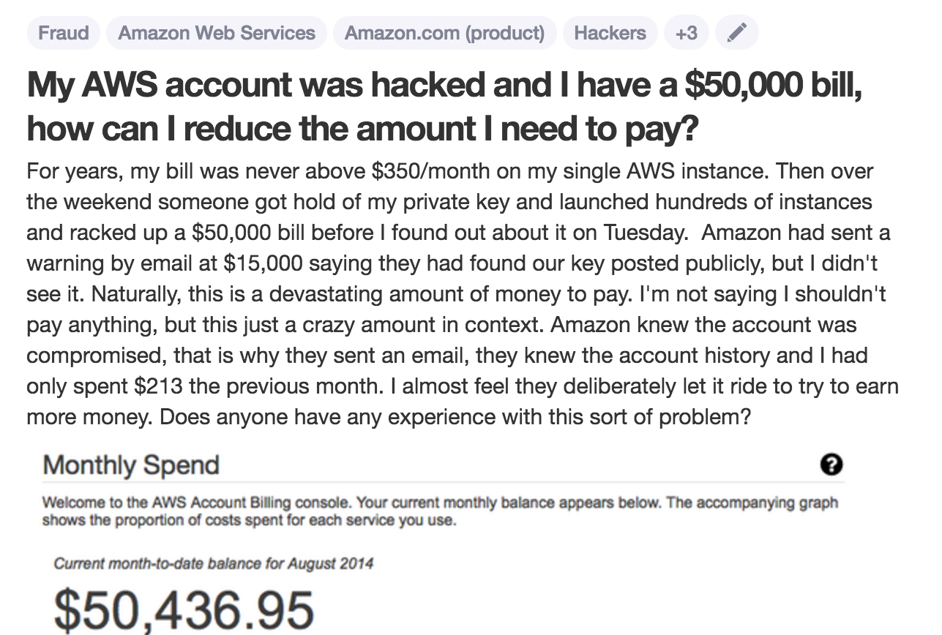
Quora & 50k bill
“After just one week of the account being compromised, the monthly bill was $285,000!”

Slide 6
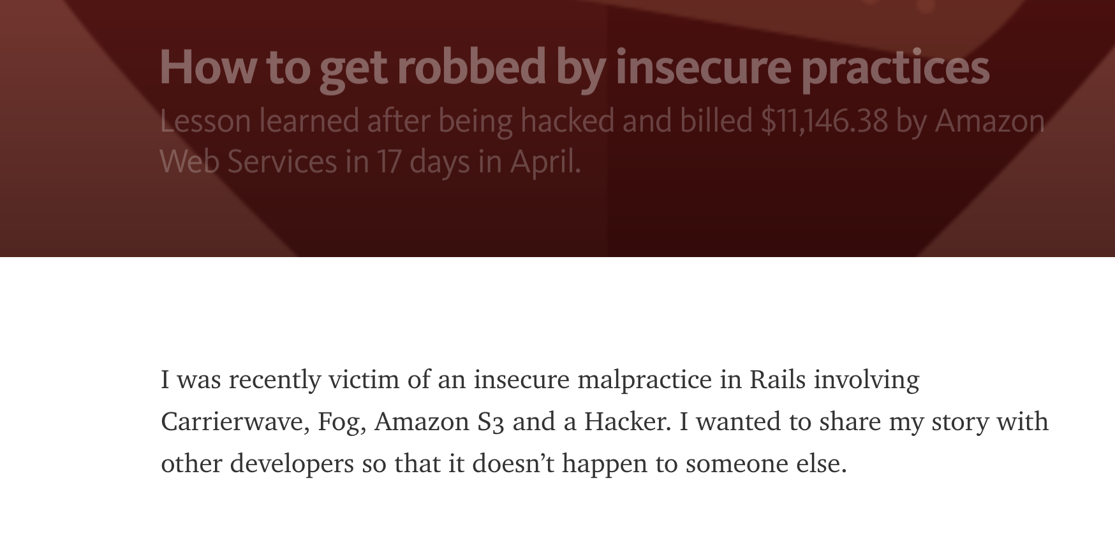
Gettin’ Robbed
“I hired a remote developer to help me with my startup. After asking him to sign a Non Disclosure Agreement (NDA), I added him to my private Github repository. He then forked my repository and publicly exposed a copy of it on his own repository”

Slide 7
Background

Slide 8
Me
CTO – nVisium
Breaker & Builder
Utilize AWS Heavily
@cktricky

Slide 9
This talk
Preventing the preventable

Slide 10
Account exploitation, in my experience, occurs due to hosting vulnerable systems, misconfigured services, or compromised credentials.

Slide 11
Exposed Credentials

Slide 12
Exposed Credentials
Keys are often stored on developer or ops machines
Typically can be found under
~/.aws/config
~/.bashrc
~/.zshrc
~/.elasticbeanstalk/aws_credential_file

Slide 13
Thankfully, developers never embed secret keys in source code or post their sensitive dot files to public repos
~ Nobody, the F%@k Ever

Slide 14
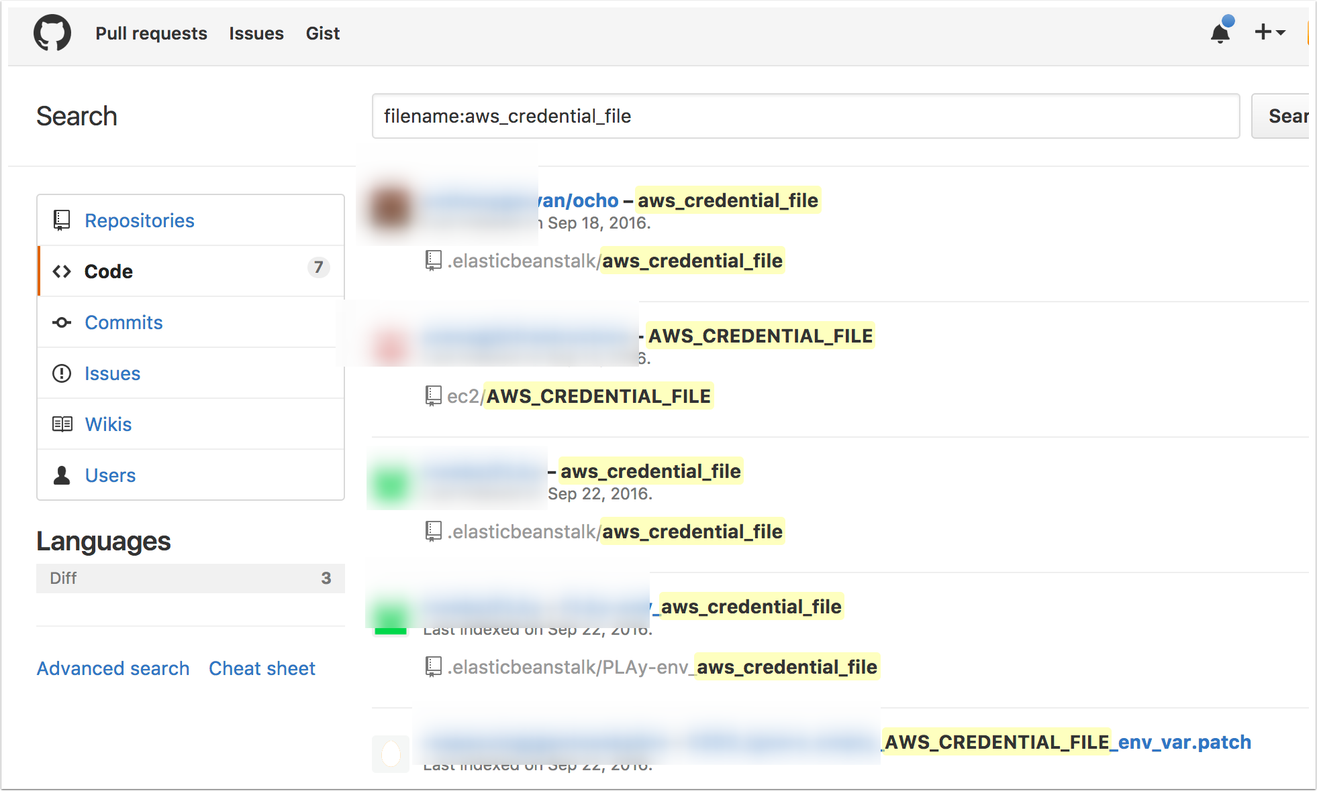
Exposed Credentials

Slide 15
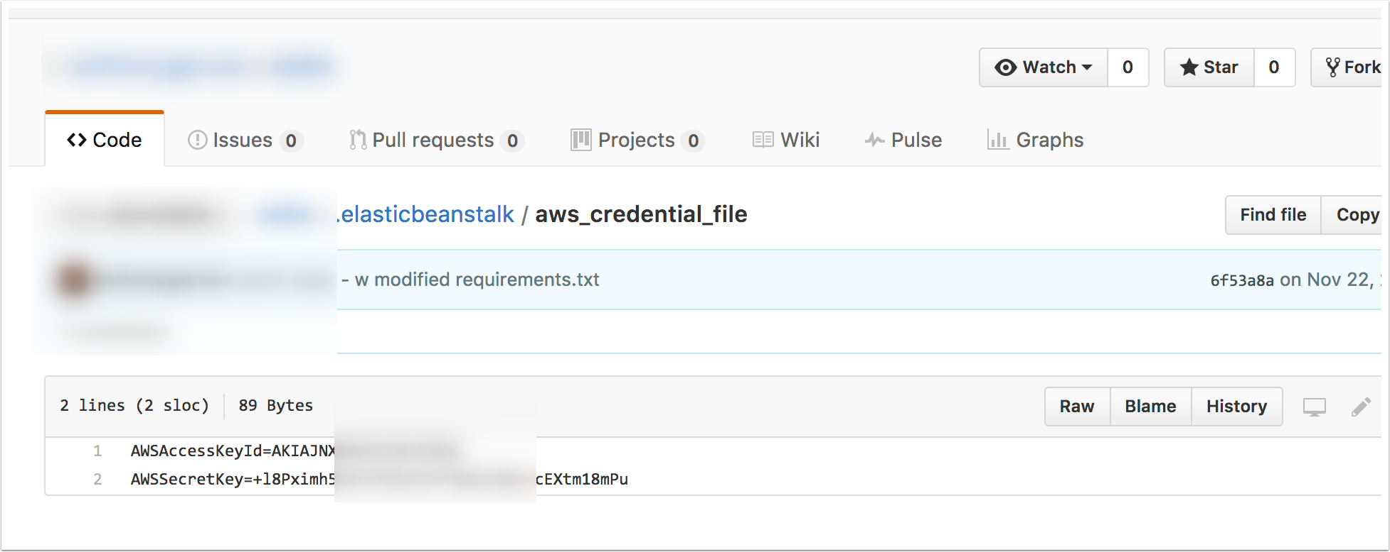
Exposed Credentials

Slide 16
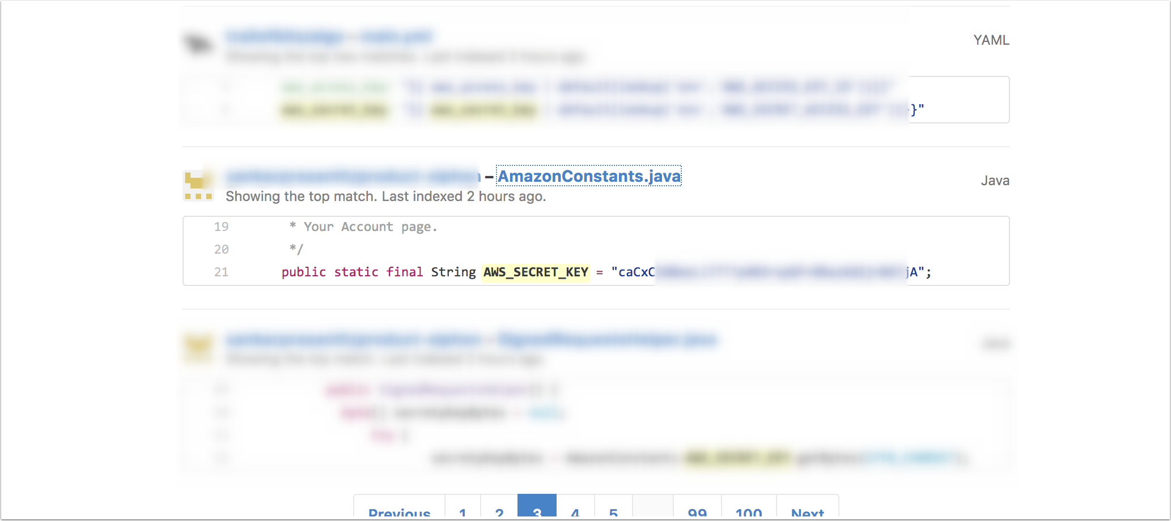
Exposed Credentials

Slide 17
Misconfigured Services

Slide 18
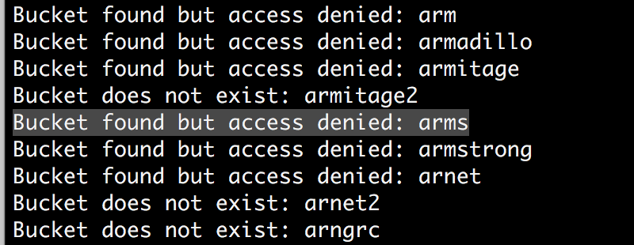
Misconfigured Services
S3 bucket with “any authenticated user” permissions (credit: Chris Gates)

Slide 19
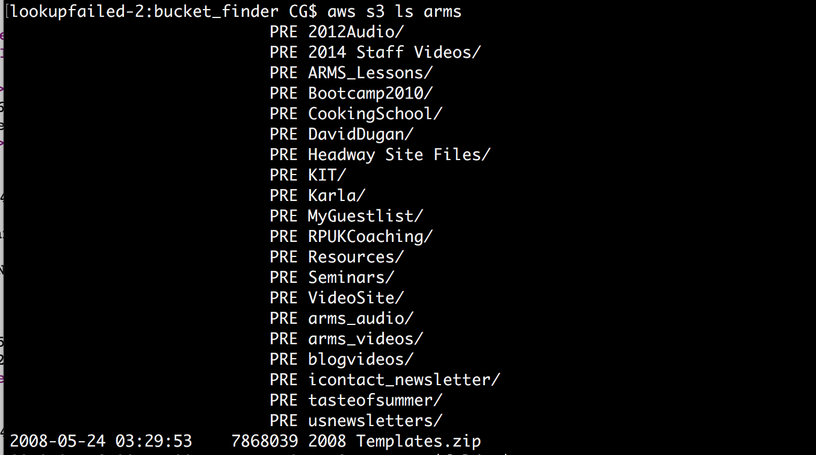
Misconfigured Services
Listing buckets contents

Slide 20
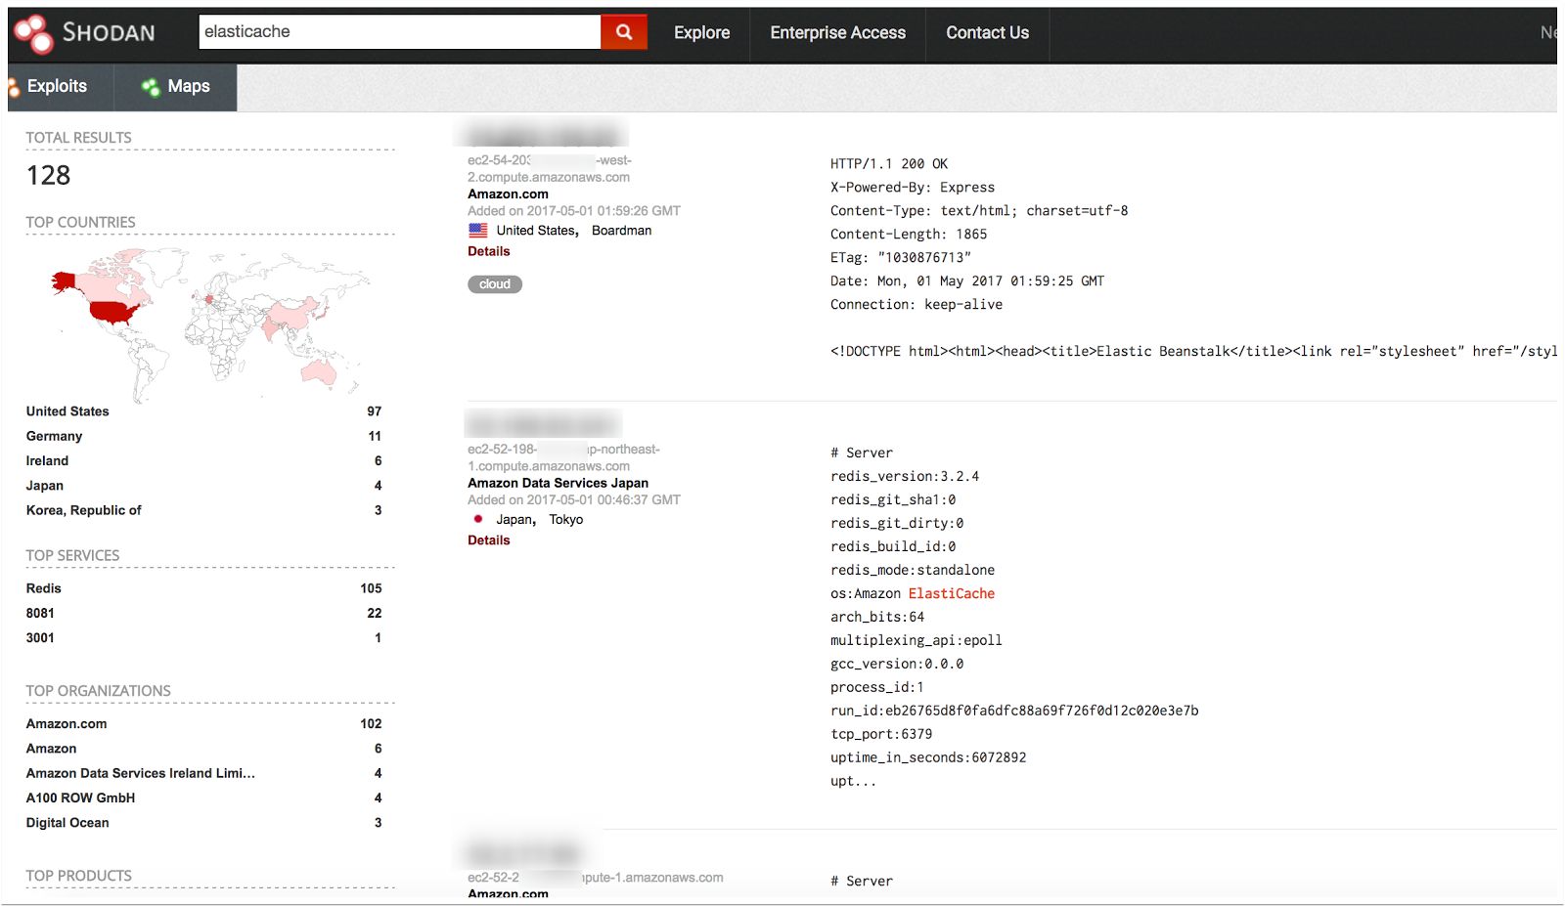
Misconfigured Services
ASK SHODAN
Don’t believe me? Just ask Shodan.io…

Slide 21
Misconfigured Services
I have many more examples including
RDS default creds
“Internal” assets on a VPC
Security groups
Unencrypted storage of PII
List goes on…

Slide 22
Vulnerable Systems

Slide 23
Vulnerable Systems
Machine is compromised
Attacker grabs metadata info
Uses these credentials to pivot

Slide 24
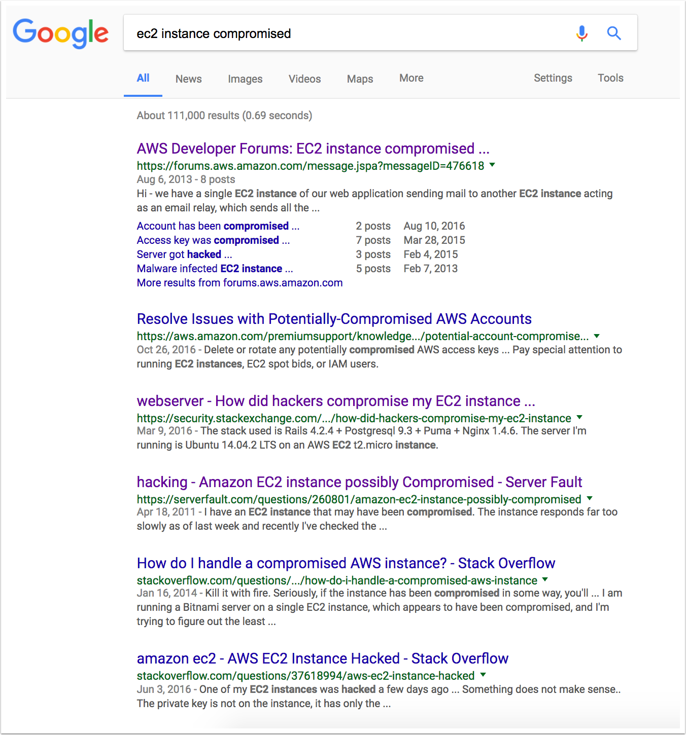
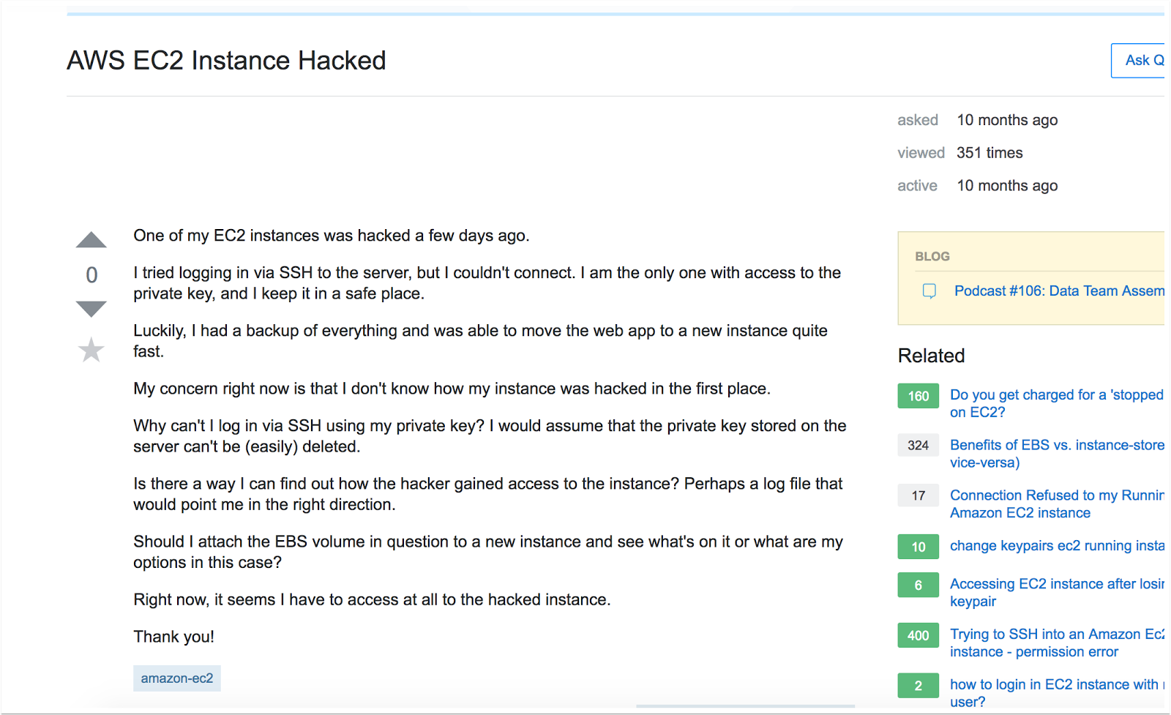
Vulnerable Systems
For compromised instances, just turn to Google...

Slide 25
Vulnerable Systems
Browse to this address from compromised machine
http://169.254.169.254/latest/meta-data/iam/security-credentials/
Obtain credentials here and pivot

Slide 26
Vulnerable Systems
Even a talk/tool to help with this
https://www.blackhat.com/docs/us-14/materials/us-14-Riancho-Pivoting-In-Amazon-Clouds-WP.pdf
https://andresriancho.github.io/nimbostratus/

Slide 27
Vulnerable Systems
Summary
Plenty of ways to get in
Plenty of ways to secure your infrastructure
Let’s get started shall we

Slide 28
Prevention

Slide 29
Prevention
Monitoring
Hardening
Q&A

Slide 30
Monitoring

Slide 31
Monitoring
AWS Solutions - Monitoring
3 Services: CloudWatch, CloudTrail, and Config

Slide 32
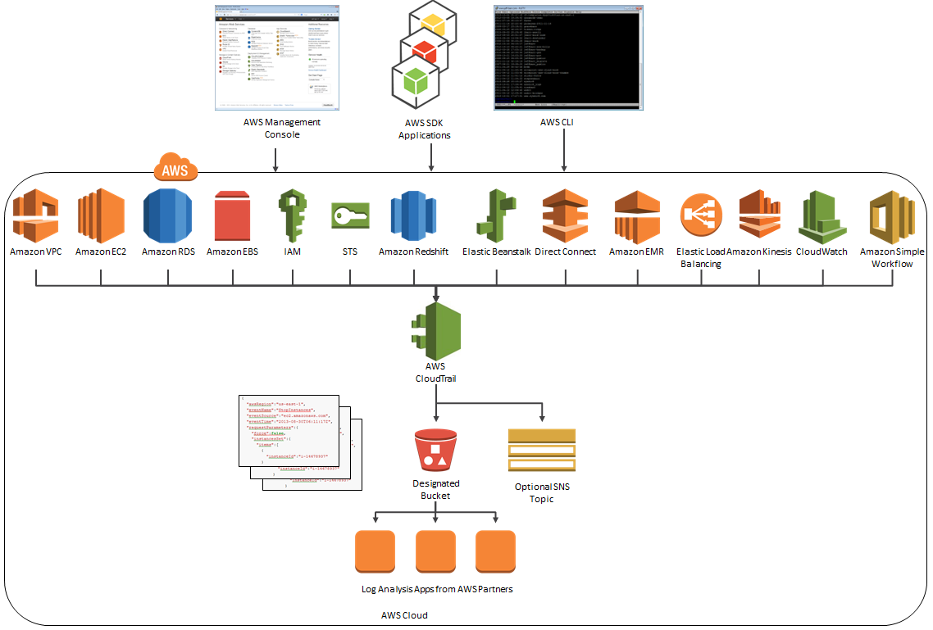
Monitoring

Slide 33
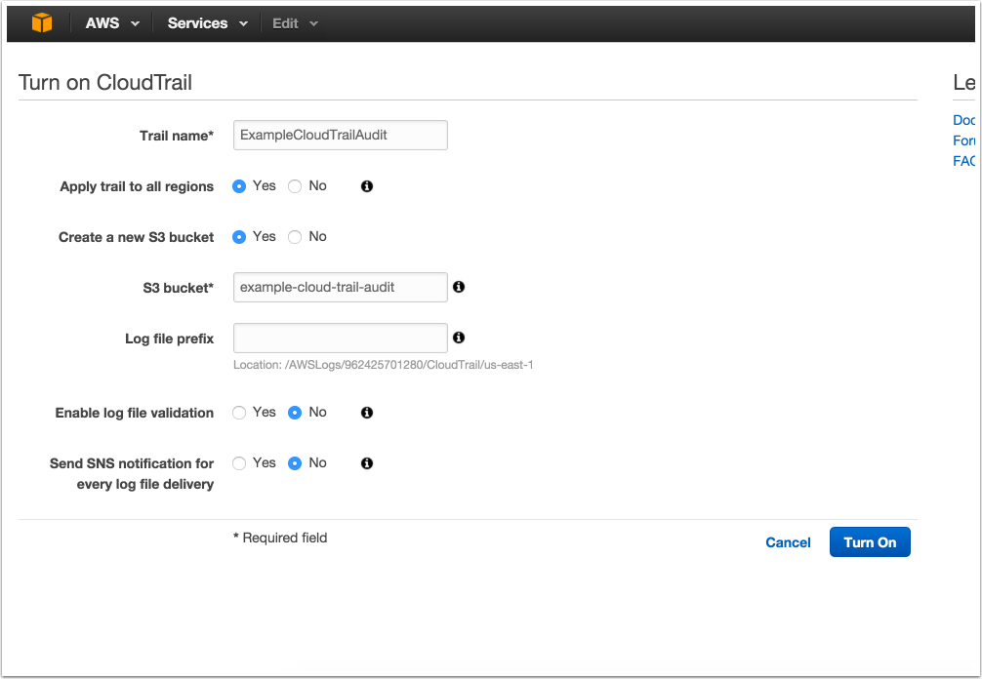
Monitoring
Step 1 – Turn it on

Slide 34
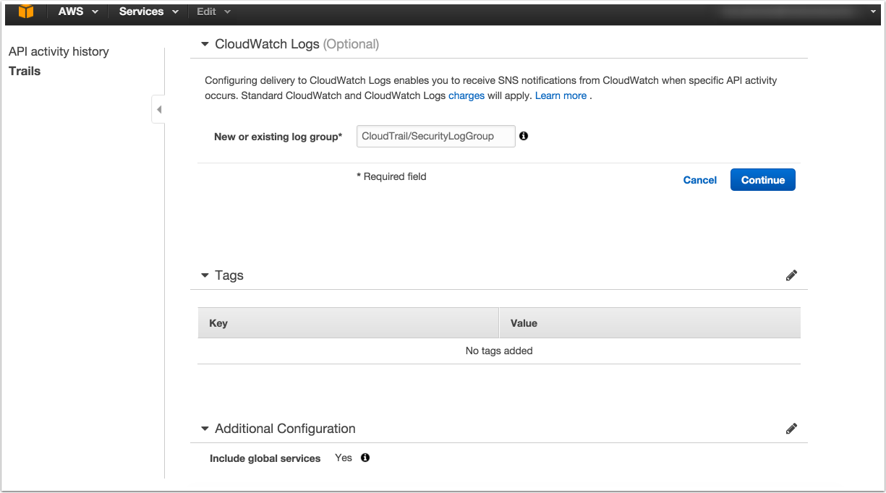
Monitoring
Step – 2 Configure Log Group

Slide 35
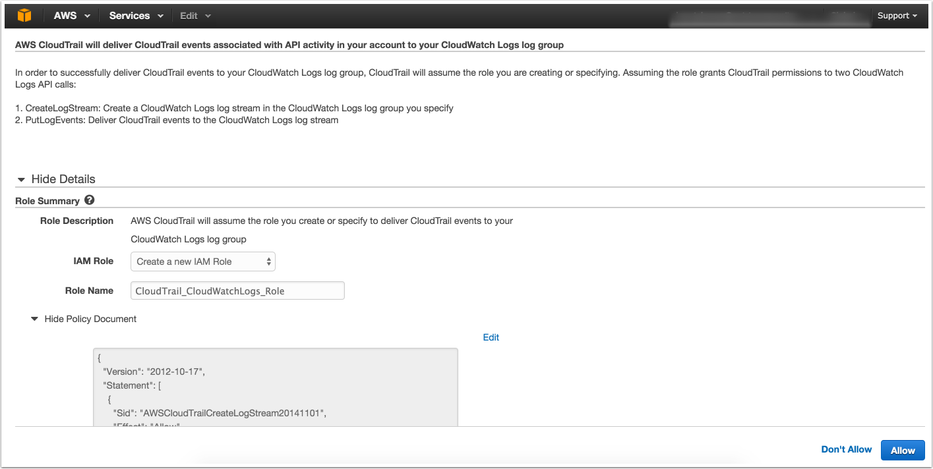
Monitoring
Step 3 - Create IAM Role

Slide 36
Monitoring
CloudWatch Alarms – Helpful but not detailed

Slide 37
Monitoring
This is more along the lines of what we want

Slide 38
Monitoring
I learned the hard way so you don’t have to
Alarms filter for metric data and, when sent to Lambda, SNS, etc. they only contain info on the metric
Events on the other hand, they send the entire event data to Lambda (much more detailed)
Both are functions of CloudWatch

Slide 39
Monitoring
First we will setup an alarm for IAM Unauthorized Activity
Second, setup a similar alarm but for events and with better, more granular details
Discuss other types of events to monitor for

Slide 40
One last thing - you want both an alarm and events… we have good reason

Slide 41
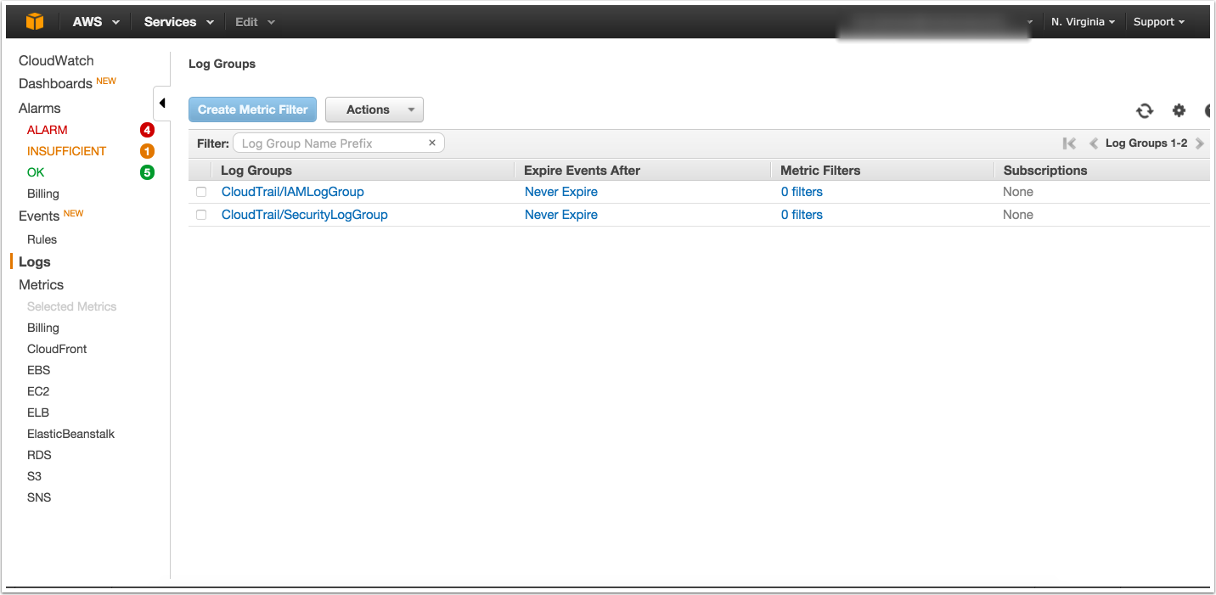
Monitoring
Choose log group, create metric

Slide 42
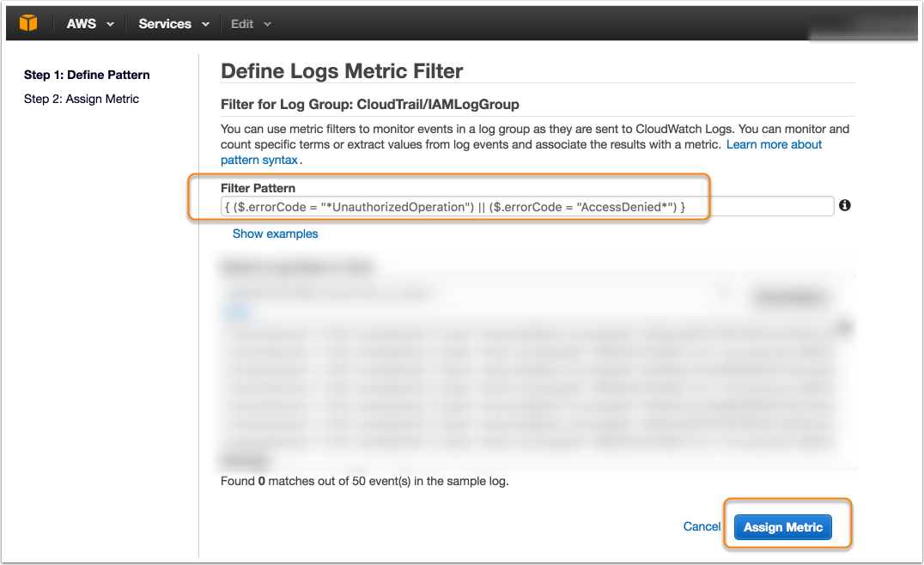
Monitoring
Define Pattern (what to grok for)

Slide 43
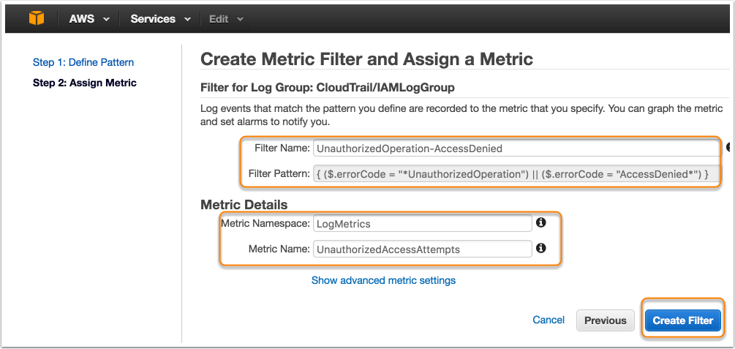
Monitoring
Assign a metric (naming conventions)

Slide 44
Monitoring
Click “Create Alarm”

Slide 45
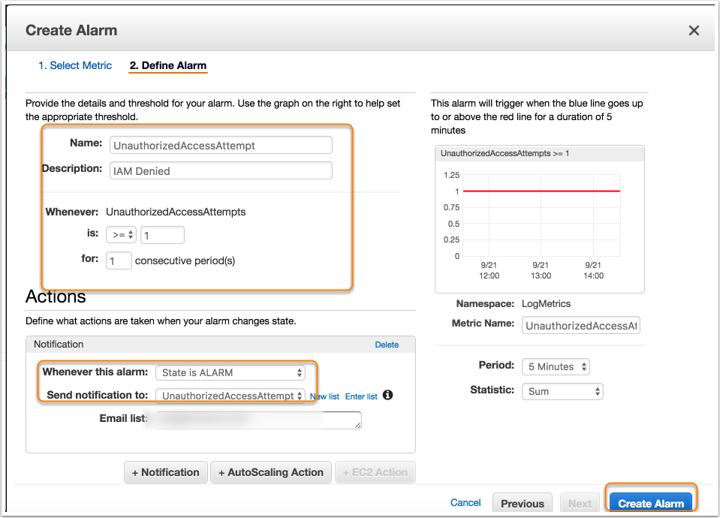
Monitoring
Give it a name, desc, etc.

Slide 46
Monitoring
It works really really well
No matter what event source the data comes from, its parsed and recognized correctly
This means its safe
But… those “details”…

Slide 47
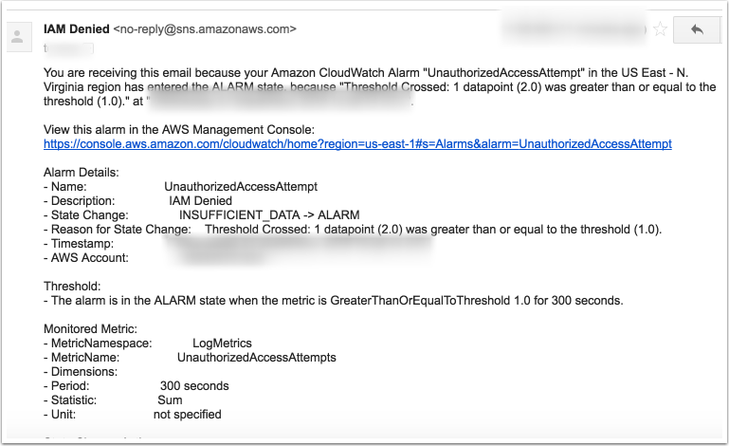
Monitoring

Slide 48
Monitoring
But then I learned about CloudWatch Events (Rules)!
If something (Event) happens, you can send that something to Lambda for processing based on a rule (Rules)

Slide 49
CloudWatch Events!
If something (Event) happens, you can send that something to Lambda for processing based on a rule (Rules)

Slide 50
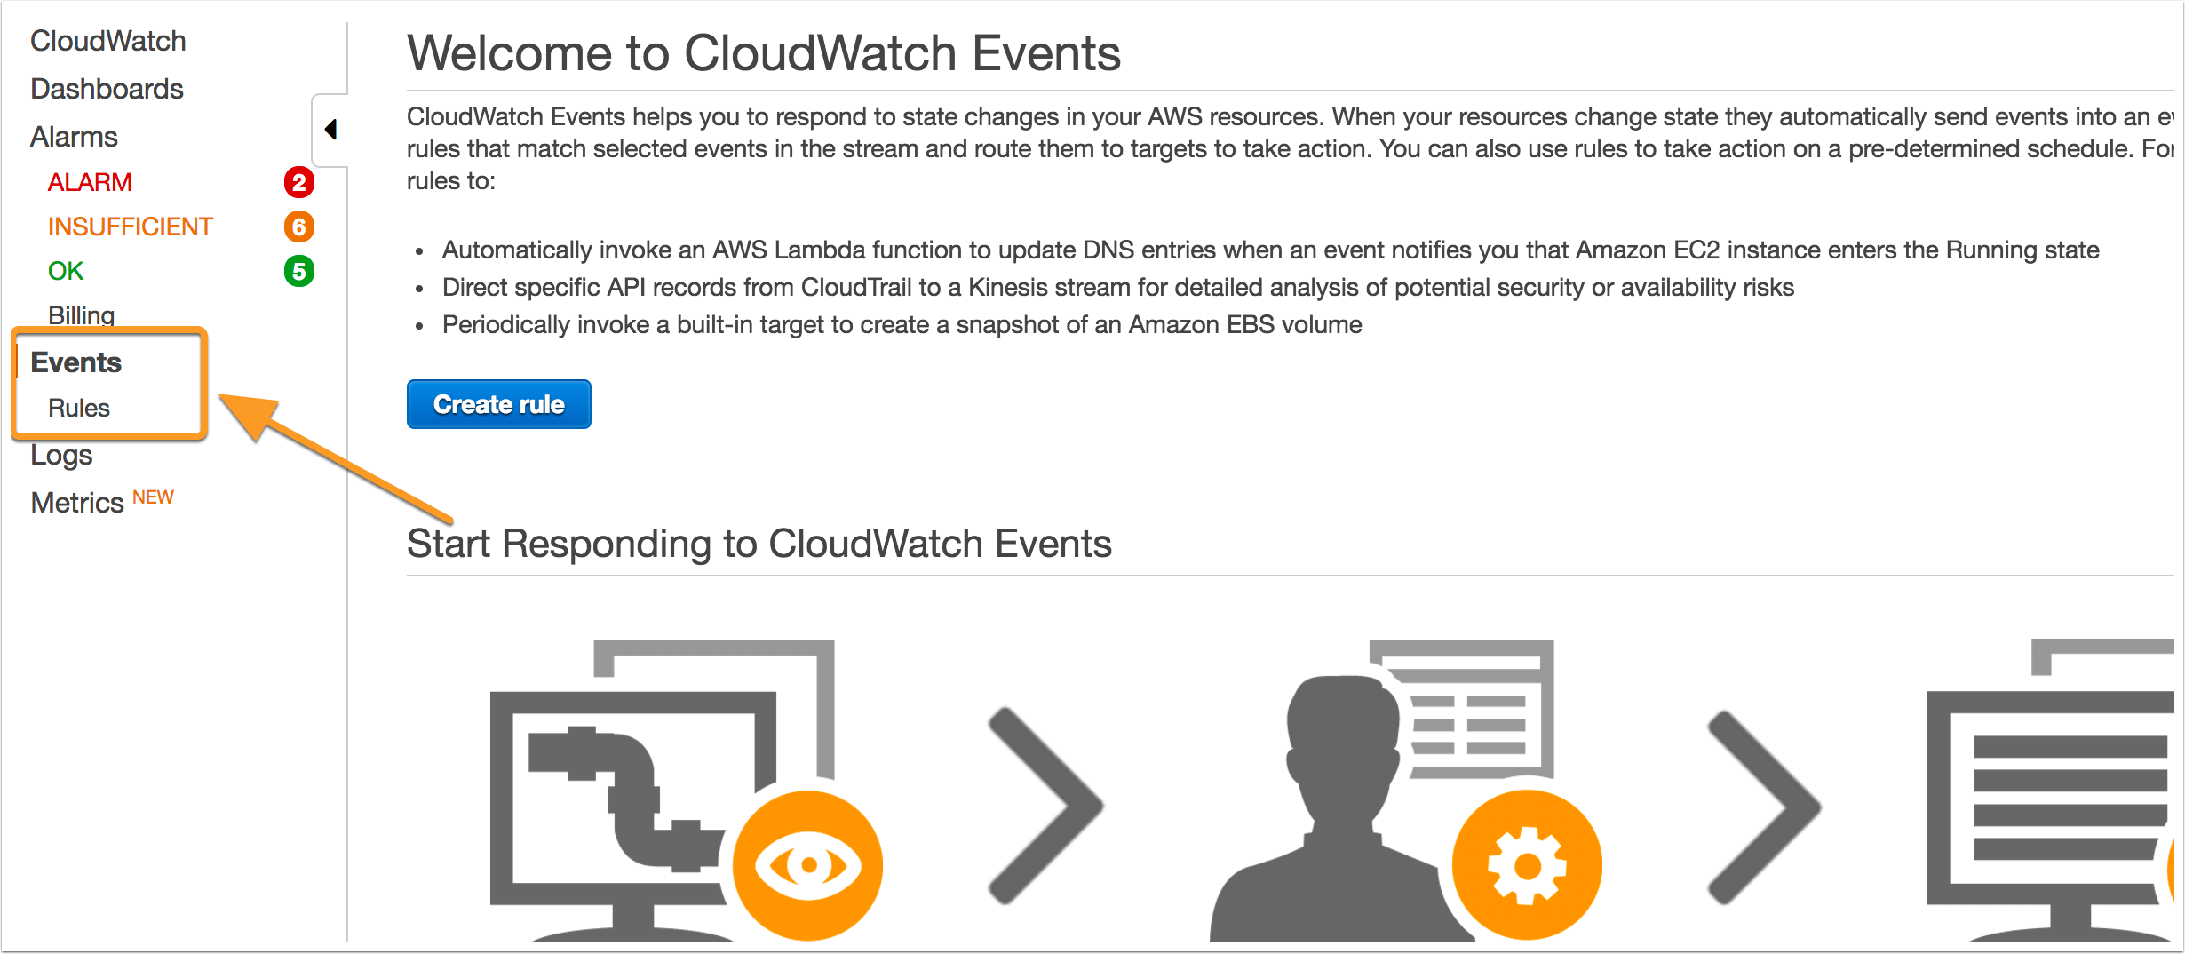
Monitoring

Slide 51
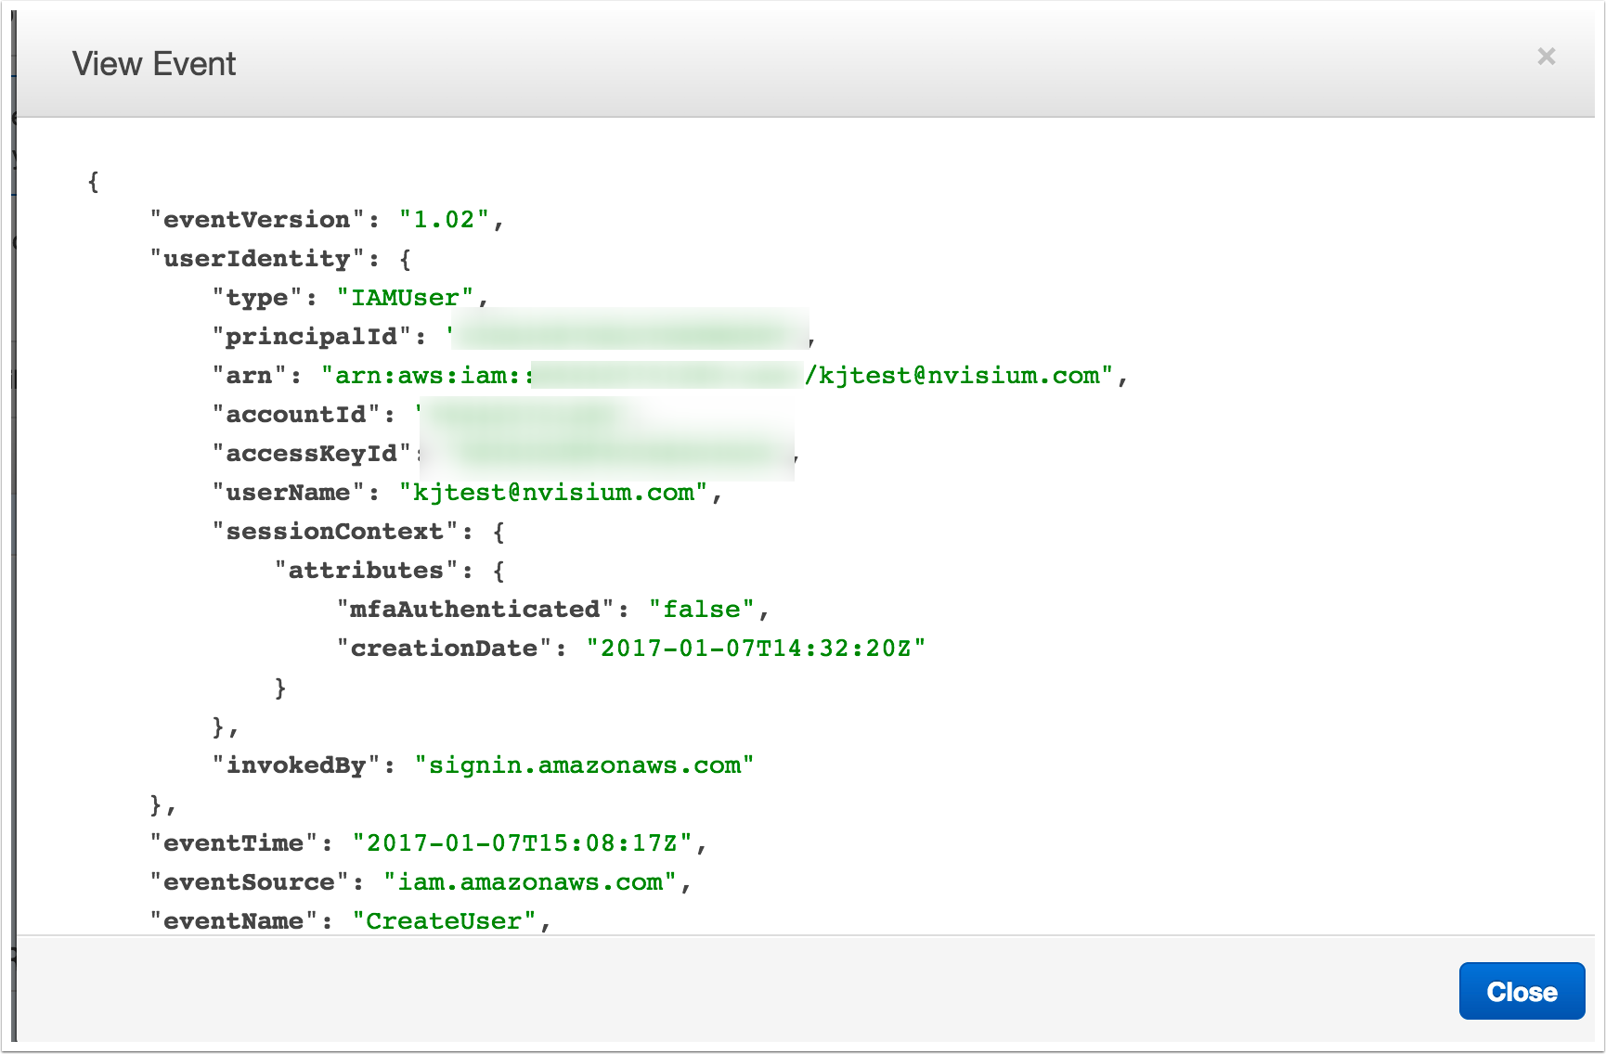
Monitoring
This what an event typically looks like

Slide 52
Monitoring
At first, I tried “How to Detect and Automatically Revoke Unintended IAM Access with Amazon CloudWatch Events”
https://aws.amazon.com/blogs/security/how-to-detect-and-automatically-revoke-unintended-iam-access-with-amazon-cloudwatch-events/

Slide 53
Monitoring
Filters requests when event source = IAM
Sends IAM event to Lambda
Check user permissions
Lacking administrative permissions? =>Revoke access

Slide 54
Monitoring
Not exactly what I want although, cool stuff
We are looking to alert on any Unauthorized Activity error triggered by AWS calls

Slide 55
Monitoring
Now for a brief interruption

Slide 56
Monitoring
Prior to Event Rule Creation
Configure Slack Webhook
KMS encrypt Slack Webhook URL
Create Lambda Function

Slide 57
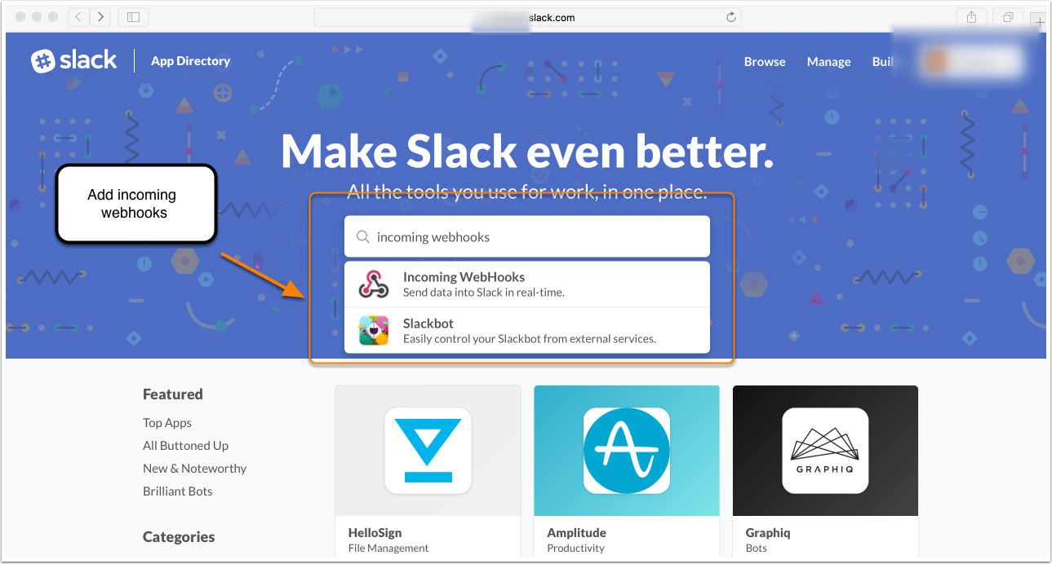
Monitoring
Start configuring incoming webhook

Slide 58
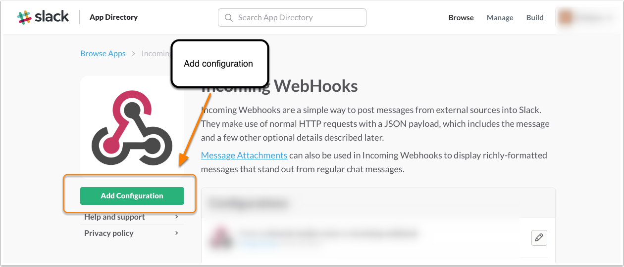
Monitoring
Add configuration inside of slack

Slide 59
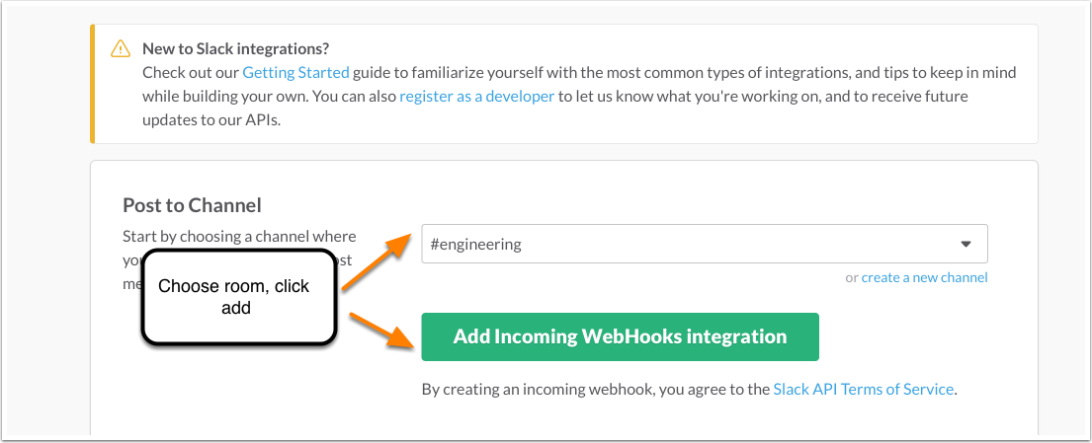
Monitoring
Choose the channel (and other details)

Slide 60
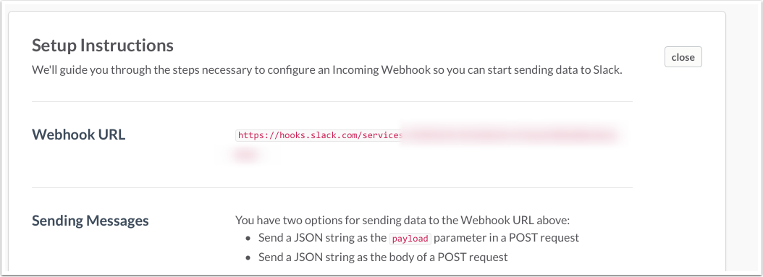
Monitoring
Retrieve the webhook URL

Slide 61
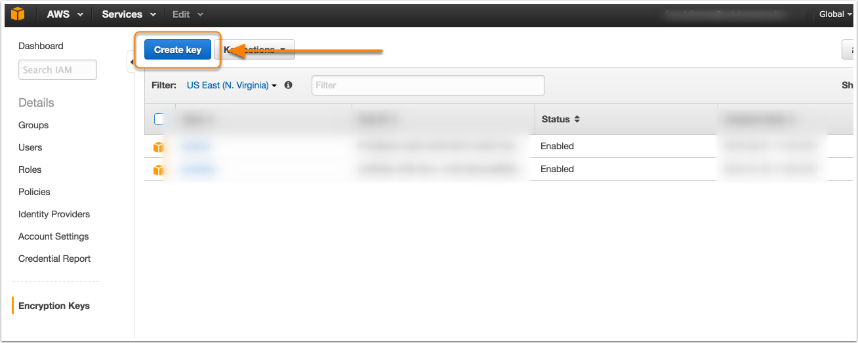
Monitoring
Create KMS key, later used to decrypt

Slide 62
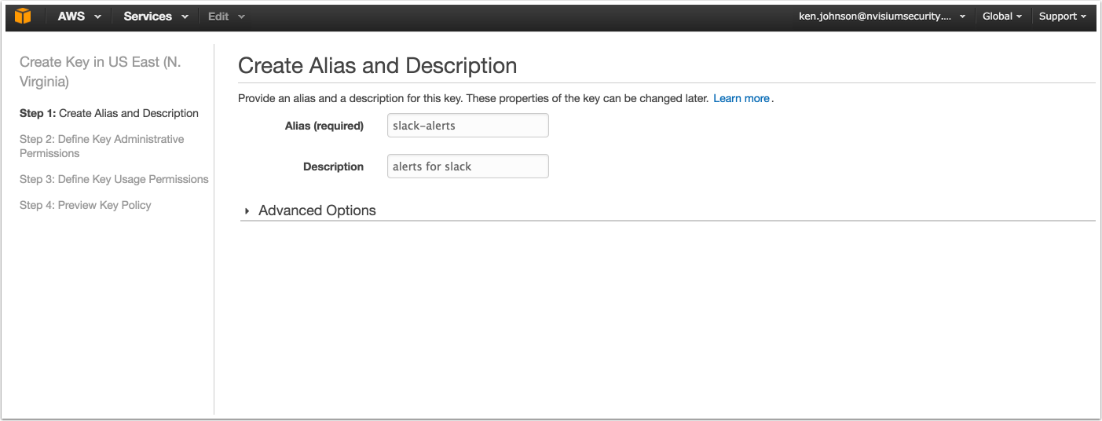
Monitoring
Name the key, follow steps 1 - 4

Slide 63
Monitoring
Use the AWS KMS encrypt function to encrypt the webhook URL

Slide 64
Monitoring
Next we will create the Lambda function
We need the Base 64 encoded + KMS encrypted URL from the previous slide
This will be needed for our code to securely retrieve the Slack Webhook URL

Slide 65
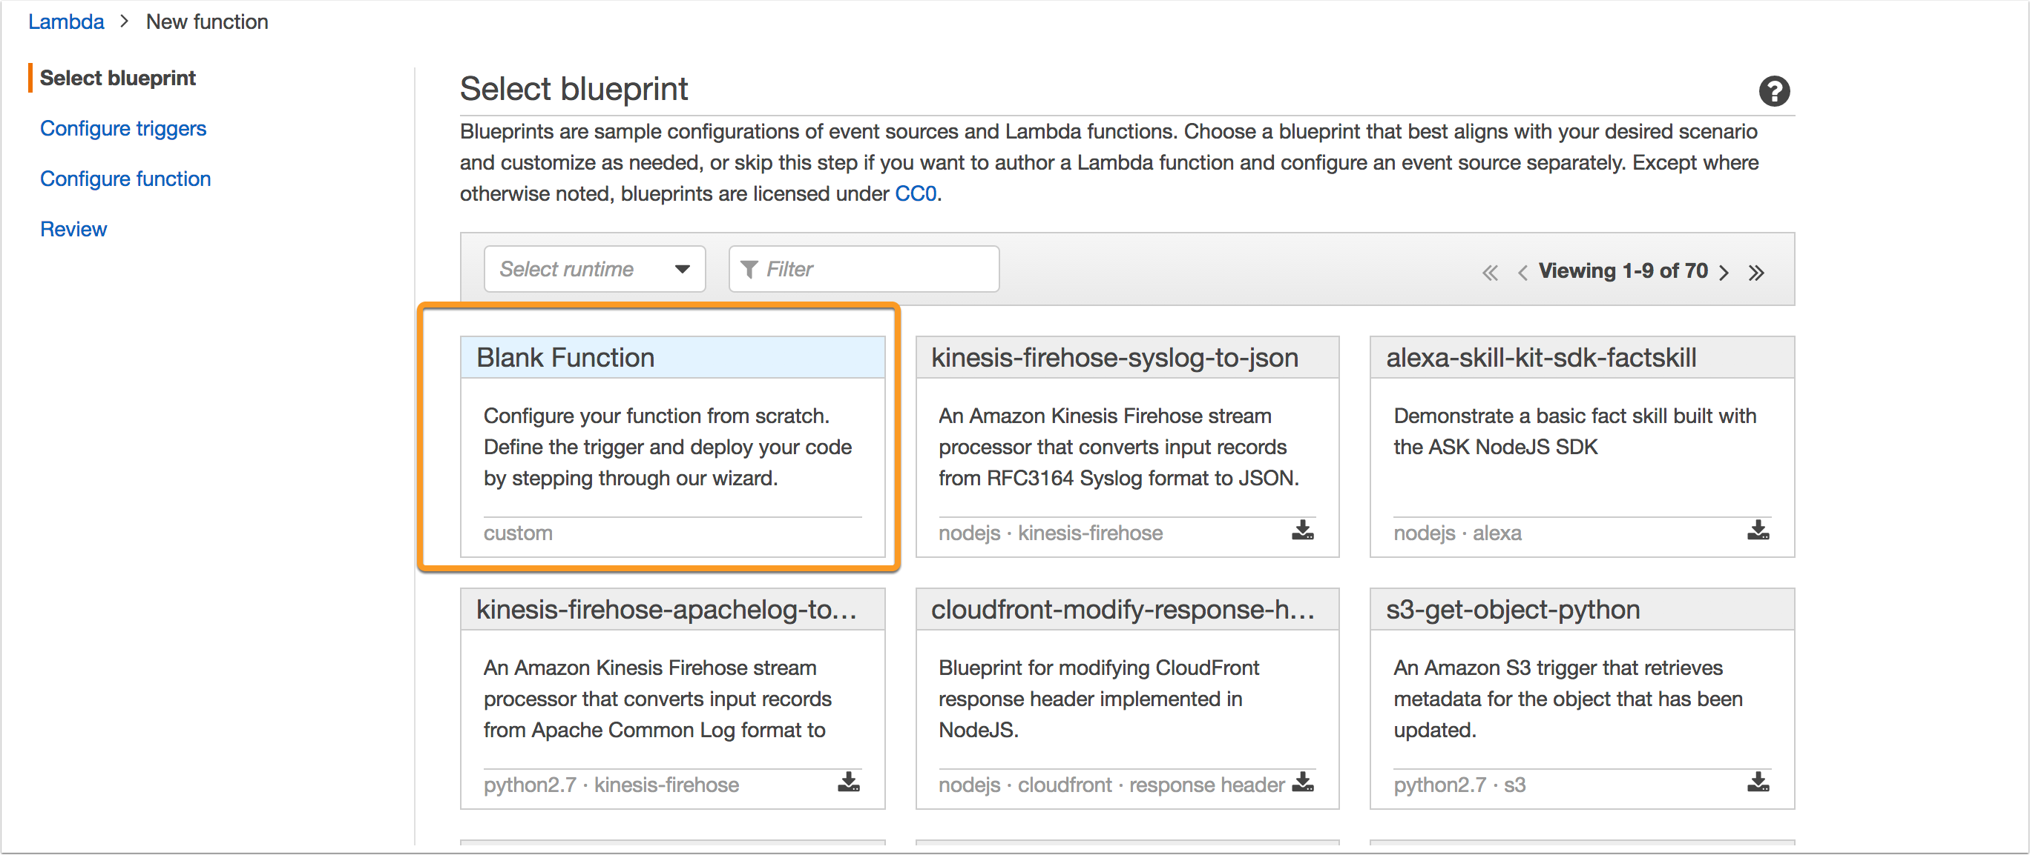
Monitoring
Select a blank function template

Slide 66
Monitoring
Configure Trigger (just click “Next”)

Slide 67
Monitoring
Place the following code into the function
https://gist.github.com/cktricky/8f4e9912f757d1ccdcd00ad8e8630620

Slide 68
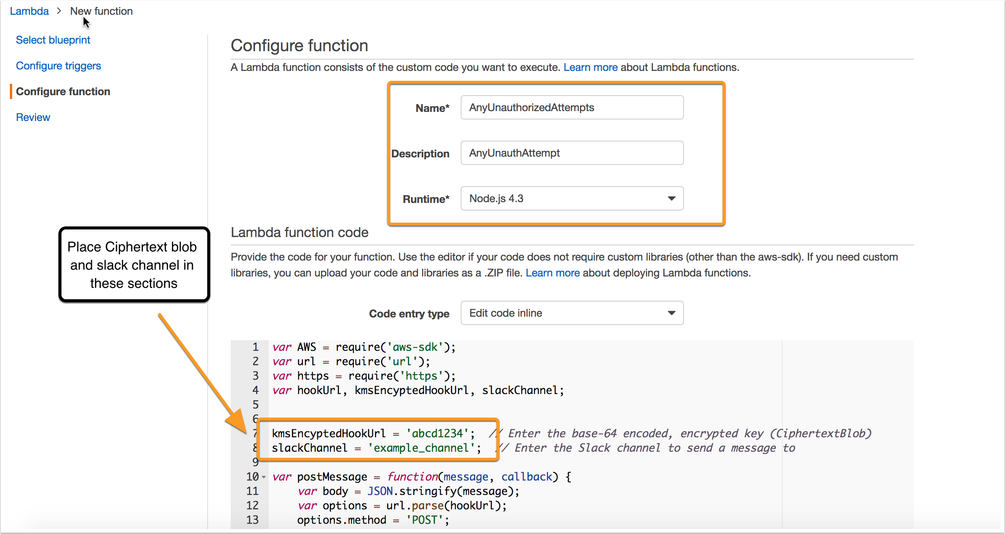
Monitoring
Use Base64+ KMS encrypted URL

Slide 69
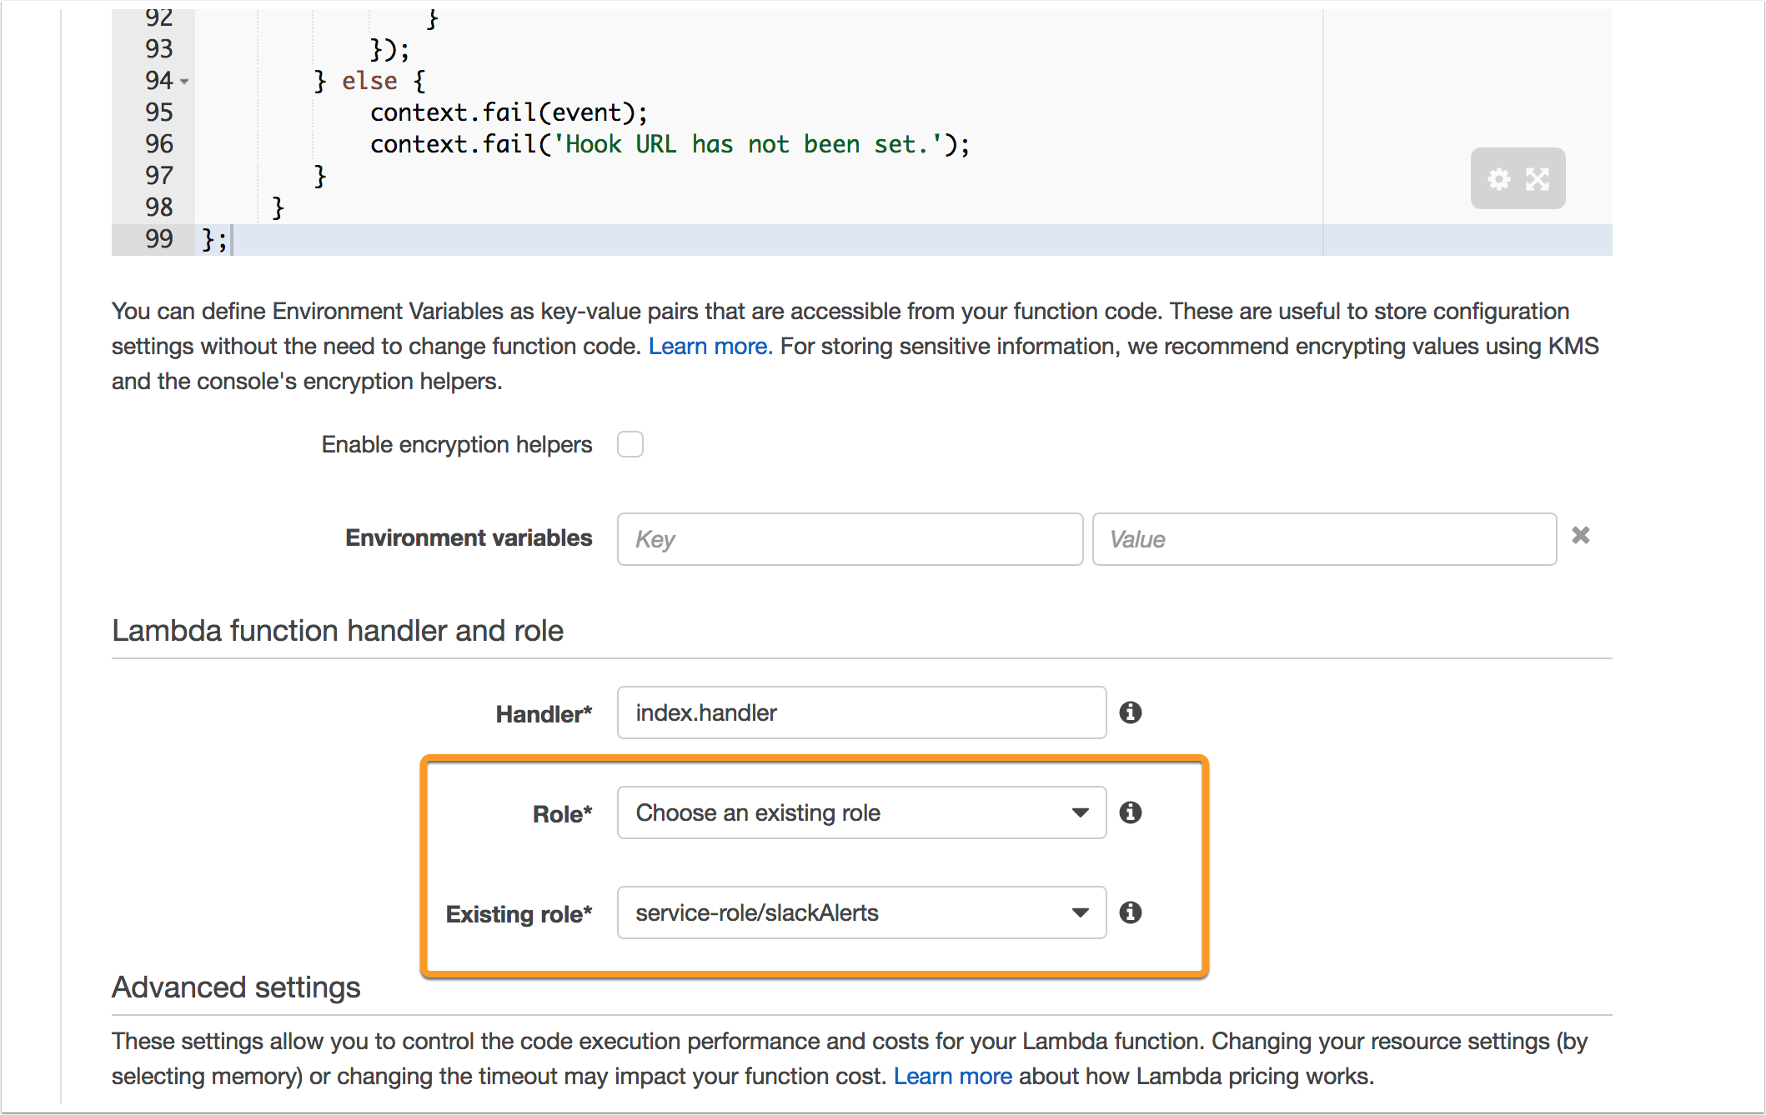
Monitoring
Lastly, choose the slack service role

Slide 70
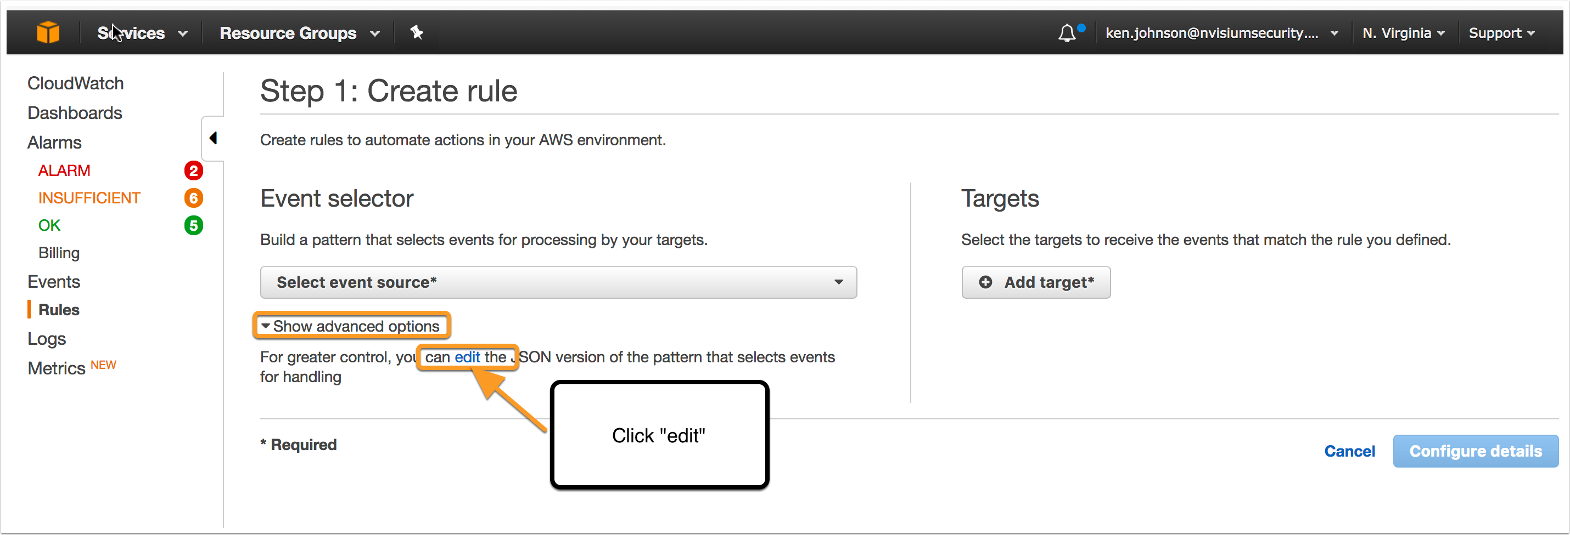
Monitoring
Directly edit the JSON

Slide 71
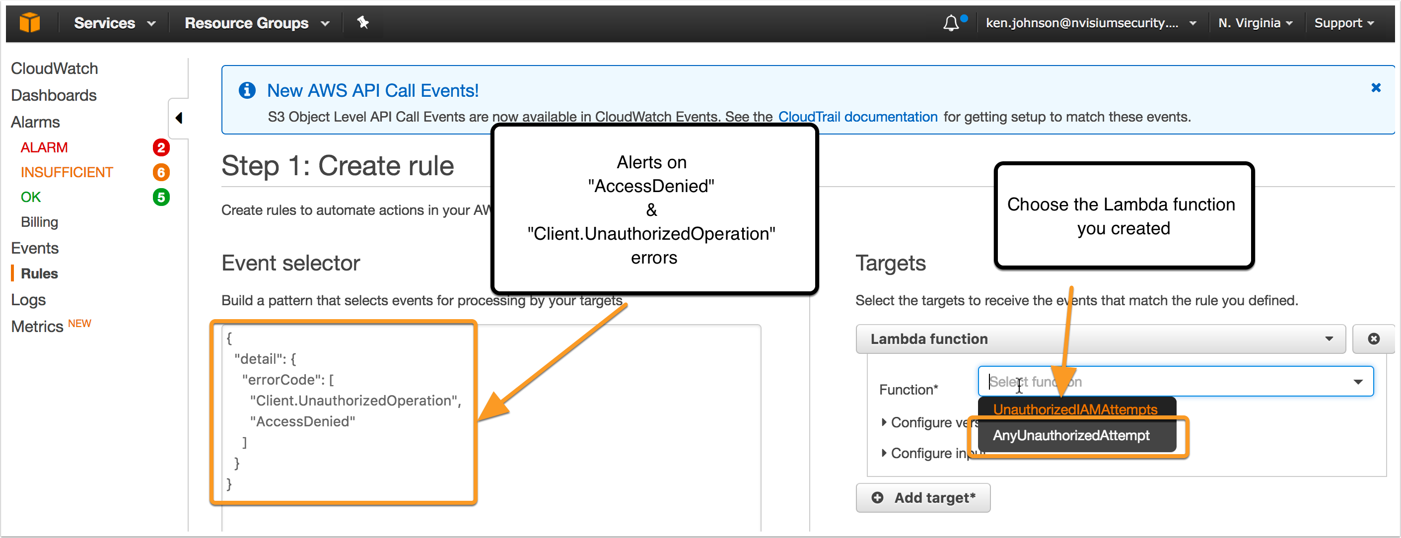
Monitoring
Paste in JSON and select Lambda Function as Target

Slide 72
Monitoring
FINISH IT

Slide 73
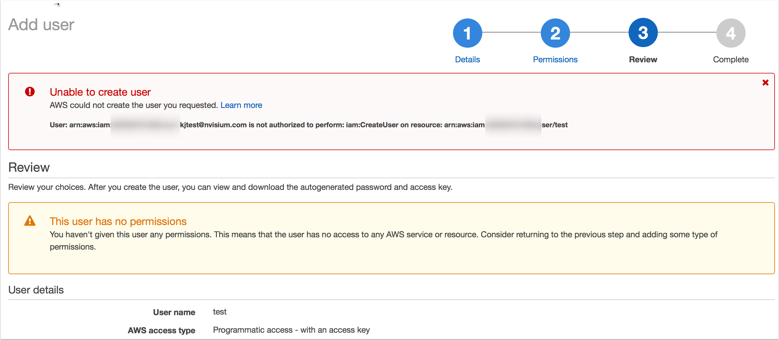
Monitoring
Time to test

Slide 74
Monitoring
W00T!

Slide 75
Monitoring
You can now unleash the power of Event Rules for other alerts
Simple as editing the JSON and parsing the data via Lambda
Use BOTH CloudWatch Alarms AND Events

Slide 76
Monitoring
Previous versions of this talk show how to configure Alerts for:
Root account usage
Billing Alerts (Exceed normal spend)
Failed Login Attempts
https://www.youtube.com/watch?v=g-wy9NdATtA&feature=youtu.be

Slide 77
Hardening

Slide 78
Hardening
The AWS Security Fundamentals Course provides the framework for your plan:
You are responsible for leveraging the tools AWS provides (financially)
Your configuration… that is on you
https://aws.amazon.com/training/course-descriptions/security-fundamentals/

Slide 79
Hardening
Don’t Use The Root Account!
Audit IAM user policies
Multi-Factor Authentication
API + MFA
IAM Roles
Misc

Slide 80
AWS ROOT ACCOUNT

Slide 81
Hardening – AWS Root Account
Every AWS environment has a root account
Root account is the king/god/all-powerful
Use only when you absolutely must
When those circumstances arise, notify your team first

Slide 82
Hardening – AWS Root Account
Simple steps:
Disable or delete access keys if they exist:
Implement verbal/written policy that states “we don’t create access keys for the root account
Use the CloudWatch Alarm I mention to alert on its use

Slide 83
Auditing IAM Permissions

Slide 84
Hardening – Auditing IAM Permissions
A single IAM user can have…
Multiple Managed Policies
Multiple Inline Policies
Belong to multiple IAM Groups which…
Have multiple managed policies
Have multiple inline policies

Slide 85
Hardening – Auditing IAM Permissions
Explanation
Managed Policies: Policies that can be attached to multiple users, groups, or roles
Inline Policies: Directly attached to a single user, group, or role

Slide 86
Hardening – Auditing IAM Permissions
Tool to inspect each user’s permissions:
https://gist.github.com/cktricky/257990df2f36aa3a01a8809777d49f5d
Will create a CSV file
Provides you with
Usernames
Inline Policies
Managed Policies
Groups

Slide 87
Hardening – Auditing IAM Permissions
Tool Output

Slide 88
Hardening – Auditing IAM Permissions
Closer look

Slide 89
Hardening – Auditing IAM Permissions
https://aws.amazon.com/blogs/security/move-over-json-policy-summaries-make-understanding-iam-policies-easier/

Slide 90
Hardening – Auditing IAM Permissions
Why this is important
If you house sensitive data, you need to know who has access
Permissions should be a need-to-have/know situation in order to limit damage should creds get stolen
AWS is a flexible environment that changes – your permission model might need to change with it (inventory it)

Slide 91
Multi-Factor Authentication (MFA)

Slide 92
Hardening – MFA
MFA == 2-Factor Authentication
If credentials are stolen or guessed, we want a second layer of protection
You can use apps or hardware to do this
Google Authenticator (Apps)
Gemalto (Hardware)
Find the full list of MFA devices here:
https://aws.amazon.com/iam/details/mfa/

Slide 93
Hardening – MFA
Let’s demonstrate enabling MFA using a virtual device (app) on an IAM account

Slide 94
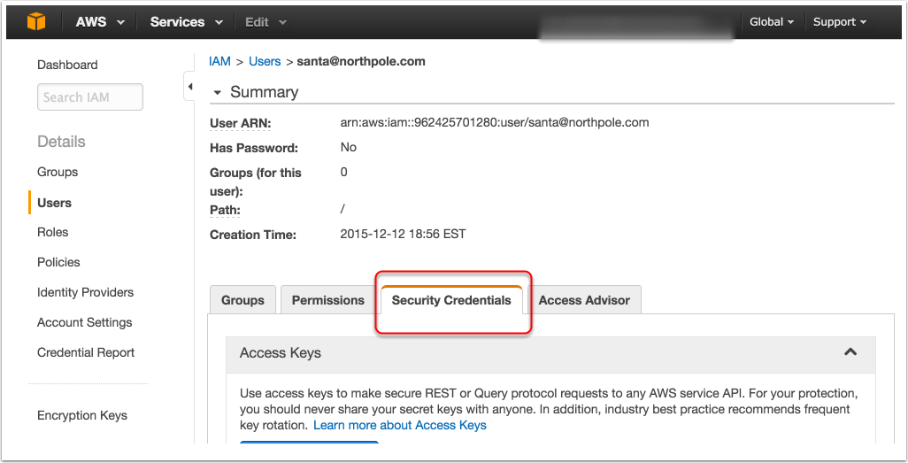
Hardening – MFA
Navigate to Identity & Access Management

Slide 95
Hardening – MFA

Slide 96
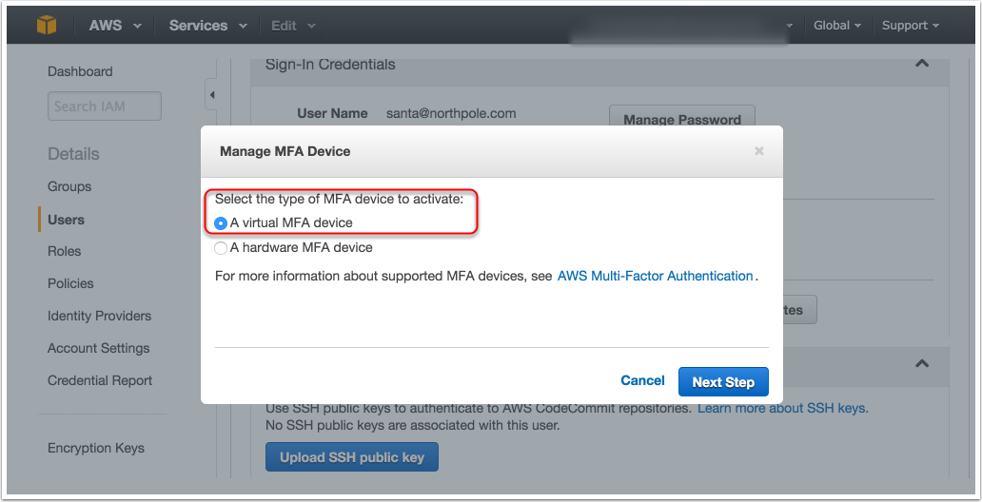
Hardening – MFA

Slide 97
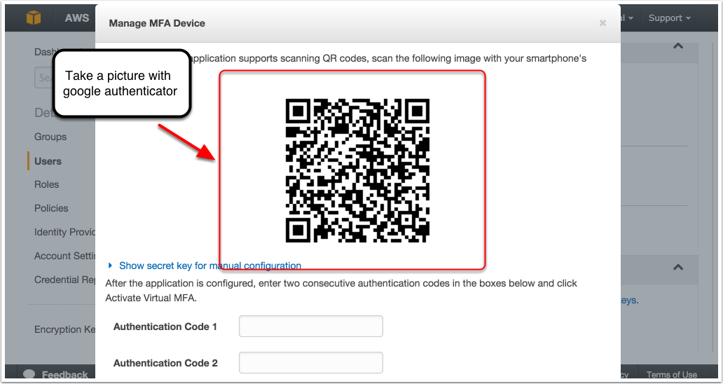
Hardening – MFA

Slide 98
Hardening – MFA
At this point, its worth mentioning that non-administrators or those without IAM privileges cannot enable MFA on their own account
Why is this a problem? Well, they need to be able to enable MFA on their own device… not the administrator’s
Fortunately, we have a solution!

Slide 99
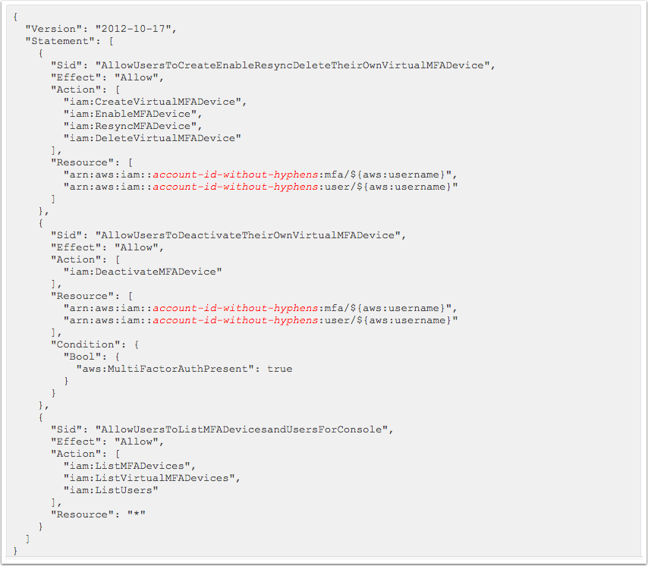
Hardening – MFA

Slide 100
Hardening – MFA
Okay so that wasn’t the easiest to read, so here is the link: http://docs.aws.amazon.com/IAM/latest/UserGuide/id_credentials_delegate-permissions_examples.html#creds-policies-mfa-console
Basically this IAM policy allows a user to manage their *OWN* MFA device

Slide 101
Hardening – MFA
Need a shared MFA for root? TOTP!
Recommend using something like 1password for teams, can share the TOTP code:
https://support.1password.com/guides/mac/totp.html
https://www.youtube.com/watch?v=eZyb-ArMK9g

Slide 102
API & MFA

Slide 103
Hardening – API & MFA
This is the alternative to interacting with the AWS environment via the web console
Typically used for automated tasks
Automated tasks means “code”.

Slide 104
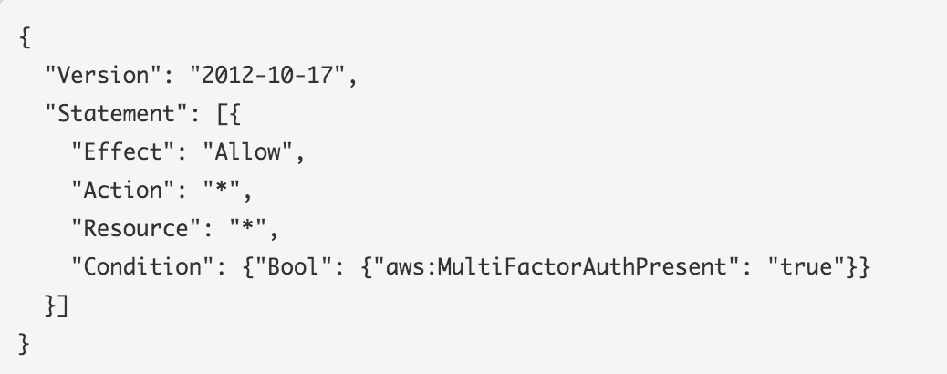
Hardening – API & MFA
At a minimum apply to those with IAM permissions

Slide 105
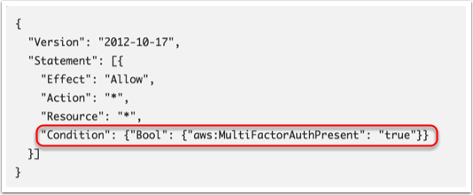
Hardening – API & MFA
This entry requires MFA for Web/API

Slide 106
Hardening – API & MFA
Truth be told, doing this can be painful at first
Things that used to work, might not (via the API)
Fortunately, we have some answers for you
Firstly, let’s discuss STS or SecurityToken Service

Slide 107
Hardening – API & MFA
Leverage STS in order to interact with the AWS API should this MFA restriction be placed on resources (and it should ☺ )
Example of using STS:
https://gist.github.com/cktricky/127be4e431563a986f0f

Slide 108
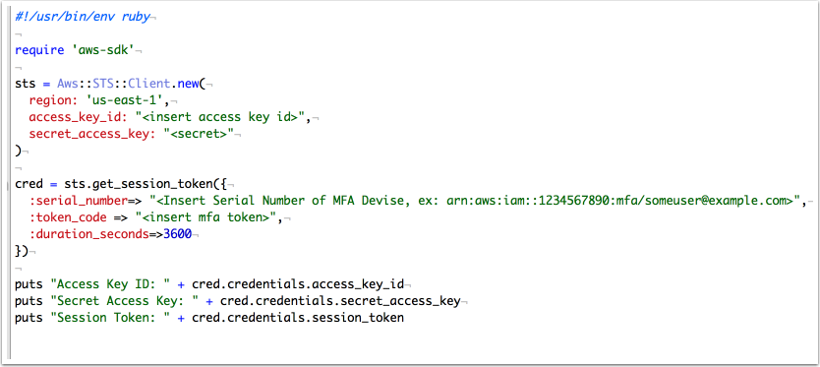
Hardening – API & MFA
Example of retrieving creds (in the gist)

Slide 109
Hardening – API & MFA
Output of script

Slide 110
Hardening – API & MFA
Use the creds to leverage tools like ec2-api-tools
(-O <access key id>–W <secret> and –T <session token>)

Slide 111
Hardening – API & MFA
https://github.com/jimbrowne/aws-sts-helpers

Slide 112
Hardening – API & MFA
ElasticBeanstalk does not work with STS. Le Terrible.
However, there is a workaround, use CodePipeline.
Very simple process to setup but only works with:
GitHub
AWS CodeCommit
Amazon S3

Slide 113
Hardening – API & MFA
Remember MFA only protects against the web and NOT the API… unless you change your policies and use STS

Slide 114
IAM Roles

Slide 115
Hardening – IAM Roles
Roles
Is *like* a user but is not an IAM user
Replaces the need for hardcoded Access Key ID & Secret
The extent of what a role can do is heavily controlled by you, the administrator

Slide 116
Hardening – IAM Roles
Credentials automatically rotate via STS
Available here on an EC2 instance: http://169.254.169.254/latest/meta-data/iam/security-credentials/
If you’re using the AWS-SDK gem/egg/etc – credential handling is built-in
If you’re using something like Paperclip + Rails, try Fog to leverage Roles
https://github.com/thoughtbot/paperclip/issues/1591

Slide 117
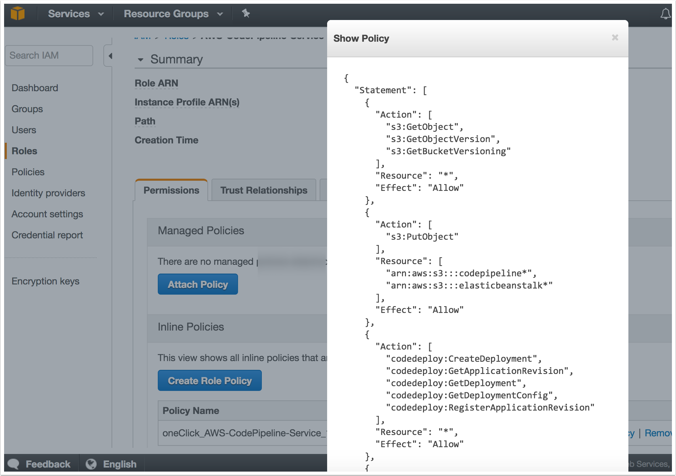
Hardening – IAM Roles
Example of a Role policy (shown within IAM)

Slide 118
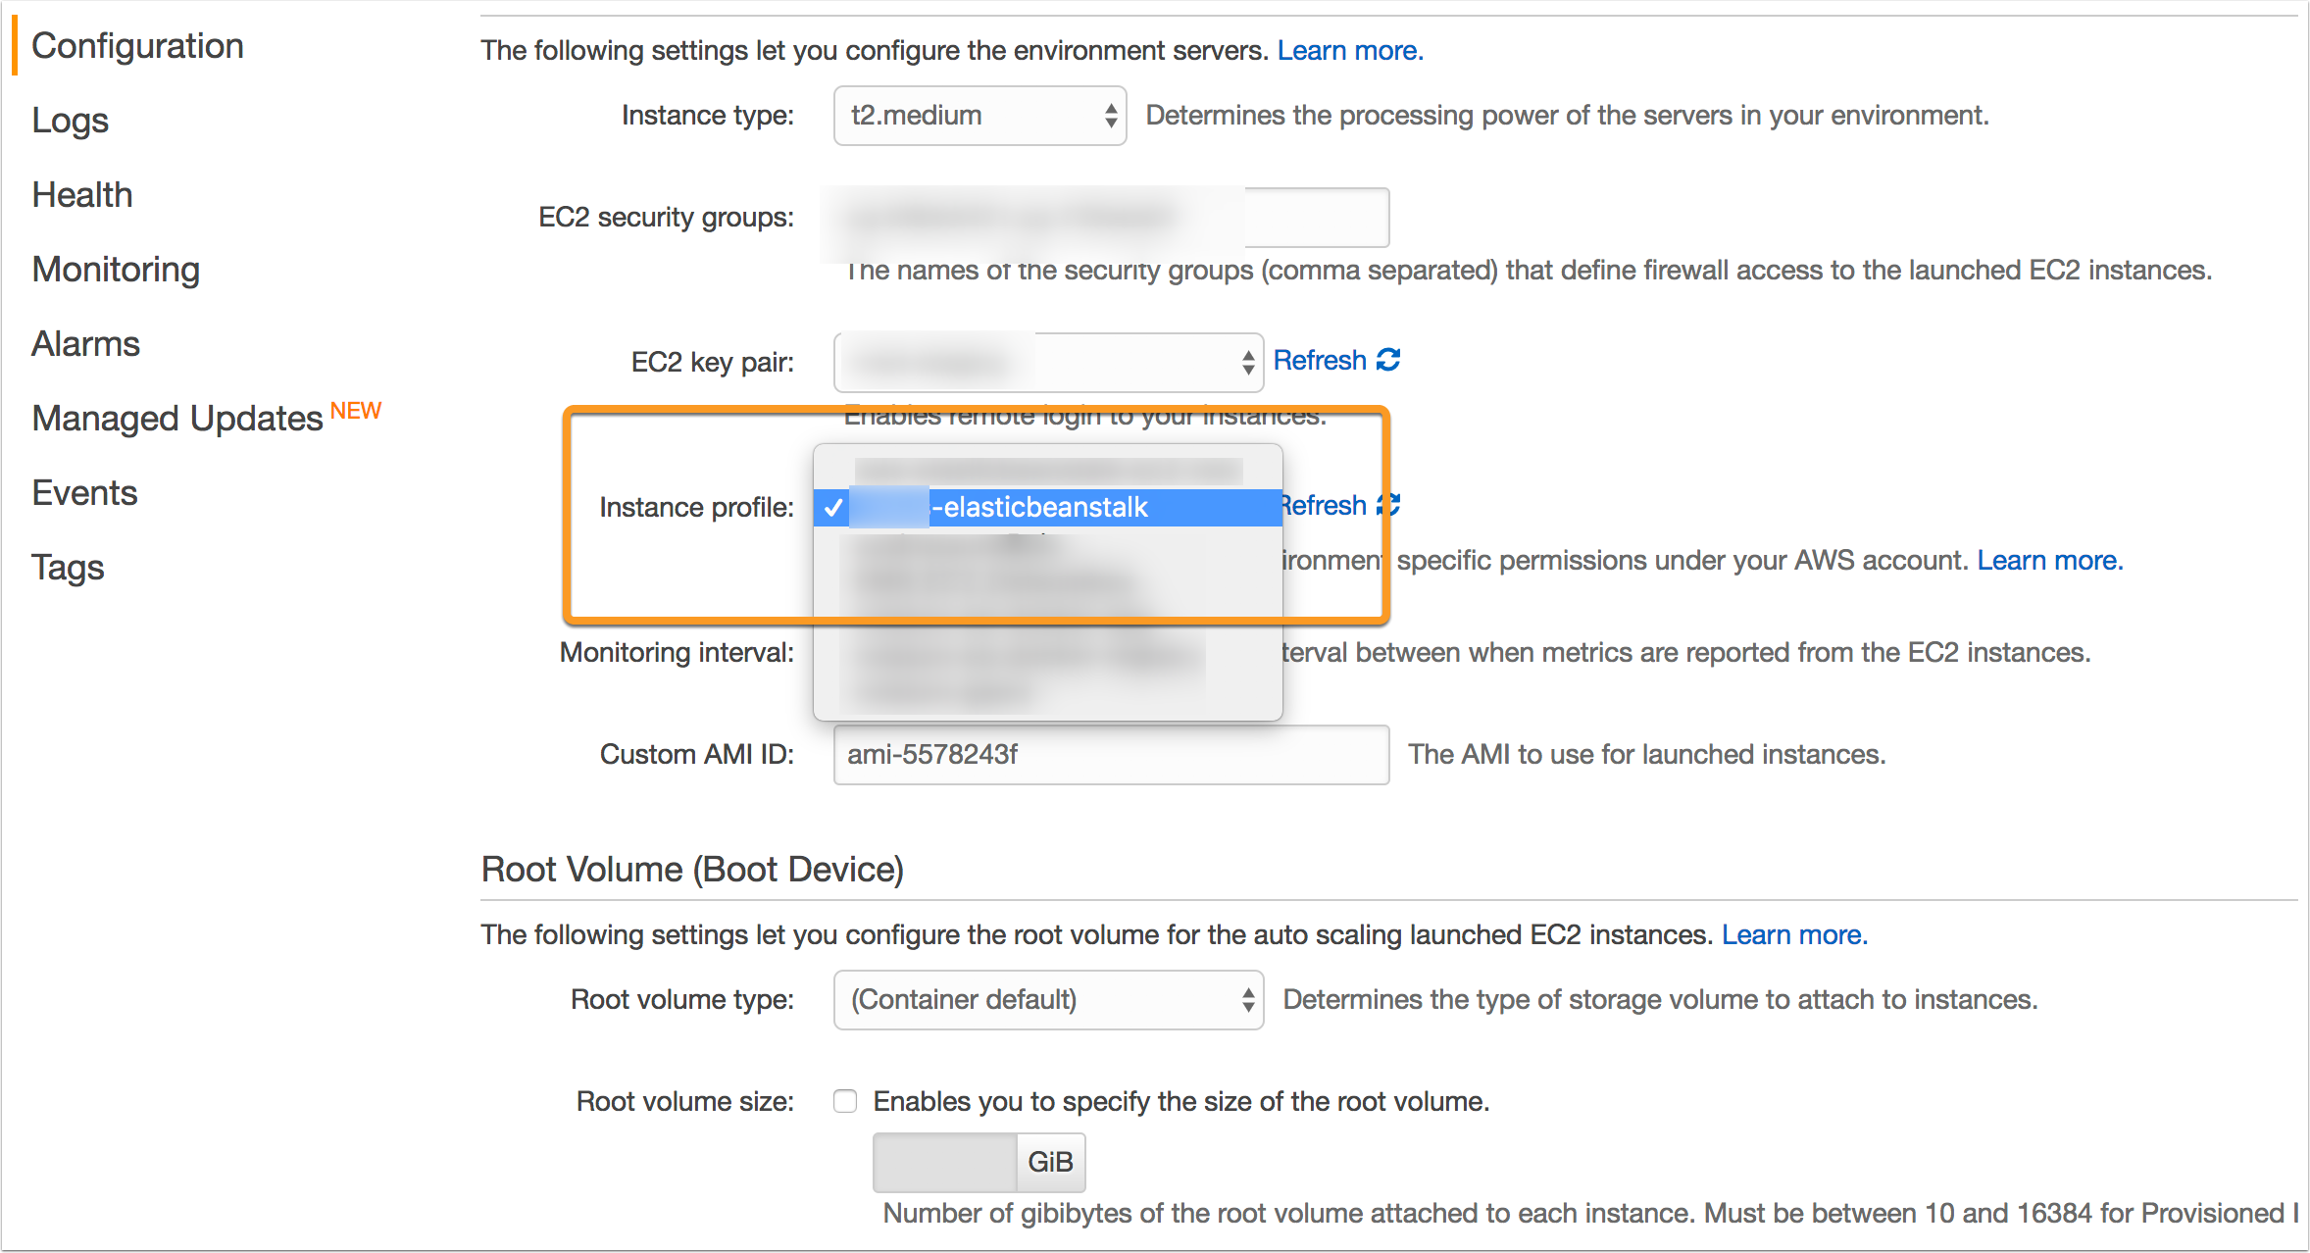
Hardening – IAM Roles
Example attaching Role to ElasticBeanstalk instance

Slide 119
Misc

Slide 120
Hardening – Misc
Review AWS environment for Unencrypted and Encrypted EBS Volumes
https://gist.github.com/cktricky/0fa3b13ca4306bcd1ec384e88eac3f55

Slide 121
Hardening – Misc
Review S3 buckets to determine security policy
https://gist.github.com/cktricky/faf0f40116e535a055b7412458136917

Slide 122
Splunk + AWS

Slide 123
Splunk + AWS
Splunk is a pretty great resource for monitoring activity
I’m fairly new to Splunk myself
Two separate plugins:
Splunk App for AWS
https://splunkbase.splunk.com/app/1274/
Splunk Add-On
https://splunkbase.splunk.com/app/1876/

Slide 124
Splunk + AWS
Examples of things you can view:
Billing
Topology
Usage
IAM Activity
SSH Key Pair Activity
User Activity
Network ACL(s)
VPC Activity
and a lot more…

Slide 125
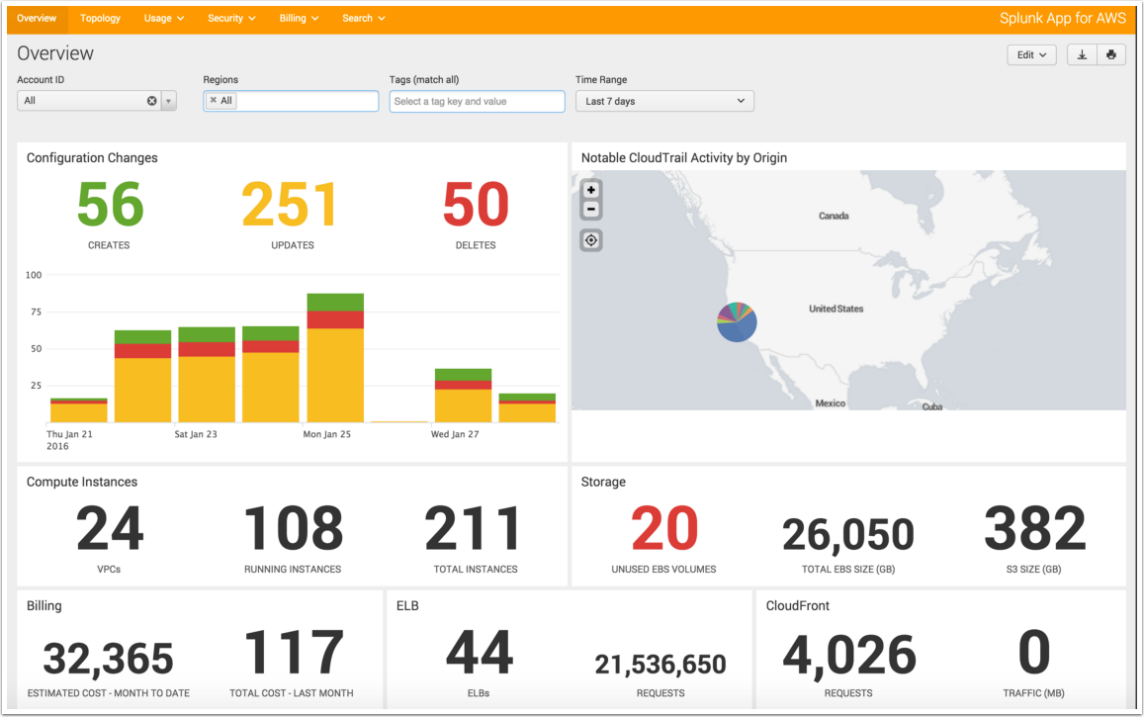
Splunk + AWS

Slide 126
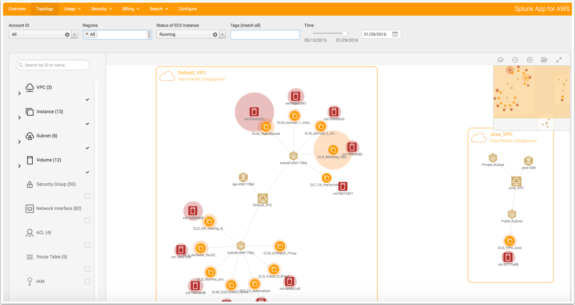
Splunk + AWS

Slide 127
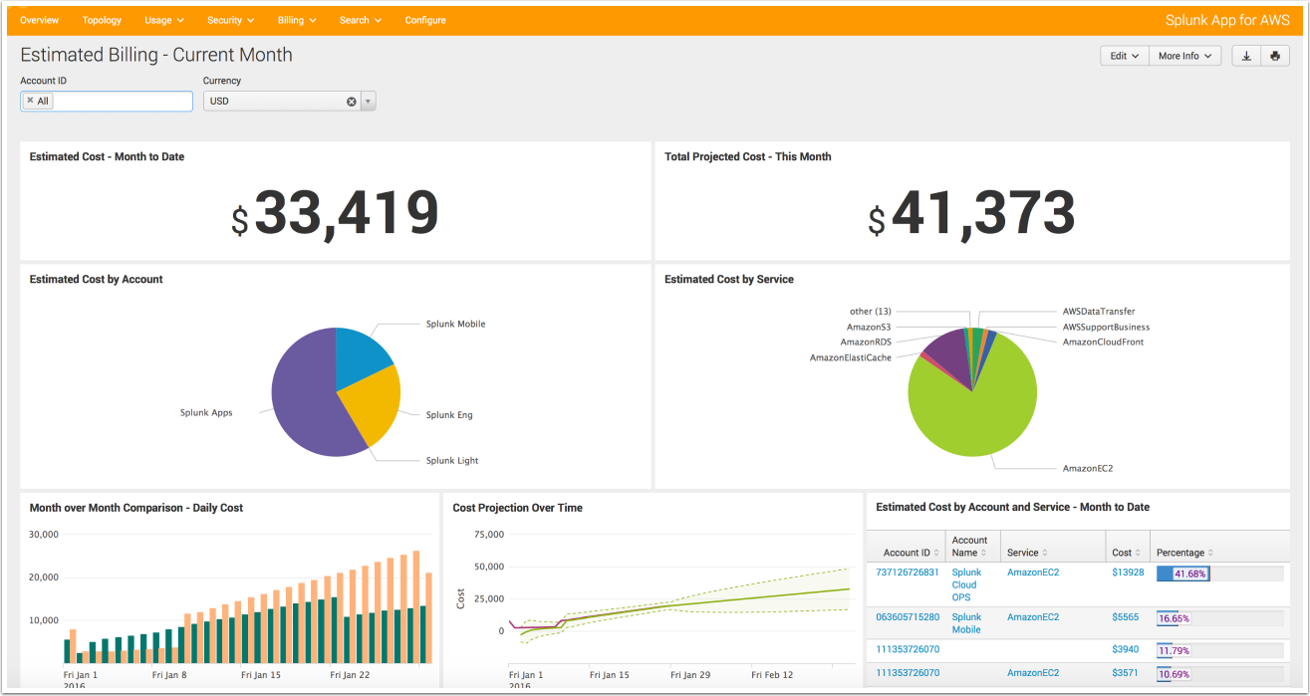
Splunk + AWS

Slide 128
Splunk + AWS
Splunk will need an AWS account in order to retrieve data
Create account(s) for Splunk, grab the necessary permission policy from here:
http://docs.splunk.com/Documentation/AddOns/released/AWS/ConfigureAWSpermissions

Slide 129
Summary

Slide 130
Hardening – API & MFA
Hopefully, I’ve given you some ideas
We talked about Monitoring & Hardening
But we did NOT discuss recovery (prepare for the worst)
http://www.irongeek.com/i.php?page=videos/derbycon6/120-hardening-aws-environments-and-automating-incident-response-for-aws-compromises-andrew-krug-alex-mccormack

Slide 131
THANKS!
Any questions?
You can find me at @cktricky & cktricky@gmail.com

