Slide 1
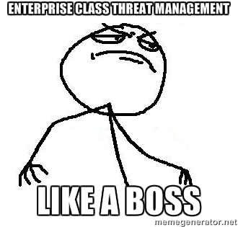
Enterprise Class Threat Management Like A Boss Rockie Brockway Business Risk Director Black Box Network Services

Slide 2
Bio
24 Year veteran in InfoSec/Risk
All certs have expired (including those I’ve taught)
Business Systems and Impact Analyst (Risk)
Enterprise Security Architect
Penetration/Red/Purple Team Tester
Speaker/Trainer/BSidesCLE
Musician/Woodworker/Landscaper/Hacker
rockie.brockway@blackbox.com
https://www.linkedin.com/pub/rockie-brockway/9/634/641
@rockiebrockway

Slide 3
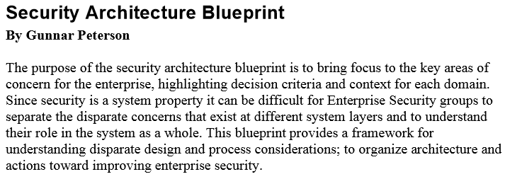
Brief History Lesson
Notes:
Gunnar Peterson, then of ARCTEC, wrote this document in 2006/2007.
This framework is still absolutely valid today and will be used as the core of this refresher talk

Slide 4
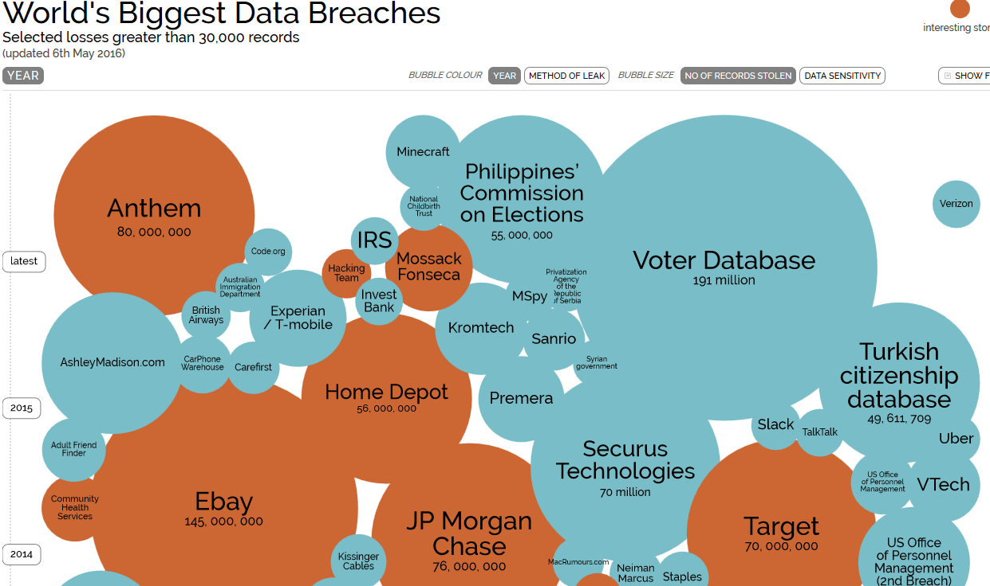
Information is Beautiful
Breach Business Impact Continues to Grow
Notes:
These are problems

Slide 5
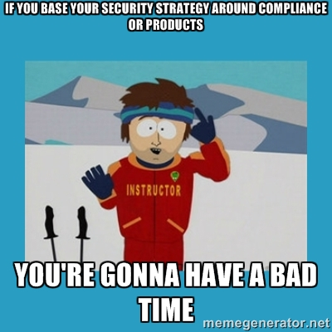
Project and/or Compliance = Incorrect
Breach Business Impact Continues to Grow
Reasons:
While most orgs understand data protection is a crucial strategic business issue, they continue to approach it on either
A project by project basis and/or
From a Compliance perspective
The reality is that data security inherently relates to financial business risk and must be treated as a function of the business itself
Notes:
What do the security nerds always say? “if you’re compliant, you’re not secure, but if you’re secure you will also be compliant”

Slide 6
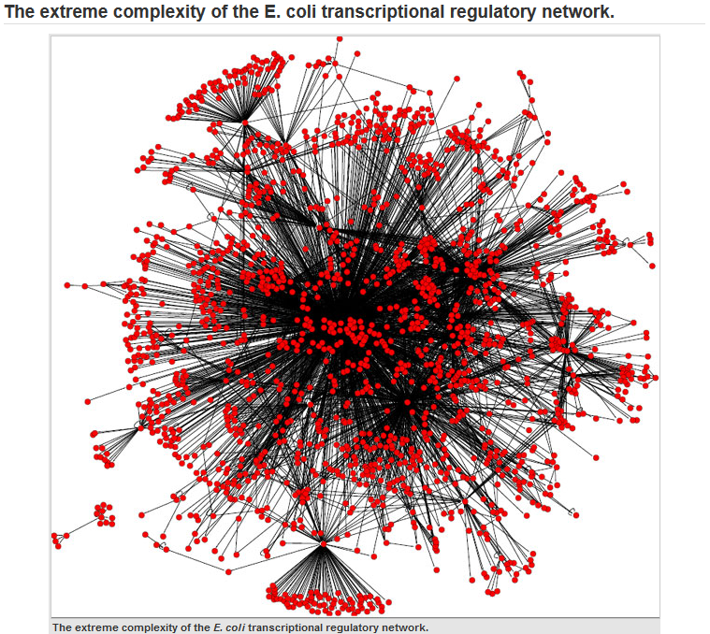
Complexity in the Enterprise
From the Enterprise to the Application, more complexity means less security
Simple, individual projects do not need “Architecture”
“Architecture” is required to successfully fit an individual project into a larger, more complex set of projects
Notes:
Infosec folk will always preach that the more complex a system is the less secure it inherently is.
And while simple projects do not typically require architecture, it is required in more complex environments

Slide 7
Organizing Complexity Through Architecture
Like the design of buildings and cities, information architecture must take into consideration:
Organizational goals to be achieved by the systems
The environment where the systems will be built and used
The technical capabilities required to build and operate the systems
Benefits:
Organizes your Enterprise’s complexity
Focuses on Security, not Compliance (but still maps to compliance, we still have auditors :P)
METRICS!
Allows business owners to make educated security/risk decisions without having to be an infosec professional
Notes:
Just like your typical definition of architecture:
What are the goals?
What is the environment where it will be built?
What is required to build it?

Slide 8
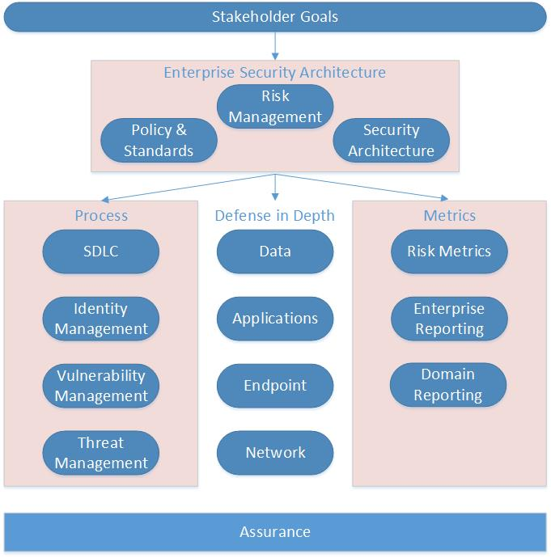
Enterprise Security Architecture
Security inherently relates to business risk and must be treated as a board supported function of the business
Enterprise Security Architecture aligns organizational business strategy and goals with the protection of the organization’s business critical data
Notes:
This ESA framework is Peterson’s from the 2007 ARCTEC paper
Security is a function of the business
Typically treated on project by project basis or from compliance perspective
Must align business goals with protection of business critical data

Slide 9
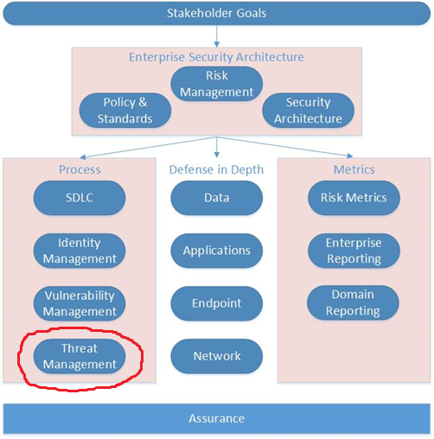
Process
Threat Management
The set of all processes for discovering, reporting and mitigating enterprise threats
Threat Management is typically broken down into:
Controls/Logging sources
Monitoring
Threat modeling
Incident response
“Threat Intelligence”
It is critical to have vulnerability accountability and ownership throughout the enterprise, with the associated metrics, to reduce the risks of asset breach by threat actors

Slide 10
Process
Threat Management Challenges
Moore’s Law – Malware evolves at equal speed
Intelligence – Having knowledge of the latest attacks and trends and if/how they affect your assets is crucial
Communication – Effectively transferring the knowledge of threat data to the service owners
Coordination – Effectively and efficiently utilizing resources across multiple business units during an incident
Accountability – Ensuring that the discovered and analyzed threats are remediated/mitigated and communicated back out to the service owners
Metrics – IS needs to be able to communicate the value of the threat management program back to the business
Talent – Negative unemployment in InfoSec in general, let alone when focusing on experienced threat analysts and IR specialists

Slide 11
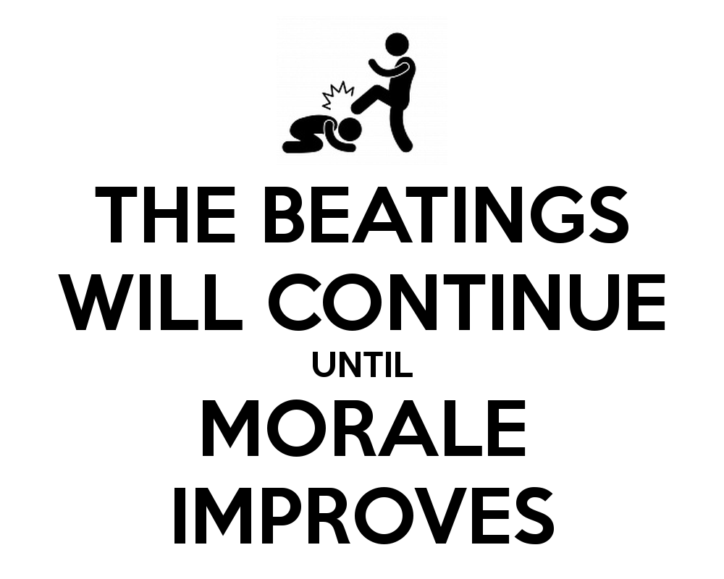
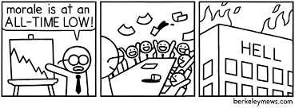
Perhaps more importantly …
Notes:
Sensage 2012 report showed that the massive and mostly manual efforts of collecting and analyzing security data has caused a severe downturn in both the mood of security teams as well as perception of their effectiveness by stakeholders. I’d cite the report but it is now a dead link.

Slide 12
I’ve seen things you people wouldn’t believe
Notes:
Which inevitably leads to this - How many of you have ever felt like this?
This year was very special for this replicant. Incept Date: January 8, 2016

Slide 13
Process
Threat Management Goals
Improved intelligence for quicker decision making and response
Buy in from all service owner/stakeholders
Utilize all primary data sources available (including people)
Integration of existing Vulnerability Management process and SOC functionality with existing business ticketing systems
Improved detection and reaction times
Threat prioritization
Includes threat multipliers
Incident Response maturity
Service Owner and Stakeholder reporting with associated metrics
Notes:
NOT threat management – vulnerabilities are just gaps that can be exploited, nothing about actor, etc.

Slide 14
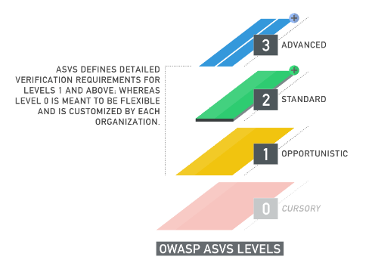
Inspiration
OWASP Application Security Verification Standard (ASVS) 2014
https://www.owasp.org/images/6/67/OWASPApplicationSecurityVerificationStandard3.0.pdf
Notes:
I got introduced to ASVS in January 2015 at Bill Sempf’s BSidesColumbus talk
ASVS is a SDLC and replaces OWASP top 20 as a framework that can actually be implemented

Slide 15
Inspiration
OWASP Application Security Verification Standard (ASVS) 2014
Level 0
Cursory – Indicates that some type of organizationally defined review has been performed on the application, and that the verification requirements were not provided by ASVS
Notes:
ASVS replaces OWASP top 20 as a framework that can actually be implemented

Slide 16
Inspiration
OWASP Application Security Verification Standard (ASVS) 2014
Level 1 (ASVS L1)
Opportunistic – Indicates that the application can adequately defend itself against application security vulnerabilities that are easy to discover
Such vulnerabilities are typically discovered with minimal to low effort, and cannot be considered a thorough inspection of the application
Threats to the application will most likely come from attackers using simple techniques and automated tools
Notes:
ASVS replaces OWASP top 20 as a framework that can actually be implemented

Slide 17
Inspiration
OWASP Application Security Verification Standard (ASVS) 2014
Level 2 (ASVS L2)
Standard – Indicates that the application can adequately defend itself against prevalent application security vulnerabilities of moderate to serious risk
Such vulnerabilities include the OWASP Top 10 and Business Logic vulnerabilities
The majority of business applications should work towards this level
Threats to the application will most likely come from opportunistic attackers, and possibly some motivated actors
Notes:
ASVS replaces OWASP top 10 as a framework that can actually be implemented

Slide 18
Inspiration
OWASP Application Security Verification Standard (ASVS) 2014
Level 3 (ASVS L3)
Advanced – Indicates that the application can adequately defend itself against all advanced application security vulnerabilities and shows principles of good security design
Level 3 requires an inspection of an application’s design
Level 3 is appropriate for critical applications that protect life, critical infrastructure and/or defense functions
Threats to the application will be from motivated actors and nation-states
Notes:
ASVS replaces OWASP top 20 as a framework that can actually be implemented

Slide 19
Inspiration
We can build on and improve this
Notes:
We shouldn’t be asking for quarterly vulnerability scans, we should be asking how mature is our vulnerability management process?
How mature is your threat management process? Applying the ASVS framework to VM and TM gets us closer to an objective score

Slide 20
Application
Applying ASVS 2014 v3 to Threat Management
Level 0 (ASVS Threat L0)
Cursory – Indicates that some type of organizationally defined Threat analysis has been performed on the organization’s data space, and that the verification requirements were not provided by this hybrid framework
Org understands threats should be monitored
May have some loose threat analysis
Not invested in threat management tools
Notes:
So, applying ASVS to vulnerability management

Slide 21
Application
Applying ASVS 2014 v3 to Threat Management
Level 1 (ASVS Threat L1)
Opportunistic – Indicates that the organization can adequately defend itself against non-targeted threat that are easy to discover
Such threats are typically discovered with minimal to low effort, and cannot be considered a thorough inspection of the threat attributes
Threats to the organization will most likely come from attackers using simple techniques and automated tools
Notes:
ASVS replaces OWASP top 20 as a framework that can actually be implemented

Slide 22
Application
Applying ASVS 2014 v3 to Threat Management
Level 1 (ASVS Threat L1)
No dedicated Infosec/Risk group
Reliance on rudimentary alerts (FW, Network IPS, AV)
Process in place for handling malware infected systems (typically cleaning or refreshing the system)
Centralized logging capabilities, no correlation
Sporadic additional “threat intelligence” (SANS alerts, infoworld, the register, etc.)
May have an open source or commercial vulnerability scanning tool
Comfortable with NIST/ISO/regulatory compliance to deter threats
Notes:
I think that’s reasonable

Slide 23
Application
Applying ASVS 2014 v3 to Threat Management
Level 2 (ASVS Threat L2)
Standard – Indicates that the organization can adequately defend itself against prevalent threats of moderate to serious capability
Such threats include hacktivists and non-targeting organized crime actors
The majority of business organizations should work towards this level
Threats to the business will most likely come from opportunistic attackers, and possibly some motivated actors
Notes:
ASVS replaces OWASP top 20 as a framework that can actually be implemented

Slide 24
Application
Applying ASVS 2014 v3 to Threat Management
Level 2 (ASVS Threat L2)
Dedicated InfoSec/Risk group (including dedicated monitoring resource)
Integration with existing L2 Vulnerability Management process
Basic monitoring framework and SIEM deployment
Documented Incident Response framework
Pen/Red/Purple testing simulating threat actor breaches using real world tactics
InfoSec/Risk group may utilize enterprise ticketing system for documenting incidents
Open-source/internal/commercial threat intelligence sources

Slide 25
Application
Applying ASVS 2014 v3 to Threat Management
Level 2 (ASVS Threat L2)
Defined standard for reviewing intelligence with escalation processes
Commercial/Open Source tools used for centralized logging/SIEM
Asset and Data classification standards based on business critical services
Role Based Access Control standards based on Asset and Data classification standards
Threat modeling standard
Advanced endpoint controls (e.g. EMET, AMP, Falcon, Carbon Black, etc.) feeding SIEM
Corporate cloud adoption standards
3rd party risk assessments

Slide 26
Application
Applying ASVS 2014 v3 to Threat Management
Level 2 (ASVS Threat L2)
ENCRYPTION

Slide 27
Application
Applying ASVS 2014 v3 to Threat Management
Level 3 (ASVS Threat L3)
Advanced – Indicates that the organization can adequately defend itself against all advanced threats and shows principles of good security design
Level 3 requires a mature Enterprise Security Architecture
Level 3 is appropriate for critical applications that protect life, critical infrastructure and/or defense functions
Threats to the organization will be from motivated actors and nation-states
Notes:
ASVS replaces OWASP top 20 as a framework that can actually be implemented

Slide 28
Application
Applying ASVS 2014 v3 to Threat Management
Level 3 (ASVS Threat L3)
Threat prioritization standard
Help Desk response (triage)
SOC investigation (suspect)
Initiate IR levers (incident)
Mature IR framework includes buy in and participation from all business units (including legal and ethics)
IR RACI
IR tabletop exercises
Domain breach -> OOB coms and IR breach simulations
Phishing high value target
Ransomware
Malicious insider
Notes:
RACI
Responsible
Accountable
Consult
Informed

Slide 29
Application
Applying ASVS 2014 v3 to Threat Management
Level 3 (ASVS Threat L3)
Internal IR CMS in production
All threat investigative activity is documented in internal threat management/IR CMS
IR honeypot and data gathering tools deployed (e.g. dcept, kansa, GRR)
Process creation auditing (Event Log 4688) and powershell execution monitored
DLP/Rights Management (can be home grown) feeding into SIEM
Defined by data classification and RBAC standards
Enforceable identity access controls
Defined by data classification and RBAC standards
Notes:
RACI
Responsible
Accountable
Consult
Informed

Slide 30
Application
Applying ASVS 2014 v3 to Threat Management
Level 3 (ASVS Threat L3)
Network identity access controls
Documented threat multipliers
Adversary capabilities assessment (ROI)
Periodic threat matrix exercises
Stakeholder and service owner reporting
Also …
Notes:
F500 client 3 week pentest performed by top 4 accounting firm – sloppy, executed powershell.exe in first 30 mins, detected by SIEM and shut down by ISE in first 60 mins

Slide 31
Metrics!!!

Slide 32
Metrics!!!
Threat Management Metrics
Incident Metrics
Incident characteristics
Target system characteristics
Timeline
Number of systems targeted
Attack Metrics
Attack vector
Attack sophistication
Attack profile/characteristics
Obfuscation techniques

Slide 33
Metrics!!!
Threat Management Metrics
Data Metrics
Data targeted
Data compromised
Data exfiltrated
Incidents by Status
New
Active
Reopened
Verified
Excepted
Pending Remediation
Fixed

Slide 34
Metrics!!!
Threat Management Metrics
Mean Time to Compromise
Cost to Disrupt
Adversary Means
Adversary ROI
Notes:
Cost to disrupt is adversary’s cost in relation to time to compromise
Cost to disrupt is the basic model successful encryption schemes are based on

Slide 35
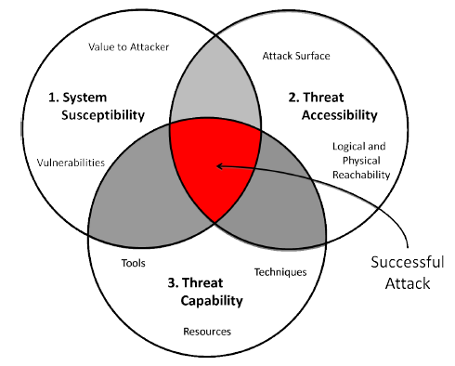
Details
Threat Modeling
Three Tenets Threat Model (1)
1. Quantitative Metrics and Risk Assessment: The Three Tenets Model of Cybersecurity
Jeff Hughes and George Cybenko

Slide 36
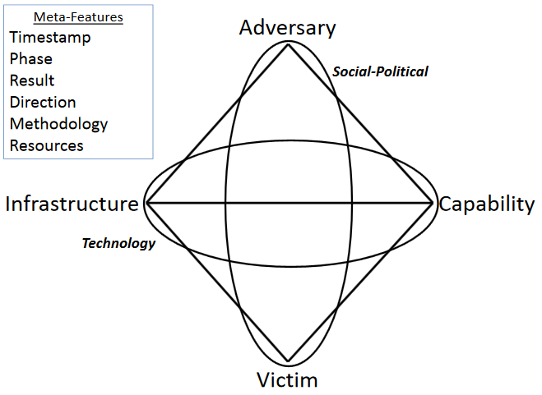
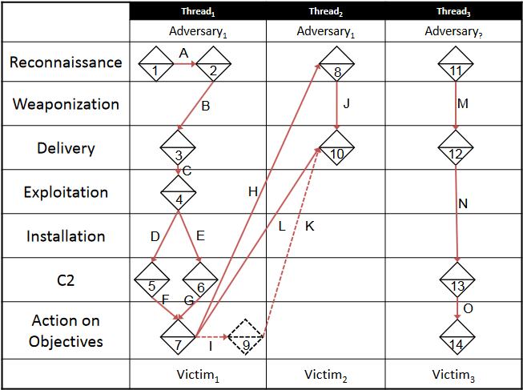
Details
Threat Modeling
Diamond Model of Intrusion Analysis (2)
2. https://www.threatconnect.com/wp-content/uploads/ThreatConnect-The-Diamond-Model-of-Intrusion-Analysis.pdf

Slide 37
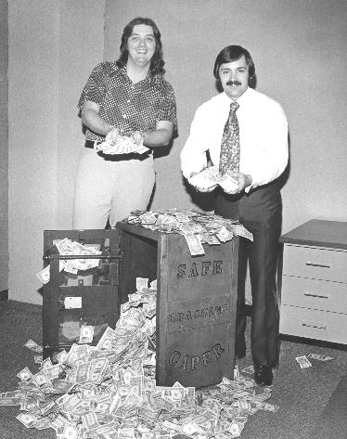
Details
Threat Modeling
ACTOR does ACTION to ASSET resulting in OUTCOME because of MOTIVATION (3)
3. Threat Modeling for Realz (Derbycon IV) - Bruce Potter

Slide 38
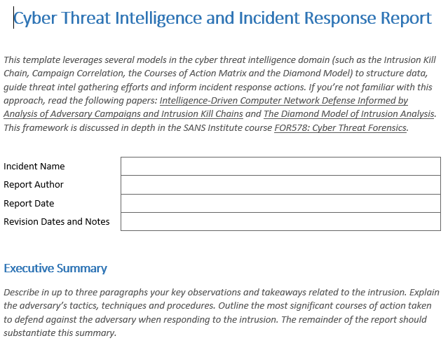
Details
Incident Documentation
Lenny Zeltzer! (4)
4. https://zeltser.com/media/docs/cyber-threat-intel-and-ir-report-template.pdf

Slide 39
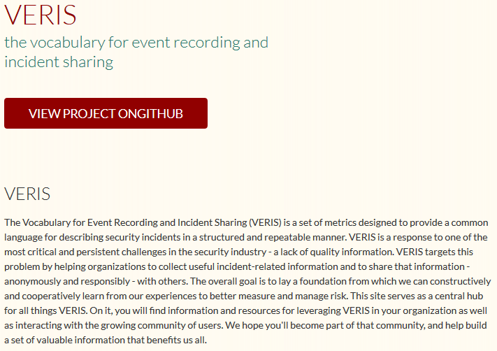
Details
Incident Lexicon
VERIS! (5)
5. http://veriscommunity.net/

Slide 40
“Demo”
“Demo” Threat Prioritization Framework
Notes:
ASVS replaces OWASP top 20 as a framework that can actually be implemented

Slide 41
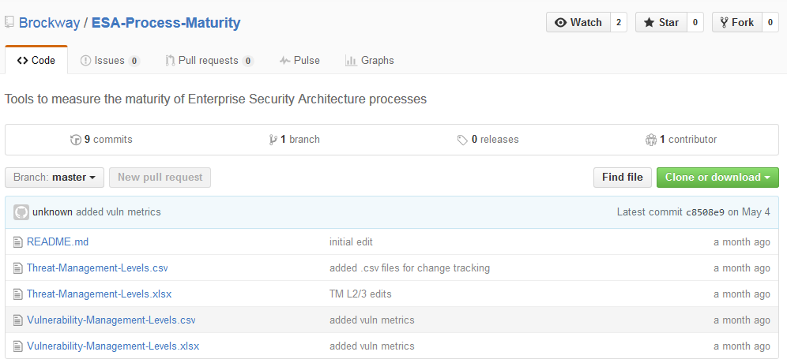
GitHub
https://github.com/Brockway/ESA-Process-Maturity
Notes:
ASVS replaces OWASP top 20 as a framework that can actually be implemented

Slide 42
What Next?
Identity Management and ASVS makes sense
Then GRC tool that defines ESA and then grades maturity of each of these processes in this manner
Yes, that is technically just an audit, but this audit has teeth and begins moving into the realm of objective security scoring and away from subjective “yay we comply so we are now safe” compliance audits
Notes:
L2 vuln scanner

Slide 43
What Next?
Notes:
L2 vuln scanner

Slide 44
Wrap Up
ASVS/Threat Management Application Gains
Security Focused, business aligned ESA process
Implementable Framework Based on Business Need
Reasonable measurement of Threat Management capabilities
Ownership and Accountability
Metrics
Notes:
Final thoughts

Slide 45
Q&A and References
ARCTEC PAPER http://www.arctecgroup.net/pdf/ArctecSecurityArchitectureBlueprint.pdf
Application Security Verification Standard 2014 v3
https://www.owasp.org/images/6/67/OWASPApplicationSecurityVerificationStandard3.0.pdf
Quantitative Metrics and Risk Assessment: The Three Tenets Model of Cybersecurity - http://timreview.ca/article/712
Diamond Model - https://www.threatconnect.com/wp-content/uploads/ThreatConnect-The-Diamond-Model-of-Intrusion-Analysis.pdf
Lenny! - https://zeltser.com/media/docs/cyber-threat-intel-and-ir-report-template.pdf
Veris! - http://veriscommunity.net/
Threat Modeling for Realz - http://www.irongeek.com/i.php?page=videos/derbycon4/t200-Threat-Modeling-for-Realz-Bruce-Potter
Contact:
rockie.brockway@blackbox.com
https://www.linkedin.com/pub/rockie-brockway/9/634/641
@rockiebrockway

