Slide 1
The Digital Battlefield

Slide 2
Intro

Slide 3
Intro

Slide 4
What we’ll cover today…

Slide 5
The War in Cyberspace

Slide 6
News clips from 2012 - Retail

Slide 7
News clips from 2012 – Social Media

Slide 8
News clips from 2012 - Government

Slide 9
News clips from 2012 – Card Processing

Slide 10
News clips from 2012 – Insurance

Slide 11
News clips from 2012 – Supply Chain Attack

Slide 12
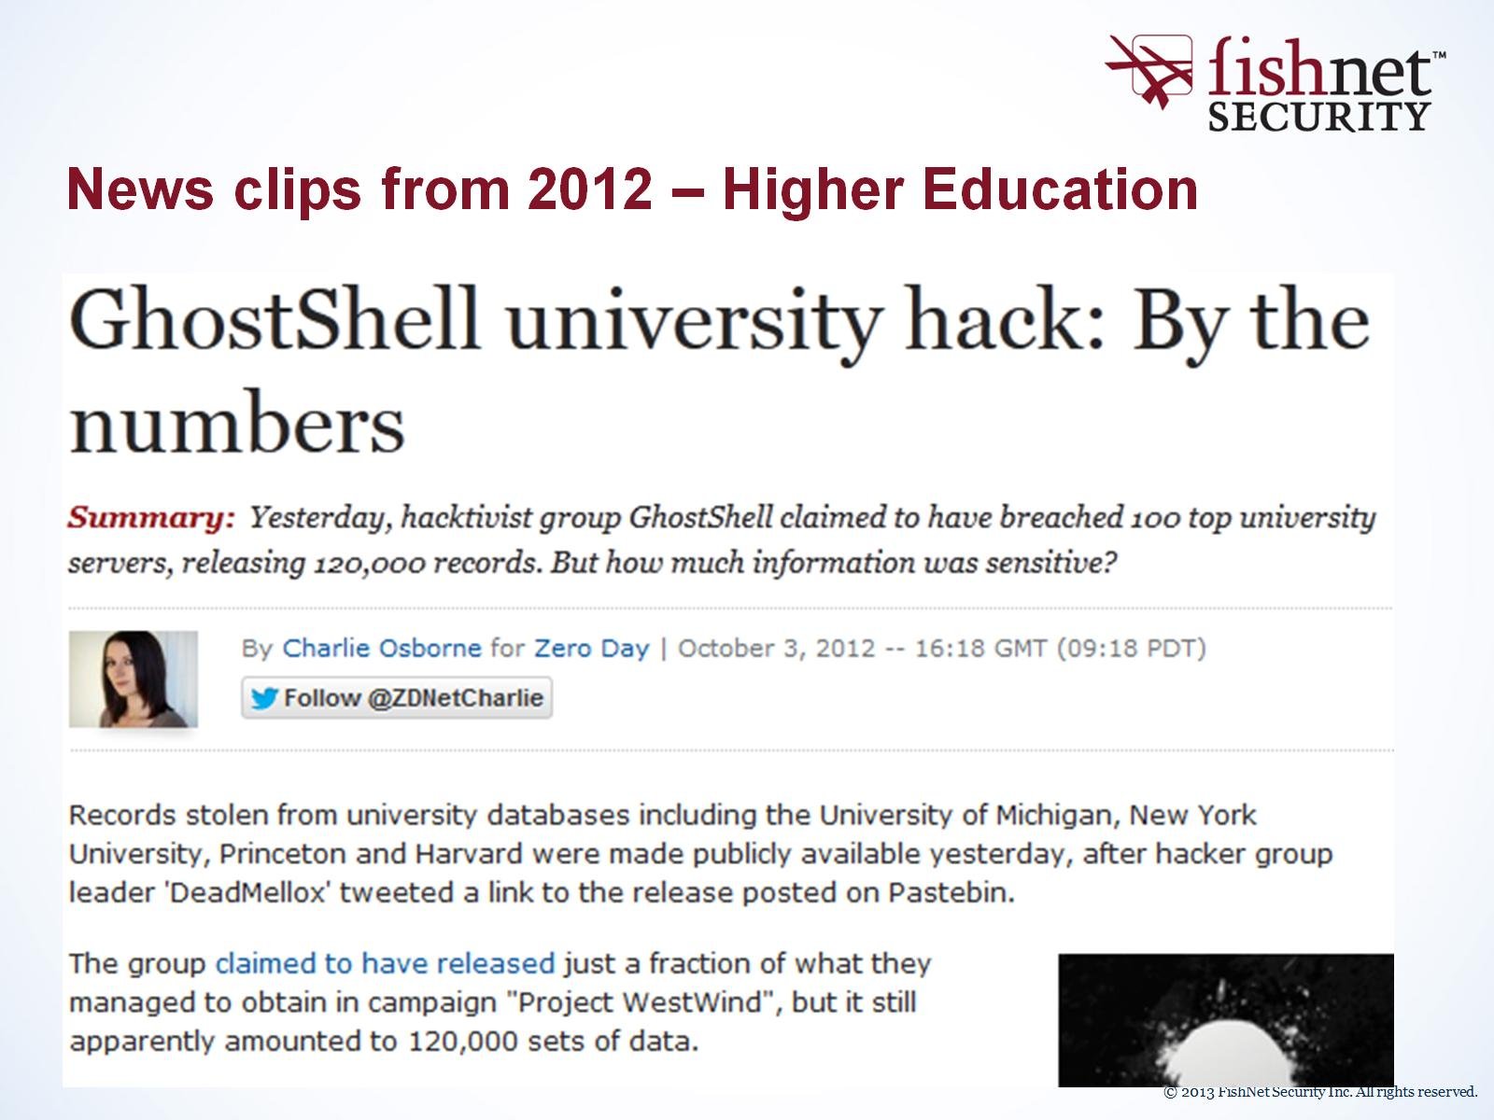
News clips from 2012 – Higher Education

Slide 13
News clips from 2012 – Hotels

Slide 14
News clips from 2012 – Technology

Slide 15
The Players

Slide 17
Report: Countries Prepping for Cyber War

Slide 18
Attackers

Slide 19
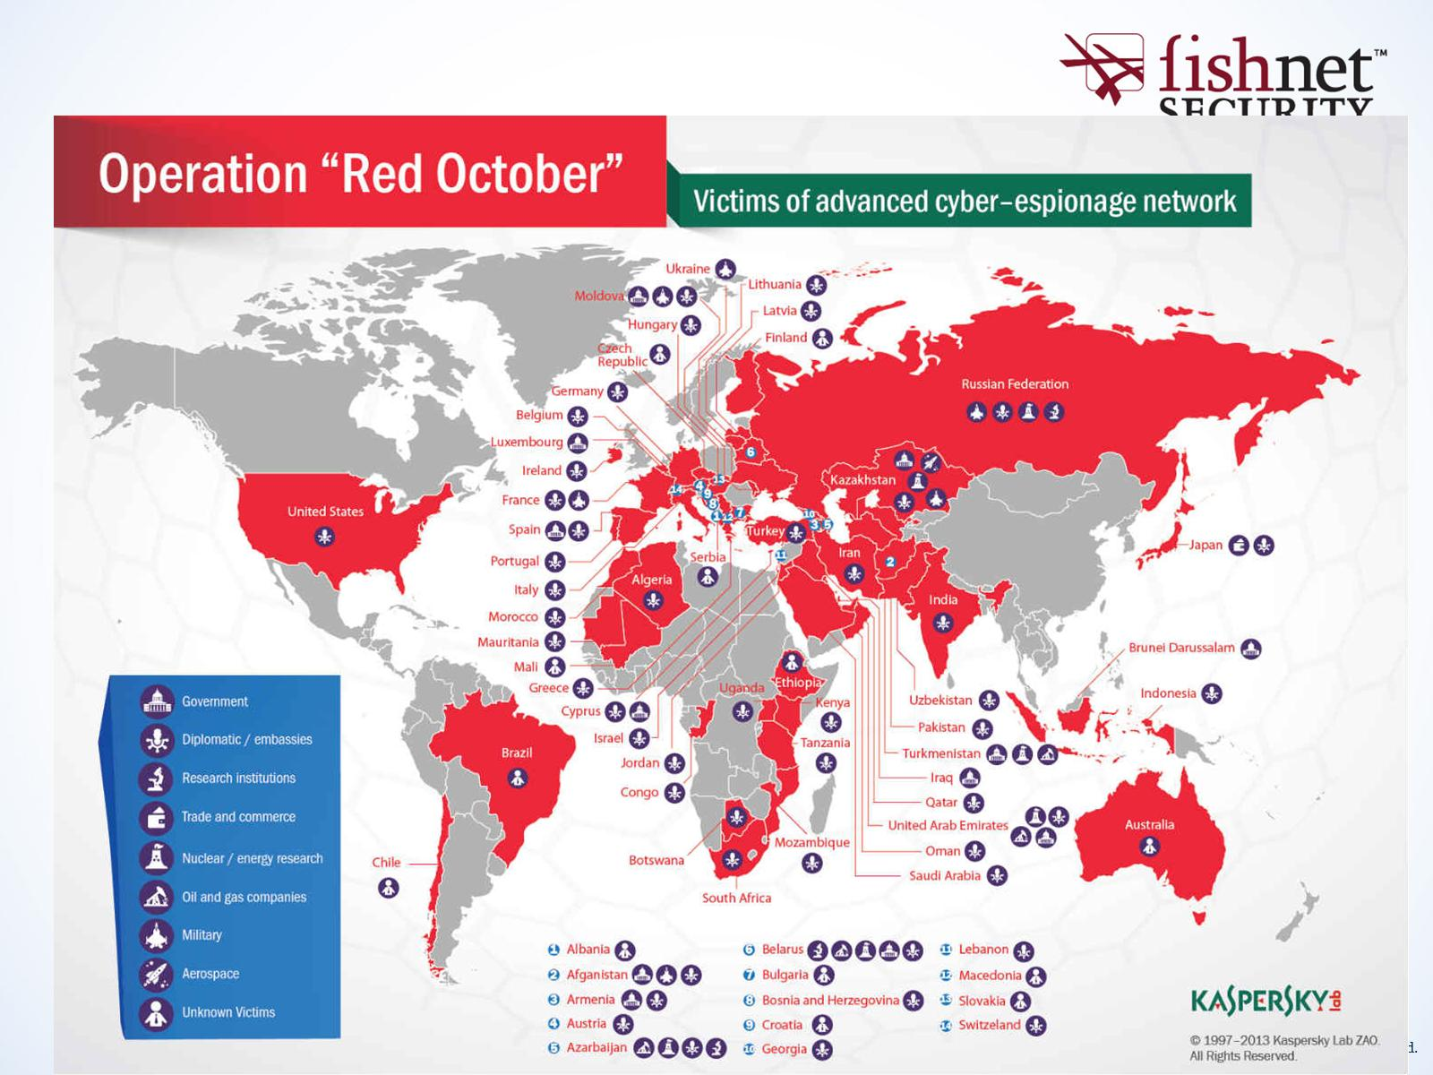
Current Events

Slide 20
Attackers

Slide 21
Attackers

Slide 22
Attackers

Slide 23
Attackers

Slide 24
Attackers

Slide 25
Attackers

Slide 26
Attackers

Slide 28
Who are the Hactivists and how are they influenced?

Slide 29
No Tests Required – Spelling is Optional

Slide 30
Who are the Targets and Why?

Slide 31
Who are the Targets and Why?

Slide 32
Who are the Targets and Why?

Slide 33
Attack Methods: DDOS Sources

Slide 34
Attack Methods: DDOS Types

Slide 35
Attack Methods: Herding the Meat-Bots

Slide 36
Attack Methods: Easy to Use Toys

Slide 37
Attack Methods

Slide 38
Attack Methods

Slide 39
Attack Methods

Slide 40
Attack Methods

Slide 41
Attack Methods

Slide 42
Attack Methods

Slide 43
Attack Methods

Slide 44
Attack Methods

Slide 45
Attack Methods

Slide 46
Attack Methods

Slide 47
Current Events

Slide 48
State of the Enterprise

Slide 50
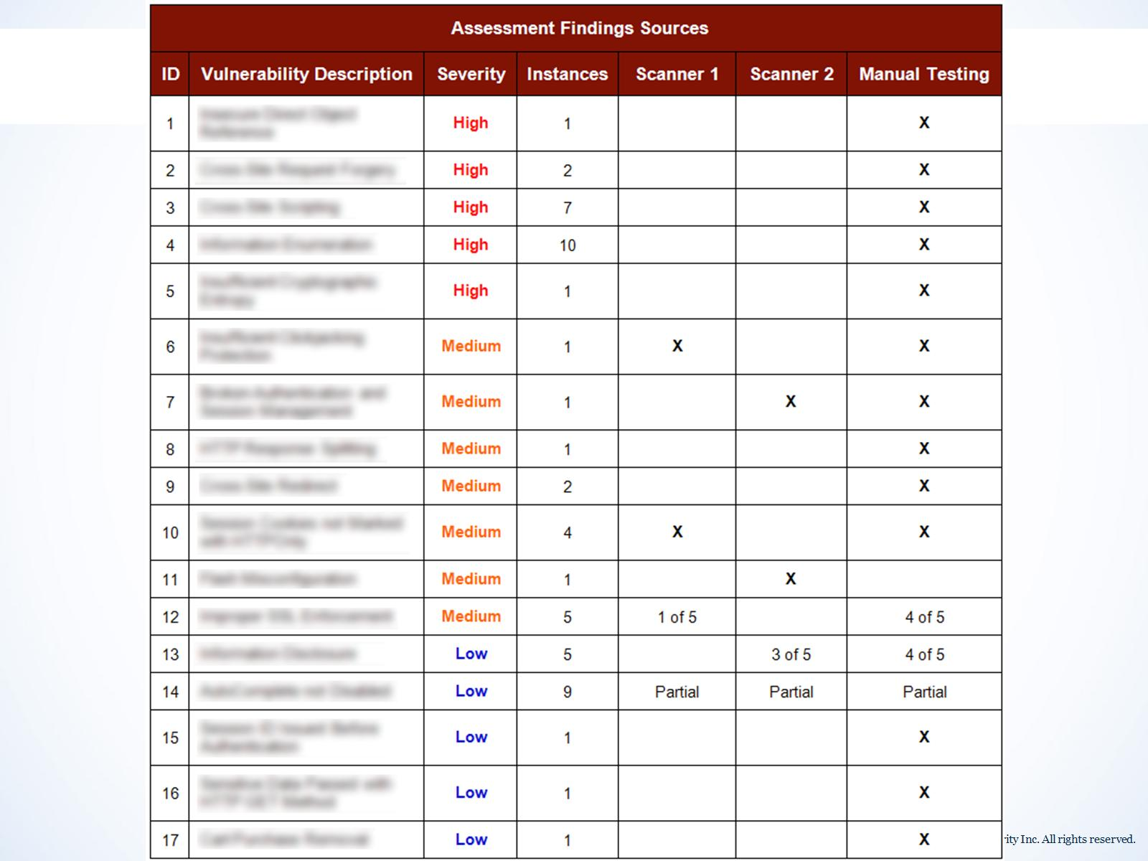

Slide 51
State of the Enterprise

Slide 52
State of the Enterprise

Slide 53
State of the Enterprise

Slide 54
Future National Defense

Slide 55
Recommendations

Slide 56
FNS Incident Management Framework

Slide 57
Recommendations

Slide 58
Recommendations

